Slide 1
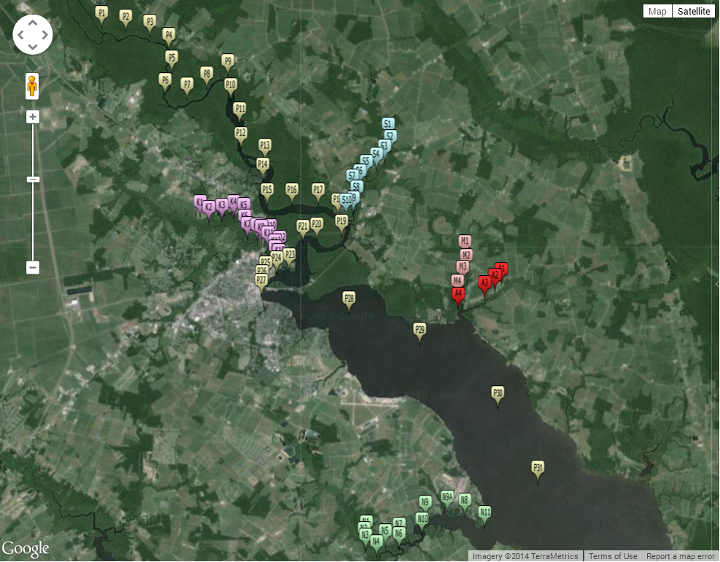
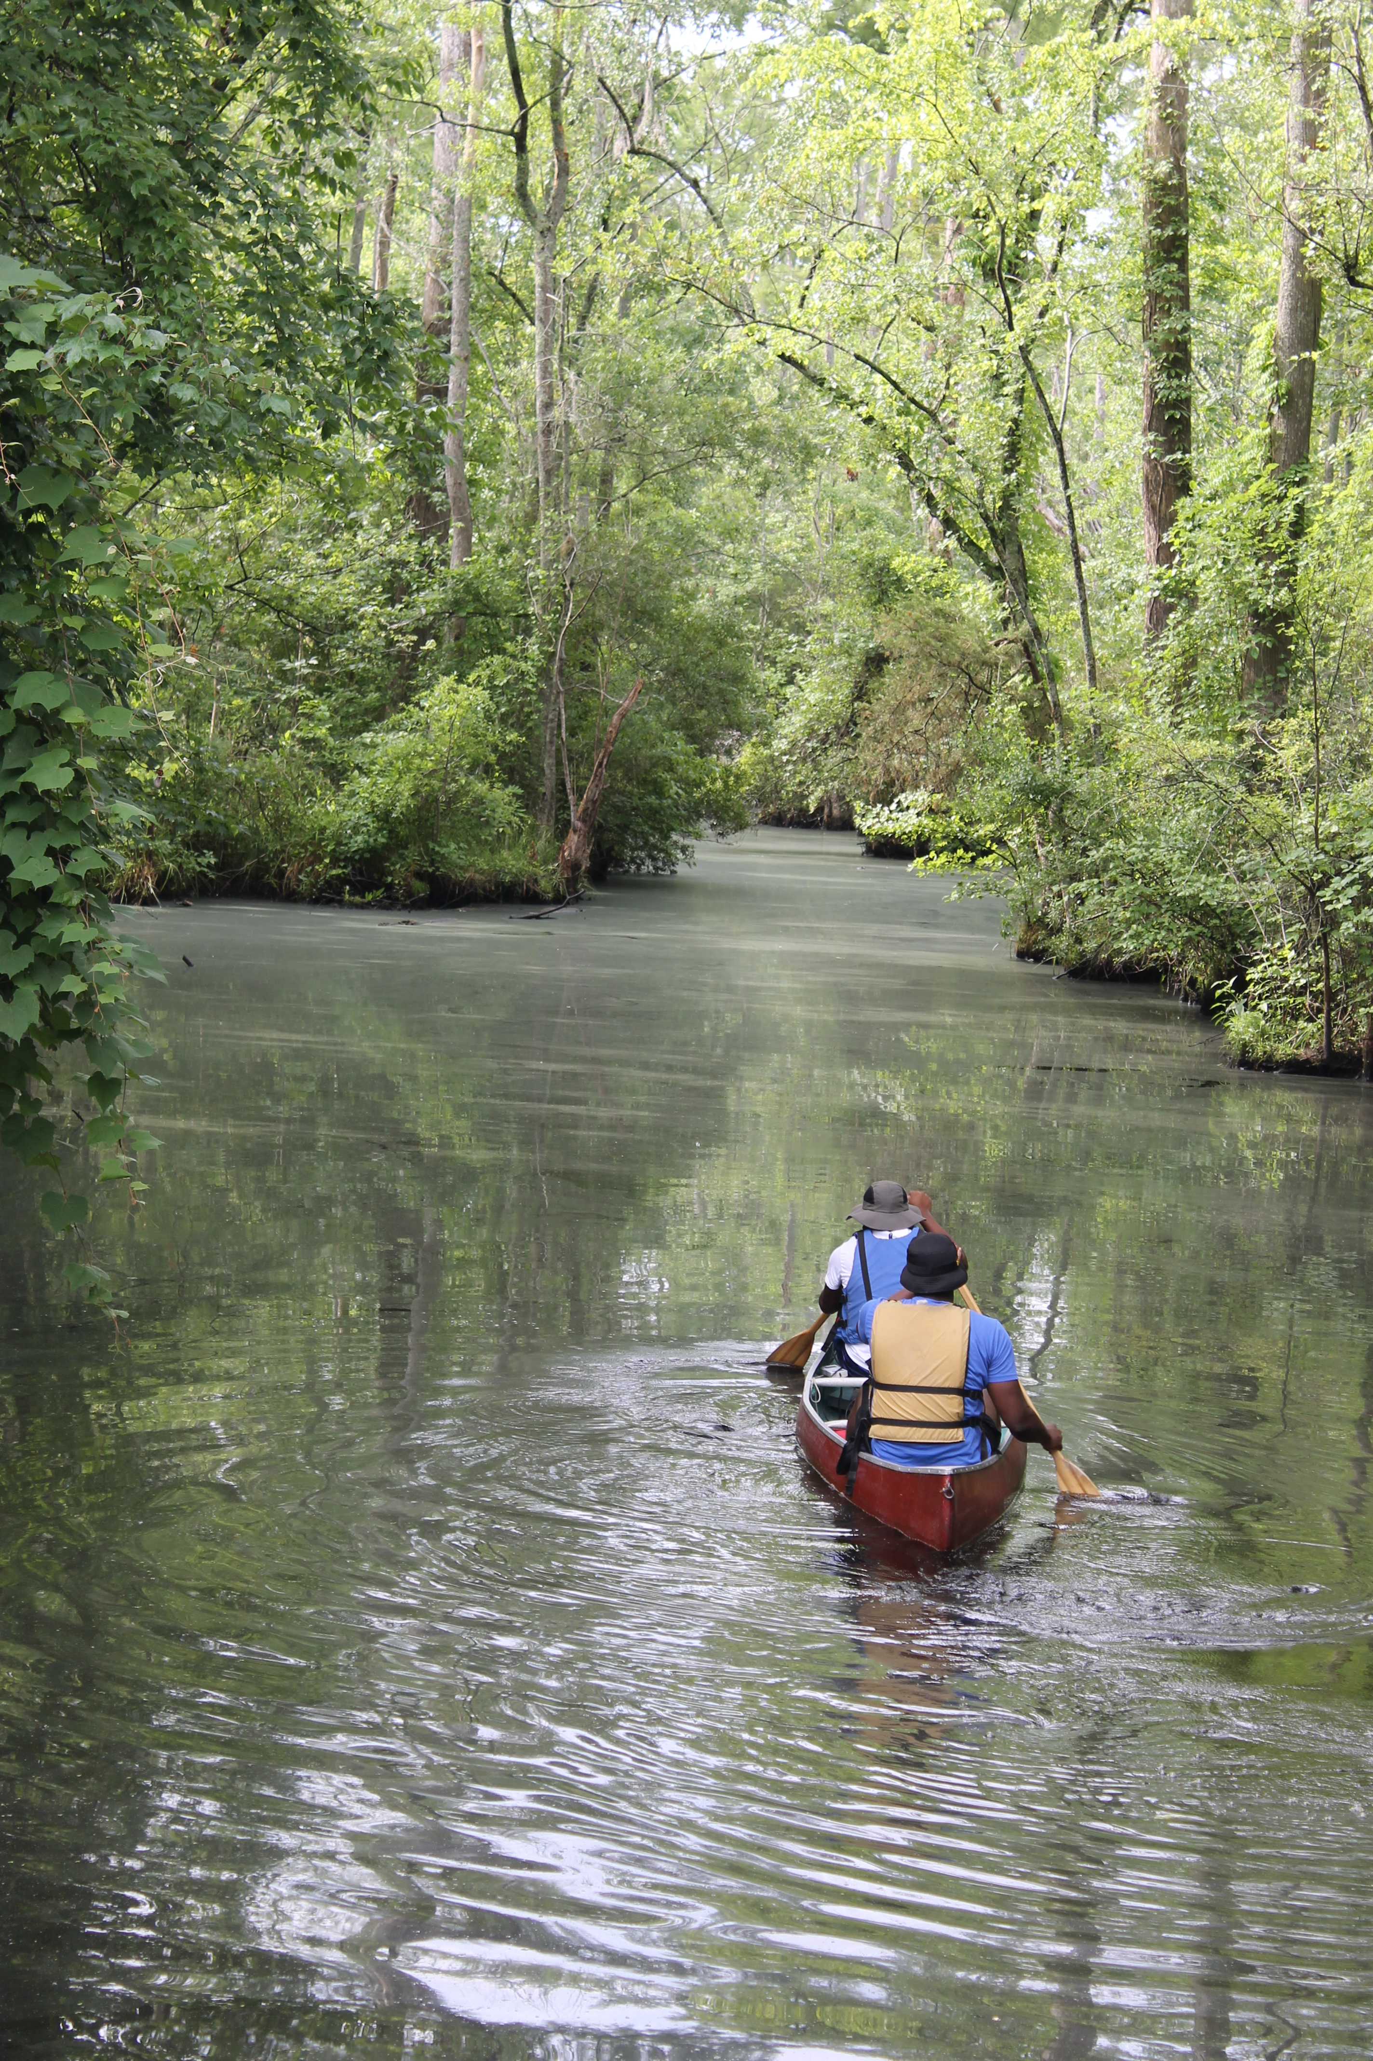
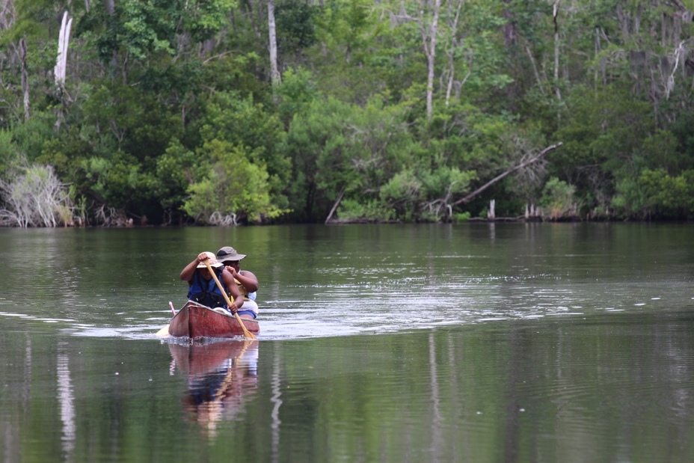
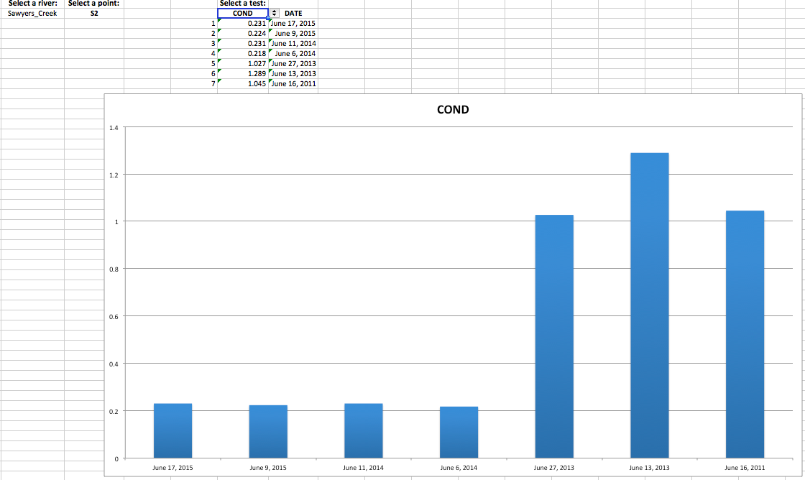
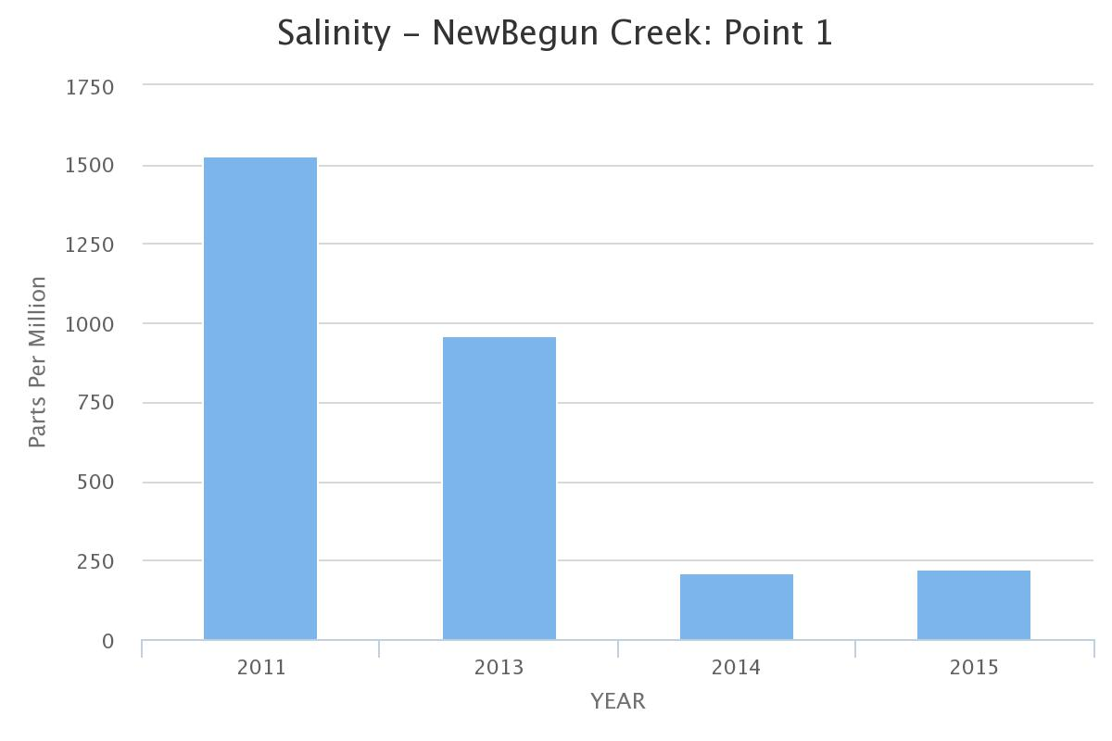
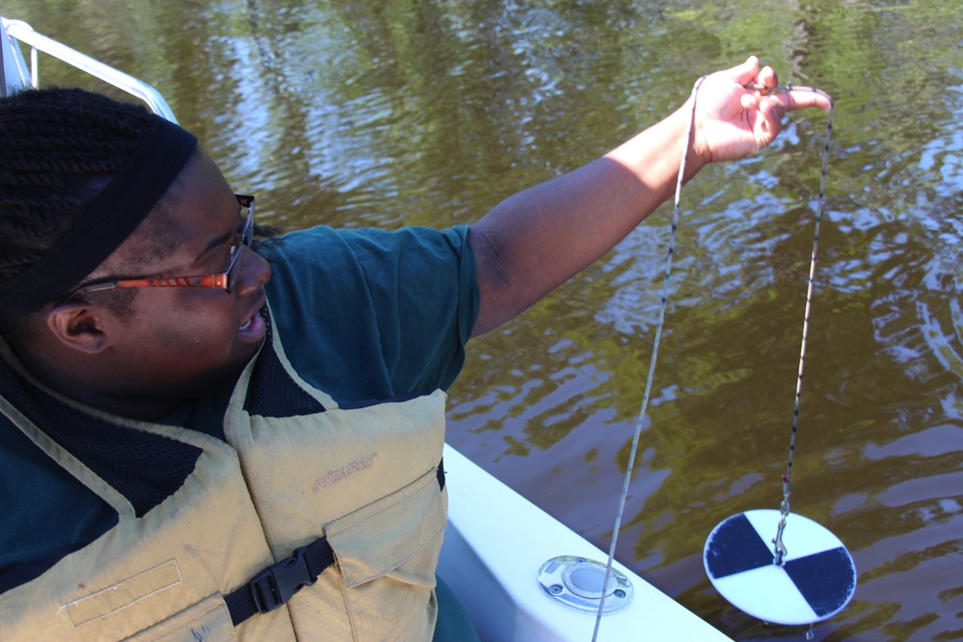
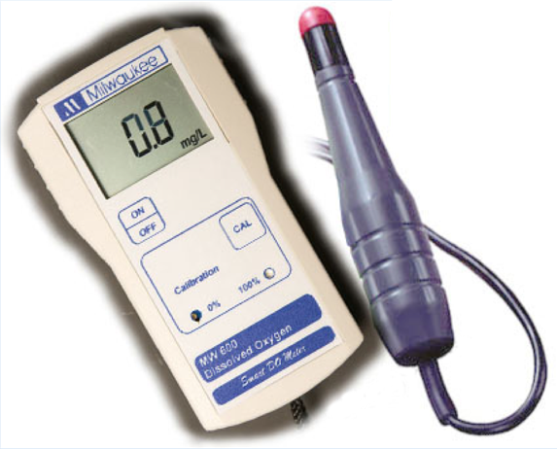
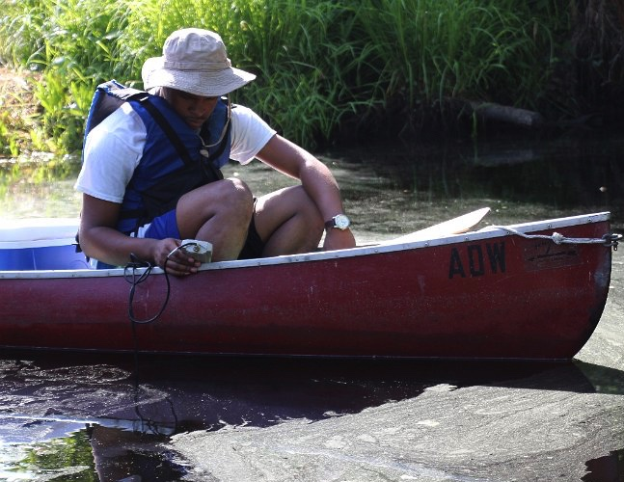
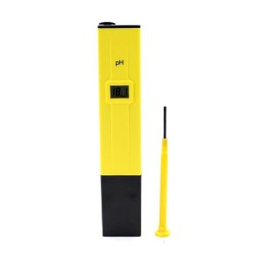
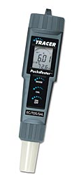
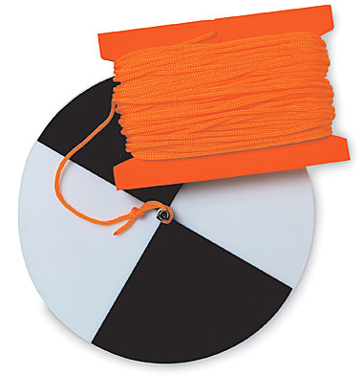
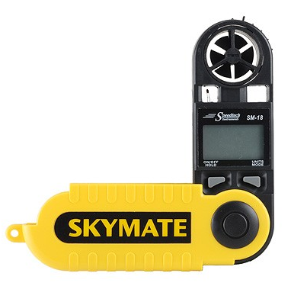
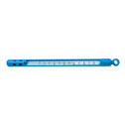
A Comparative Study of Water Quality Assessments of the Pasquotank Watershed in Northeastern North Carolina with a sea level rise component
Ricky Dixon (MVSU), Raveen McKenzie (MVSU), Jamal Stevenson (MVSU) , Steffi Walthall (SCAD) Mentor: Mr. Jeffrey A. Wood (ECSU) Principal Investigator: Dr. Linda B. Hayden (ECSU), 1704 Weeksville Rd, Box 672, Elizabeth City, North Carolina 27909
Abstract
The Pasquotank River Watershed covers over 450 square miles and is located in the Coastal Plain of northeastern North Carolina. It flows from the Great Dismal Swamp at the Virginia/North Carolina border into the Albemarle Sound. The watershed is part of the Albemarle-Pamlico Estuarine System, the second largest system in the United States after the Chesapeake Bay Estuary and provides a transition between spawning grounds and the waters of the Albemarle Sound. Forested swamp wetlands border much of the waterways. Increased agricultural and urban development has greatly affected water quality during recent years
.
The 2015 Research Experience for Undergraduates Pasquotank River Watershed Team completed various tests along the tributaries and the river itself, adding to the previously gathered data from 2011, 2013, and 2014. The test points were derived during the 2011 Summer Watershed Team research project with four points added during the 2014 summer project. Results were compared with previous readings for analysis. Streams tested were the Newbegun Creek, Knobbs Creek, Areneuse Creek, Mill Dam Creek, and Sawyers Creek. These streams, along with the river, cover a large area of the watershed and provide a wide variety of shore development from swampland and farmland to industrial development.
In-house tests on this year’s samples continued to include pH, salinity, total dissolved solids, and conductivity. Air/water temperature, dissolved oxygen, wind speed/direction, and turbidity/clarity measurements were taken in the field. The results from these readings were placed into an online database where they are correlated to the location of the sample using Google Maps®.
Analysis tools were developed in order to compare the data from all years for any variations or similarities. Excel spreadsheets were developed to look more closely at individual points and tests for each point. Past projects have used a general analysis of the entire stream to determine water quality. Steps were also made to research the development of an online graphing tool for analyzing the data at individual points over several years. Test results collected were added to a database developed during the 2014-2015 academic year at Elizabeth City State University. This database was connected to a data visualization page utilizing Google Maps®.
Analysis
Water Quality Index
The results show that there were variations for the individual water quality scores, but the overall water quality score for all the tested water sources remained at a comparable level from previous years. Mill Dam Creek rose above the previous three teams’ scores of 48 (2011), 47 (2013), and 49 (2014) and achieved a medium water quality score of 57. Areneuse Creek improved in water quality with a medium water quality score of 60. Sawyers Creek became the lowest scoring waterway tested at 35. Knobbs Creek decreased from previous years with a water quality score of 42. For a fourth consecutive testing year, NewBegun Creek fell within the medium water quality range with a score of 65. Pasquotank River rose from the previous testing year’s score of 35 but still remained within the bad water quality range with a score of 45. The Lower Pasquotank remained the highest scoring tributary for a second consecutive year with a score of 85.
Dissolved Oxygen
The dissolved oxygen readings for 2015 went through some variations over the years. One factor is the temperature. This is because different temperatures came bring out different plant and animal life, which can also affect the dissolved oxygen. This may be the cause for the low dissolved oxygen readings for Sawyers Creek and Knobs Creek. Another factor of dissolved oxygen is the width of the waterway. The Lower Pasquotank had the highest dissolved oxygen reading due to the width of this waterway as it flows into the Albemarle Sound.
TDS/Salinity/Conductivity
Overall, the readings for total dissolved solids, salinity, and conductivity have decreased from the previous testing years. The rain during nights before testing may have affected the readings. Rain dilutes the salt in the water by mixing the freshwater with the salinity of the waterways. This also made an impact on the Lower Pasquotank, which is a key indictor in sea level rise. Point N11, also referred to as point NA11, correlates with point 31 of the Lower Pasquotank in salinity, conductivity, and total dissolved solids because N11 of NewBegun Creek empties into point 31 of the Lower Pasquotank.
pH
The pH readings for this testing year changed slightly. This year, most of the waterways were acidic than basic compared to the previous testing year. Mill Dam Creek, Areneuse Creek, Sawyers Creek, Knobbs Creek, and the Pasquotank River all have an acidic reading of 6.99 or lower. NewBegun Creek and the Lower Pasquotank settled at basic readings of 7.1 or higher. After further analysis, the data shows that the mouths of Areneuse Creek, Mill Dam Creek, and NewBegun Creek correlate in pH as they have averaged basic water. The mouths of Sawyers Creek and Knobbs Creek have mainly resulted with in acidic water.
Clarity/Turbidity
This year’s clarity readings have decreased from the 2013 and 2014 testing years. Because clarity determines how clear the water is and turbidity determines the number of suspended particles, clarity was four to ten inches higher than turbidity. The clarity for Areneuse Creek and Knobbs Creek increased between one and two inches. Individually, the remaining waterways decreased in clarity between 0.2 and nearly 4 inches from the 2014 readings. This year’s turbidity readings remained consistent with the 2013 and 2014 testing years.
Conclusion
The overall Water Quality Index (WQI) score of the Pasquotank Watershed was calculated by using the Water Quality Index Calculator. Percent saturation of dissolved oxygen, NTU measurements of turbidity, and pH measurements were used to determine the individual scores for each waterway. Mainly due to their dissolved oxygen readings, the lowest score came from Sawyers Creek, and the highest score came from the Lower Pasquotank. The pH readings for Mill Dam Creek, Areneuse Creek, and NewBegun Creek correlate with one another as basic waterways, and the same applies for Sawyers Creek and Knobbs Creek as they were proven to be acidic waterways. The rain during nights before testing the next morning may have affected the readings. Rain dilutes the salt in the water by mixing the freshwater with the salinity of the waterways, which cause the lowering of salinity, conductivity, and total dissolved solids. Also, all the data was successfully stored into a pull down table. It could be used to select a waterway, waypoint, and test to active a chart that displays data from the testing dates within the summers of 2011 and 2015.
.
[4]
Future Work
For future works, we recommend the Control Company VWR Waterproof Thermometer because it would be able to provide a more accurate reading compared to the subjective readings from the Mercury thermometer. The same applies for the Portable Turbidity Meter and Bentonite Check Meter, and it also minimizes stray light and color interference when measuring clarity and turbidity. The online data visualization should represent a basic graph that displays a data point and test over the number of years tested. This should be done with a MySQL, which is a popular open-source database. For the nitrate test, the HI764 Marine Ultra Low Range Checker HC Device is recommended for measuring nitrate. Another test that can be added without adding new test equipment is the change of water temperature. This measures the difference in temperature between the beginning of a tributary and the end. This, along with the nitrate test, would increase the accuracy of the water quality index score for each waterway tested.
Methodology
Pre-Field Work
In preparation for the fieldwork, the Global Positioning Systems (GPS) devices were loaded with points and routes by using the Garmin BaseCamp software for each waterway. Before each waterway was tested, the Dissolved Oxygen (DO) meter was calibrated using zero solutions and distilled water. Once calibration was completed, a checklist was completed to ensure that all necessary gear was gathered and prepared to be taken on each trip to obtain accurate data.
Field Work
The canoe, or boat and kayak was launched into the water and loaded with all the gear needed such as paddles, test equipment, and data recording equipment. All of the test equipment was secured to the platforms in case of accidents. At each test point, there were several factors that were tested and recorded and water samples were obtained. The time was documented as a reference for water samples being taken as test results may vary throughout the day. Once the time was recorded, the wind speed and direction, air temperature, and water temperature was recorded, along with the water sample being taken. Clarity and turbidity was observed and recorded using the secchi disk. The dissolved oxygen was obtained using the DO meter.
Post-Field Work
After collecting data from each waterway, in-house tests were done to obtain the pH, conductivity, salinity, and total dissolved solids readings. The water samples from the field water were poured into small styrofoam cups for testing. The pH meter is calibrated in distilled water and a pH tablet set for 7.0. The pocket tester, which is used to test for salinity, conductivity, and total dissolved solids, is self calibrated meter. Each meter is placed in the water sample to obtain readings.
Data Entry
Data was entered into Google Drive Excel sheets. These spreadsheets were used for recording the data in field and laboratory testing. The data was also used in Microsoft Excel spreadsheets to compare using visual graphs. The spreadsheet contains the following data: name, date, points, time, dissolved oxygen, corrected dissolved oxygen, pH, clarity, turbidity, salinity, conductivity, total dissolved solids, air temperature, water temperature, wind speed, and wind direction. The data in the spreadsheet merged with HTML and JavaScript to be used in Google Maps to display the data in the web browser.
Data Visualization
Data was entered into Google Drive Excel sheets. These spreadsheets were used for recording the data in field and laboratory testing. The data was also used in Microsoft Excel spreadsheets to compare using visual graphs. The spreadsheet contains the following data: name, date, points, time, dissolved oxygen, corrected dissolved oxygen, pH, clarity, turbidity, salinity, conductivity, total dissolved solids, air temperature, water temperature, wind speed, and wind direction. The data in the spreadsheet is merged with HTML and JavaScript to be used in Google Maps to display the data in the web browser.
A Microsoft Excel file was developed in order to analyze in detail each point with each test. This file began as a table containing the data collected each year for this project dating back to 2011. A new spreadsheet was created to house the different pull down bars from which data would be selected for analysis. There were three pull down bars that were validated [1]: source, point, and test data. Once the lists were made and functioning properly a new table was created to display information based on what was selected from the source and point pull down bars. Once that was done, another chart was made that would display only the test data from that specific point. This is the data that was used to create a dynamic chart [2] in which the title, x and y axis would change with the selection of a source, point, or test. It was concluded that this feature could be very helpful for future works because of its ability to allow researchers to isolate any given point and find any variations in the data.
The feasibility of an online data visualization was also researched. This online data visualization would be utilized for comparisons of a specific test factor of a specific waterway for the four years of water testing. This visualization would be placed on the team’s webpage as a reference for analyzing the data.
“Highcharts Product” is a free charting library that contains charts that are written in Javascript. [3] Utilizing the software’s template, an activity was conducted to determine if this software would be eligible to display to desired data. A basic bar graph was created that displayed data manually entered.
The next step in creating this tool will be connecting the JavaScript based file to the online database using PHP Hypertext Preprocessor (PHP) and MySQL. This would allow researchers to identify trends at specific points from the web browser versus the Excel file created during this project.
References
[1] Chuesheva, S. (2003). “Excel drop-down list- how to create, edit and remove a drop box down box”. [Online]. Available. https://www.ablebits.com/office-addins-blog/2014/09/24/excel-drop-down-list/
[2] Cantu, A. (2012). “Using VLOOKUP and MATCH To Retrieve Data from A Table Excel Tutorial”. [Online]. Available. https://www.youtube.com/watch?v=xOB-gA87oAk
[3] Highcharts. (2015). “Interactive JavaScript charts for your webpage | Highcharts”. [Onlne]. Available. http://www.highcharts.com
[4] “Water Quality Index Calculator”. [Online]. Available. www.swrp.esr.pdx.edu/teacher_info/presentations/WQI_calculator.xls
For a full list of the reference, visit this URL:
http://nia.ecsu.edu/reuomps2015/teams/water/links.html
Wind Meter
Thermometer
Aquarium Water Tester
Secchi Disk
Dissolved Oxygen Meter
Pocket Tester

