Slide 1
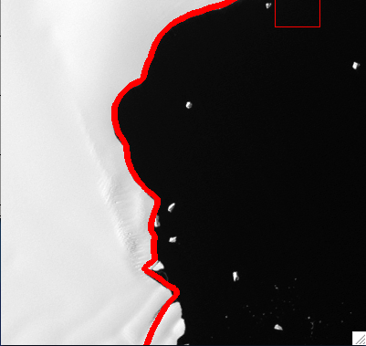
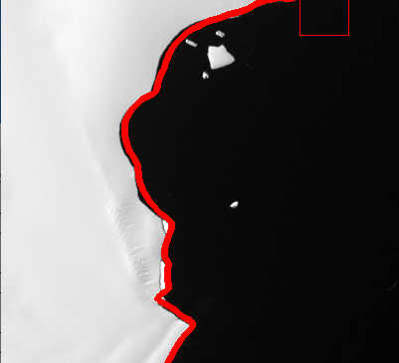
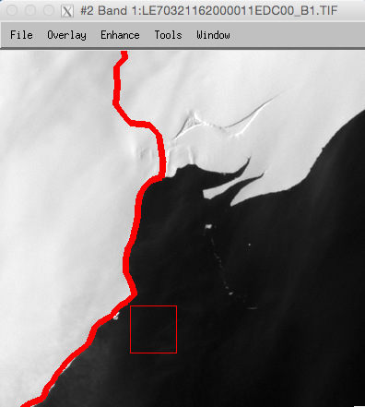
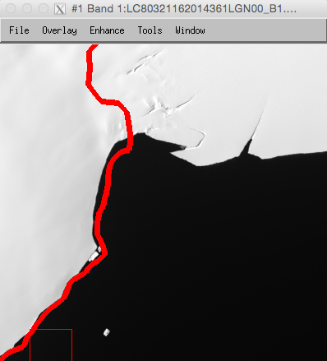
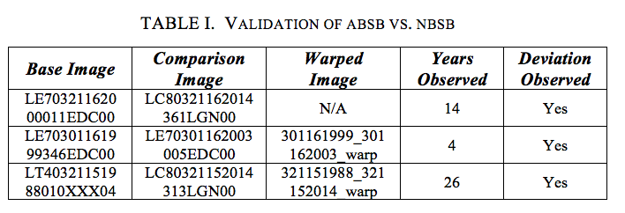
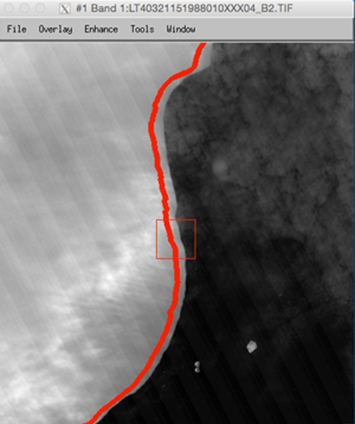
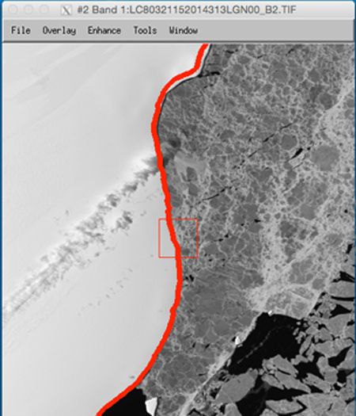
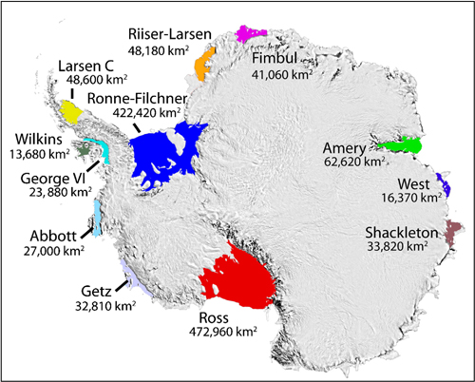
Validation of the Antarctic Snow Accumulation and Ice Discharge Basal Stress Boundary in
the Southeastern Region of the Ross Ice Shelf, Antarctica
Charlie Nelson (KSU), Ayanna Overton (NCAT), Kamberlin King (MVSU) Mentor: Mr. Michael Jefferson (ECSU) Principal Investigator: Dr. Linda B. Hayden (ECSU), 1704 Weeksville Rd, Box 672, Elizabeth City, North Carolina 27909
Abstract
The largest ice shelf in Antarctic, Ross Ice Shelf, was investigated over the years of 1970-2015) Near the basal stress boundary (BSB) between the ice shelf and the West Antarctic ice sheet, ice velocity ranges from a few meters per year to several hundred meters per year in ice streams. Ice velocity increases as the ice moves seaward, reaching more than 1 km yr-1 in the central portions of the ice front. Most of the drainage from West Antarctica into the Ross Ice Shelf flows down two major ice streams, each of which discharges more than 20 km3 of ice each year.
Along with velocity changes, the warmest water below parts of the Ross Ice Shelf resides in the lowest portion of the water column because of its high salinity. Vertical mixing caused by tidal stirring can thus induce ablation by lifting the warm water into contact with the ice shelf. This process can cause melting over a period of time and eventually cause breakup of ice shelf.
With changes occurring over many years a validation is needed for the Antarctic Snow Accumulation and Ice Discharge (ASAID) basal stress boundary created in 2003. After the 2002 Larsen B Ice Shelf disintegration, nearby glaciers in the Antarctic Peninsula accelerated up to eight times their original speed over the next 18 months. Similar losses of ice tongues in Greenland have caused speed-ups of two to three times the flow rate in just one year. Rapid changes occurring in regions surrounding Antarctica are causing concern in the polar science community to research changes occurring in coastal zones over time. During the research, the team completed study on the Ross Ice Shelf located on the southwestern coast of the Antarctic. The study included a validation of the ABSB vs. the natural basal stress boundary (NBSB) along the Ross Ice Shelf. The ASAID BSB was created in 2003 by a team of researchers headed by National Aeronautics and Space Administration Goddard Space Flight Center (NASA GSFC), with an aim of studying coastal deviations as it pertains to the mass balance of the entire continent. The point data file was aimed at creating a replica of the natural BSB. Select cloud free Landsat satellite imagery from satellites 1 through 7 was used to detect changes occurring over the span of 19 years. The last major interest in the study included documenting the deviations or incorrect placements of the ABSB vs NBSB. ENVI 4.7 as well as ENVI 5.0 image manipulation software was used in the geo-rectifying and the geo-referencing process. Changes that occurred were documented in the form of a data table with the change that occurred along with the latitude and longitude geographic coordinates..
Introduction
Observations of tidal stirrings have produced vertical mixing, which can drastically affect the Ross Ice Shelf. The main affect vertical mixing can have on the Ross Ice Shelf is causing it to melt and eventually break apart. There have been many variations along the basal stress boundary (BSB) of the Ross Ice Shelf that have occurred from 1988 to present day. The original speed, of the glaciers in the Antarctic Peninsula, has advanced up to eight times more over an 18-month period. Variations in glacier movements have a critical impact on ice sheet balance, and ice shelves become floating blocks of ice that forms where the glacier runs down to a basal stress boundary and onto the ocean’s surface. In West Antarctica, more than 20 km3 of ice is discharged every year due to the drainage from West Antarctica into the Ross Ice Shelf. This paper reports a validation of the Antarctic Basal Stress Boundary (ABSB) in the South Eastern region of the Ross Ice Shelf, Antarctica.
The image-interpretation was gathered by the Antarctic Snow Accumulation and Ice Discharge (ASAID) project from United States Geologic Survey to map the basal stress boundary and to explore the data (http://earthexplorer.usgs.gov). Path and rows for the images were determined for the Ross Ice Shelf with less than 30% cloud coverage images taken with Landsat satellites 1-7, and taken from earth explorer. Bands from the level one Landsat imagery image were selected to show the features that are apparent near the BSB. The most utilized band was Band 2 because features close to the BSB were most appealing. Exelis Visual Information Solutions (ENVI) 4.7 was used to show the comparison and contrast of the GeoTiff images in the satellite data. According to Mike Ruth, GeoTiff is a public domain metadata format, which has geographic data inserted as tags within the TIFF file, that can be used to store and transfer digital satellite imagery. One very productive feature of ENVI 4.7 allowed used to overlay the basal stress boundary on the satellite images that were obtained to perform a validation of its location in the South Eastern region of the Ross Ice Shelf, Antarctica.
Methodology
Ross Ice Shelf
The primary step was to identify the path and row of the Ross Ice Shelf. The path and row was needed in order to find Landsat images that covered the region of the Ross Ice Shelf. Each member was assigned a specific path and row to examine.
Landsat Images
There have been observations of the Landsat Antarctic coastline that have been conducted for about 40 years [4]. There are websites that provide these Landsat images to users for free. Using the United States Geological Survey (USGS) Global Visualization Viewer (GloVis) (http://glovis.usgs.gov/) and Earth Explorer (http://earthexplorer.usgs.gov/) a collection of images ranging from 1980 to 2014 were obtained. The team searched for images that had less than thirty percent cloud coverage. The images that were selected and downloaded were level 1 Landsat images. Level 1 products were downloaded because it allowed for multiple bands to be chosen from depending on what the team was look for, in this case it was deviations of the BSB. The naming convention of the images includes the path and row, the Julian day, and the year the image was taken.
Shrinking Text File
Exelis Visual Information Solutions (ENVI) Classic 4.7 was used to view the original text file, which contained the entire Antarctica Peninsula. In the text file, the outline of Antarctica was represented by X column, Y column, latitude points, and longitude points. Before shrinking down the text file the longitude and latitude coordinates of the southwest portion of the Ross Ice Shelf were identified. The website iTouchMap (http://itouchmap.com) was used to input geographical coordinates for a visual representation of the point on map of Ross Ice Shelf, Antarctica. The team then used trial and error to figure out which points closely followed the basal stress boundary (BSB) of the ice shelf. The points outside of the area of interest were deleted to shrink down the size of the text file. There were initial failures with converting the text file at first because of the size of the file was still too large, so the size of the boundary continued to be shrunken down. The size of the file began as 236 megabytes (MB) and the ending file size was 6.4 MB. The modified text file, containing only the BSB, included points within (77 3’ 18.579’’ S, 158 5’ 15.324’’ W) and (81 48’ 31.9248’’ S, 154 12’ 37.224’’ W).
Converting a Text File to a Vector File
In order to create a vector file the points from the text file we imported into ENVI Classic using the point collection data table. The team then worked to change the settings to determine whether or not the X column should be labeled one or two and vice versa for the Y column. The latitude column was labeled three and the longitude column was labeled four. The map projection was set to geographical latitude/longitude. The datum was set to WGS-84, and the unit was in degrees. The file as then saved as an EVF layer. Next the file was opened as a vector file and it displayed the basal stress boundary of the ice shelf that was previously shrunken down.
Validation
The accuracy of pixel registration and the resolution of the Landsat images have improved over the years [4]. In order for older images, captured before 2003, to be compared to newer images they have to go through additional processing. The process of image warping improves the accuracy of older images so that they can be used in comparison to more recent Landsat images. The team began with checking to see if the basal stress boundary of the images taken prior to 2003 matched up to the images taken around 2003. This was necessary in order for the image warp to be accurate.
Geo-referencing the Image
In order to geo-reference the image, an image taken before 2003 and an image around 2003 were open in two separate windows. In the options bar, Map was selected followed by registration and Ground Control Point (GCP) image to image. The most recent image was used for the base image and the image from the past was used for the warp image. ENVI 5.0 was also used to geo-reference images. The program has a great workflow to warp images, but sometimes human corrections are needed for a more accurate image. Using ENVI 5.0, after opening the images and selecting the GCP, the program provides the option to predict the GCPs needed to warp the image. It also provided the option to view a list of predicted and actual points, while reporting the root mean squared error.
Image warping
A minimum of five points was created which highlighted the similarities between the past image and the most recent image. The settings of the warp display band were changed to set the method to polynomial, the degree to one, and the background to zero. The upper left x and upper left y was left as the default setting. A good warped image I determined by a GCP root mean squared value that is less than one, and how closely the warped image mimics an original image.
Linking Images
The two images were linked together to help identify similarities between the two images. The linking of the images allowed the team to view the same region of both reference images at the same time by moving around on one image.
Tracking Deviations
The new warped image was then opened in ENVI Classic and the ASAID BSB was superimposed onto the warped image. A standard zoom of ~x4 was used for the validation process to view any deviations along the Ross Ice Shelf.
Results/Conclusion
The research team conducted validation of the ABSB vs. NBSB using three comparison sets of Level 1, Band 2 Landsat images: (1) years 1988 and 2014 of path 32 and row 115, (2) years 1999 and 2003 of path 30 and row 116, and (3) years 2000 and 2014 of path 32 and row 116. Selecting the aforementioned path and row combinations allowed the team to observe the Ross Ice Shelf at the line of equinox to the southwest-most border of the ice shelf. Observation of the ice shelf spanned a total of 25 years, in select sections, and features images before and after the discovery of the natural basal stress boundary. By utilizing the standard zoom of ~x4 of the ENVI Classic zoom window feature, the research team concluded that there had been a misplacement of the NBSB along the Ross Ice Shelf.
1993
2003
Future Work
Furthering this research, adjustments in the original ASAID BSB text file could be sectioned and used for the identification of individual ice shelves of Antarctica. In doing so, an entirely new file would be created and used quicker for the identification of sections around the map of Antarctica. Each ice shelf would have an ASAID basal stress boundary text and ENVI vector file in an unique file.
2000
2014
1988
2015
References
[1] O. Owens, A. Scott, M. Jefferson, L. B. Hayden, "Validation of the basal stress boundary utilizing satellite imagery along the George VI Ice Shelf, Antarctica," 2014
[2] Antarctic warming trends image of the day, Earthobservatory.nasa.gov, [online] 2009, http://www.earthobservatory.nasa.gov/IOTD/view.php?id=36736, [Accessed 9 June 2015]
[3] E. Rignot, J. L. Bamber, M. R. van den Broeke, C. Davis, L. Yonghong, W. J. van deBerg, et al, “Recent Antarctic ice mass loss from radar interferometry and regional climate modeling,” Nature Geoscience, vol. 1, pp. 106 – 110, 2008
[4] J. W. Quinn, “Band combination”, [online] 2001 http://www.web.pdx.edu/~emch/ip1/bandcombinations.html, [Accessed 9 June 2015]
[5] M. LeCompte, R. Bindschadler, L. B. Hayden, M. Jefferson, Y. Bridgers, R. Lawrence, et al, “Reduction and loss of an ice shelf in Elizabeth City State University Bay, Antarctica: 1972 – 2003, 2013
[6] Y. Bridgers, M. Jefferson Jr., G. Koch, R. Lawrence, M. LeCompte, “Survey to detect long-term variability in Pine Island Bay Coastal Ice morphology using Archive Landsat Imagery, 2012, unpublished
[7] M. Ruth, F. Warmerdam, “GeoTIFF FAQ Version 2.4”, [online] http://www.remotesensing.org/geotiff/faq.html#What%20is%20the%20purpose%20of%20GeoTIFF%20format%20for%20satellite%20data, [Accessed 9 July 2015]

