Slide 1
Validation of the Antarctic Snow Accumulation and Ice Discharge Basal Stress Boundary of the Southeastern Region of the Ross Ice Shelf, Antarctica

Slide 2
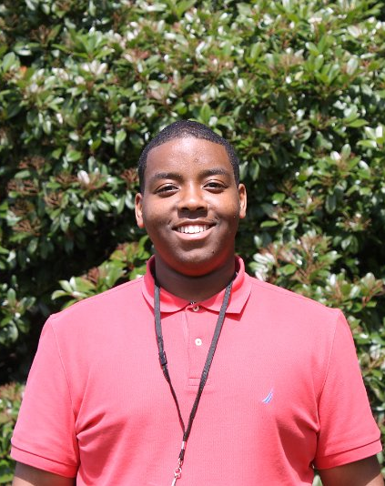
Team Members
Ayanna Overton, junior
Charlie Nelson, senior
Kamberlin King, sophomore
North Carolina A&T State University
Kentucky State University
Mississippi Valley State University

Slide 3
Mentor
Michael Jefferson Jr.
Elizabeth City State University

Slide 4
Overview
Abstract
Introduction
Methodology
Conclusion
Future Work
Acknowledgements
Questions
Notes:
Ayanna

Slide 5
Abstract
The largest ice shelf in Antarctic, Ross Ice Shelf, was investigated over the years of (1970-2015). Near the basal stress boundary between the ice shelf and the West Antarctic ice sheet, ice velocity ranges from a few meters per year to several hundred meters per year in ice streams. Ice velocity increases as the ice moves seaward, reaching more than 1 km yr-1 in the central portions of the ice front. Most of the drainage from West Antarctica into the Ross Ice Shelf flows down two major ice streams, each of which discharges more than 20 km3 of ice each year.
Along with velocity changes, the warmest water below parts of the Ross Ice Shelf resides in the lowest portion of the water column because of its high salinity. Vertical mixing caused by tidal stirring can thus induce ablation by lifting the warm water into contact with the ice shelf. This process can cause melting over a period of time and eventually cause breakup of ice shelf. With changes occurring over many years a validation is needed for the Antarctic Snow Accumulation and Ice Discharge (ASAID) basal stress boundary created in 2003. After the 2002 Larsen B Ice Shelf disintegration, nearby glaciers in the Antarctic Peninsula accelerated up to eight times their original speed over the next 18 months.
Notes:
Ayanna/Kamberlin

Slide 6
Abstract
Similar losses of ice tongues in Greenland have caused speed-ups of two to three times the flow rates in just one year. Rapid changes occurring in regions surrounding Antarctica are causing concern in the polar science community to research changes occurring in coastal zones over time. During the research, the team completed study on the Ross Ice Shelf located on the south western coast of the Antarctic. The study included a validation of the ABSB vs. the natural basal stress boundary (NBSB) along the Ross Ice Shelf. The ASAID BSB was created in 2003 by a team of researchers headed by National Aeronautics and Space Administration Goddard Space Flight Center (NASA GSFC), with an aim of studying coastal deviations as it pertains to the mass balance of the entire continent. The point data file was aimed at creating a replica of the natural BSB. Select cloud free Landsat satellite imagery from satellites 1 through 7 was used to detect changes occurring over the span of 19 years. The last major interest in the study included documenting the deviations or incorrect placements of the ABSB vs. NBSB. ENVI 4.7 as well as ENVI 5.0 image manipulation software was used in the geo-rectifying and the geo-referencing process. Changes that occurred were documented in the form of a data table with the change that occurred along with the latitude and longitude geographic coordinates.
Notes:
Charlie

Slide 7
Methodology
Identifying the Ross Ice Shelf
Locating Landsat images
Shrinking the text file
Converting text file to a vector file
Validation of the Basal Stress Boundary
Geo-referencing the Image
Image Warping
Linking Images
“Tracking Deviations”
Notes:
Ayanna

Slide 8
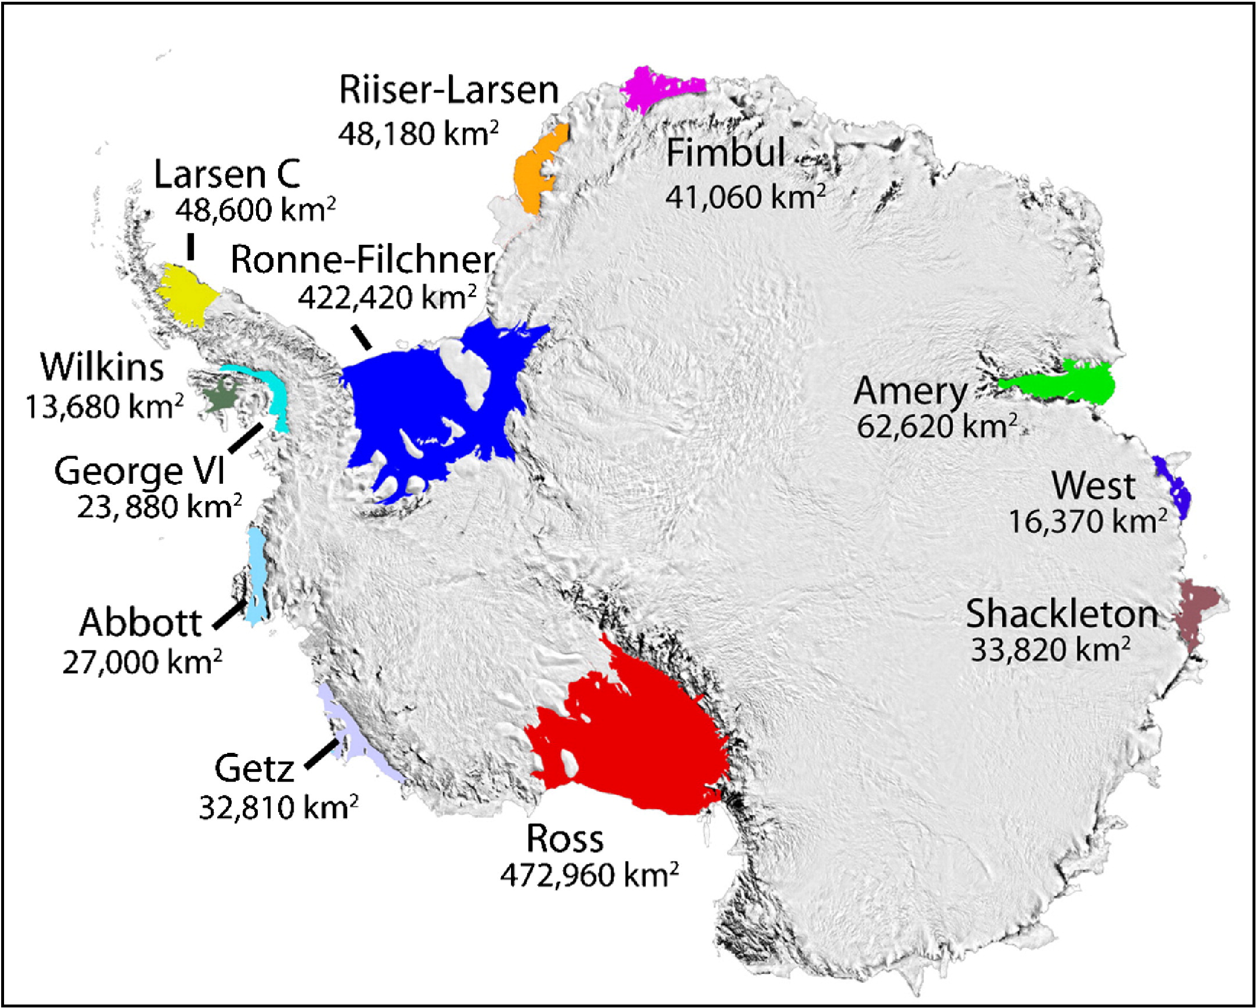
Ross ice shelf
Located in the Southeastern region of Antarctica
Path/Row: 32/115, 32/116, 30/116
Notes:
Ayanna: The Ross Ice Shelf is the largest ice shelf in Antarctica. The primary step was to identify the path and row of the Ross Ice Shelf. The path and row was needed in order to find Landsat images that covered the region of the Ross Ice Shelf. Each member was assigned a specific path and row to examine.

Slide 9
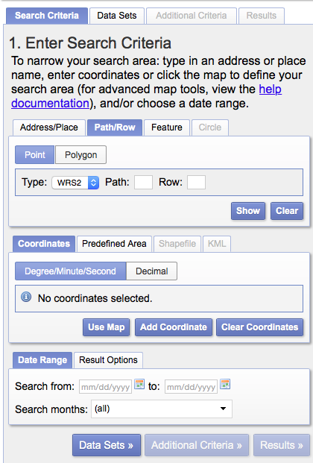
Locating Landsat Images
Notes:
Charlie

Slide 10
Basal Stress Boundary Text File
Water
Land
Notes:
Charlie

Slide 11
Error in File Shrinking
Notes:
Charlie: Explain the equinox

Slide 12
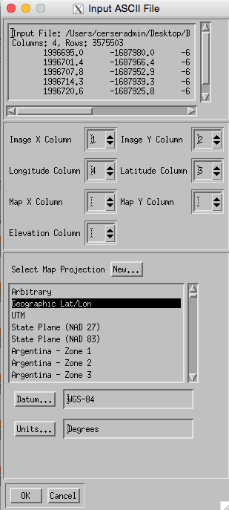
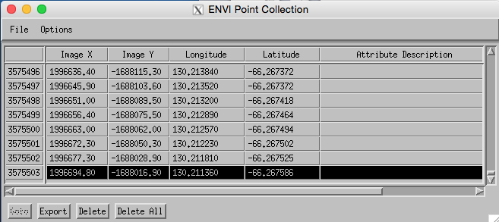
Converting to a vector file
Notes:
Ayanna: In order to create a vector file the points from the text file were imported into ENVI Classic using the point collection data table. The team then worked to change the settings to determine whether or not the X column should be labeled one or two and vice versa for the Y column. The latitude column was labeled three and the longitude column was labeled four. The map projection was set to geographical latitude/longitude. The datum was set to WGS-84,which stands for World Geographic Standard 1984, and the unit was in degrees. The file as then saved as an EVF layer. Next the file was opened as a vector file and it displayed the basal stress boundary of the ice shelf that was previously shrunken down.

Slide 13
Validation of the basal Stress Boundary
Image accuracy and resolution has improved over time
Older images needed additional processing
Image warping
Notes:
Kamberlin: An old image was needed/collected by each team member. To validate the BSB an image that was captured before 2003 was compared to an image after 2003 to see if it would create a good warp image. My images were from 1988 and 2014. Ayanna’s image was from 1999 and 2003. Charlie’s image was from 2000 and 2014. For validation, the vector file that was created was superimposed over both images to show the BSB.

Slide 14
Geo-referencing the image
ENVI Classic and ENVI 5.0
Base image: recent image
Warp image: older image
Notes:
Kamberlin:
Geo-reference means to associate geographic with locations of physical space
ENVI Classic 4.7 GCP’s were selected manually for the 1998 and 2003 images and the 2000 and 2014 images
ENVI 5.0 was used for the warping of 1988 and 2014 images. GCP’s were selected and if the images were not similar they were deleted and created manually. The program has a great workflow to warp images, but sometimes human corrections are needed for a more accurate image.

Slide 15
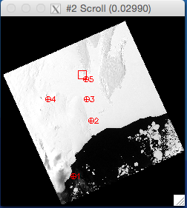
Image warping
Minimum of 5 points
Images are linked
Similarities are highlighted
Notes:
Ayanna: A minimum of five points was created which highlighted the similarities between the past image and the most recent image. Images were linked together easily find geographical similarities between the two images. The settings of the warp display band were changed to set the method to polynomial, the degree to one, and the background to zero. The upper left x and upper left y was left as the default setting. A good warped image is determined by a root mean squared value that is less than one, and how closely the warped image mimics an original image.

Slide 16
Linking images
Notes:
Kamberlin: The base image and warped image were linked for comparison of the GCP an it showed how the BSB being overlaid on the images look in comparison to the other. It also shows the different resolutions of the images. The 1988 image had a 60 m resolution, which meant each pixel within the photo represents 60 m 2003 image had a 30 m resolution. Less pixels that is covered per resolution the more clean the picture is.

Slide 17
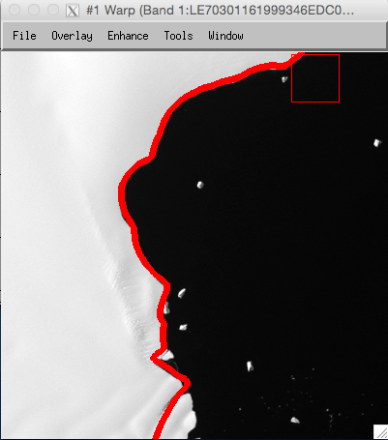
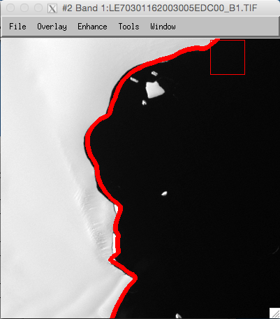
“Tracking Deviations”
Land
Water
Land
Water
Notes:
Ayanna: The new warped image was then opened in ENVI Classic and the ASAID BSB was superimposed onto the warped image. A standard zoom of ~x4 was used for the validation process to view any deviations along the Ross Ice Shelf. There was a negative (towards the continent) deviation of the basal stress boundary in 2003. Point out sea ice at the bottom of the image.
Path/Row: 30/116
Year: 1999 and 2003

Slide 18
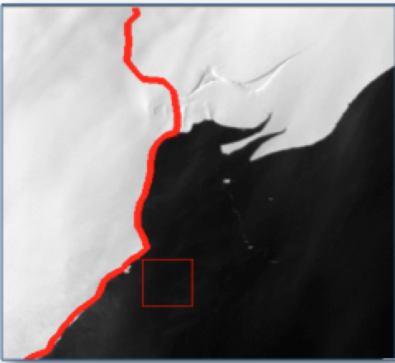
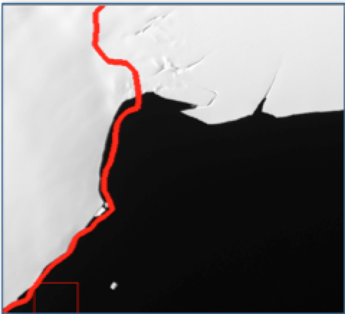
2000
2014
Notes:
Path/Row: 32/116

Slide 19
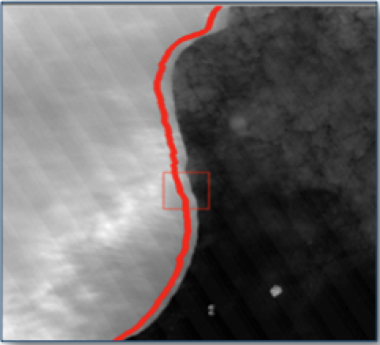
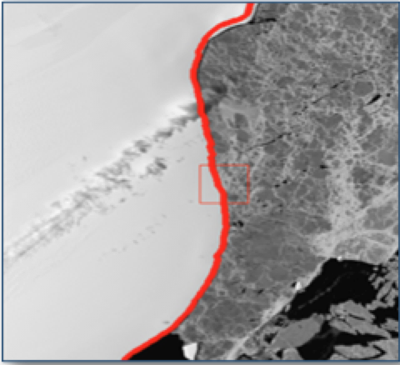
2014
1988
Notes:
Path/Row: 32/115

Slide 20
Conclusion
Observation spanned a total of 25 years
Features images before and after the NBSB was discovered
Utilized the standard zoom of ~x4 of the ENVI Classic zoom window feature
There had been a misplacement of the NBSB along the ice shelf
Notes:
Charlie

Slide 21
Future Work
Add the text file and vector file into one folder
Finish validation of the Ross Ice Shelf in the Southwestern region
Notes:
Charlie

Slide 22
Acknowledgements
Michael Jefferson Jr., Mentor
Dr. Linda B. Hayden, Principle Investigator
CReSIS

Slide 23
Questions?
Questions?

