Slide 1
Validation of the basal stress boundary utilizing Satellite Imagery along the George VI Ice Shelf, Antarctica

Slide 2
Team Members
Anthony Scott
Omar Owens
Winston Salem State University
Winston Salem State University

Slide 3
Mentor
Michael Jefferson Jr.
Elizabeth City State University

Slide 4
Overview
Abstract
Introduction
Methodology
Results
Conclusions
Future Work
Acknowledgements
Questions

Slide 5
Abstract
Majority of ice shelves are fed by inland glaciers. Together, an ice shelf and the glaciers feeding it can form a stable system, with the forces of outflow and backpressure balanced. Warmer temperatures can destabilize this system by increasing glacier flow speed and more dramatically by disintegrating the ice shelf. Without a shelf to slow its speed, the glacier accelerates. After the 2002 Larsen B Ice Shelf disintegration, nearby glaciers in the Antarctic Peninsula accelerated up to eight times their original speed over the next 18 months. Similar losses of ice tongues in Greenland have caused speed-ups of two to three times the flow rate in just one year.
Rapid changes occurring in regions surrounding Antarctica are causing concern in the polar science community to research changes occurring in coastal zones over time. During the research, the team completed a study on George VI Ice Shelf located on the western coast of the Antarctic Peninsula. The study included a validation of the Antarctic Snow and Ice Accumulation Discharge Basal Stress Boundary (ABSB) vs. the natural basal stress boundary (NBSB) along the George VI Ice Shelf. The ASAID BSB was created by a team of researchers headed by National Aeronautics and Space Administration Goddard Space Flight Center (NASA GSFC), with an aim of studying coastal deviations as it pertains to the mass balance of the entire continent. The point data file was aimed at creating a replica of the natural BSB. Select cloud free Landsat satellite imagery from satellites 1 through 7 was used to detect changes occurring over the span of 19 years. The last major interest in the study included documenting the deviations or incorrect placements of the ABSB vs NBSB. Changes that occurred were documented in the form of a table with the change that occurred along with the geographic coordinates.

Slide 6
Key Terms
ENVI – Image Analysis Software
GloVis- Online search and order tool for selected Satellite and aerial data
NBSB- The Natural Basal Stress Boundary
ABSB- Asaid Basal Stress Boundary
Ice Shelf- Thick floating platform of ice that forms where a glacier or ice sheet floats down to a coastline and onto ocean surface
Ice Sheet- Mass of glacier ice that cover surrounding land and bigger than 50,000 km²
Landsat- Series of Earth Observing Satellites launched by NASA

Slide 7
Methodology
Search for path and row of George VI Ice Shelf
Locate Pre-2003 cloud free Landsat Images
Truncate Basal Stress Boundary text file
Turn text file into a ENVI vector file
Create Mosaics of reference and older images
Linking reference images to the older images
Warp Images
Conducted a Validation of the BSB

Slide 8
Region of Interest
George VI Ice Shelf
Path/Row 217/110

Slide 9
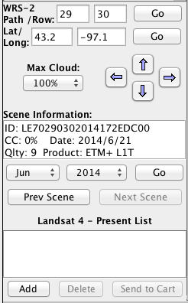
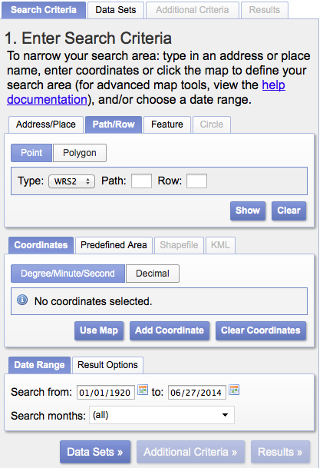
Locate and Download Images

Slide 10
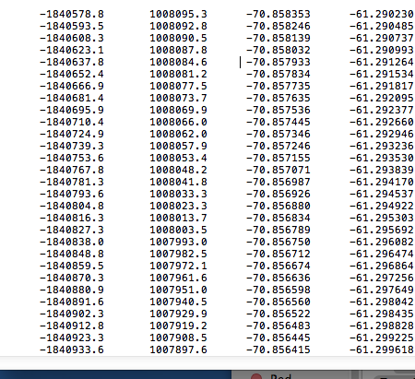
Basal Stress Boundary File
Dr. Robert Bindschalder (NASA)
3,573,503 lines of data
236mb to 38.4mb

Slide 11
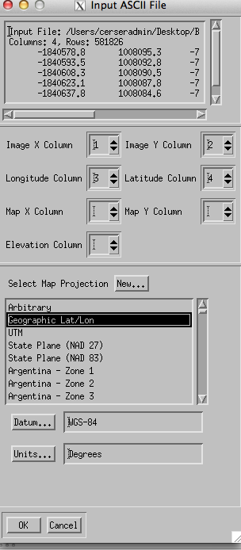
Creating Vector File

Slide 12
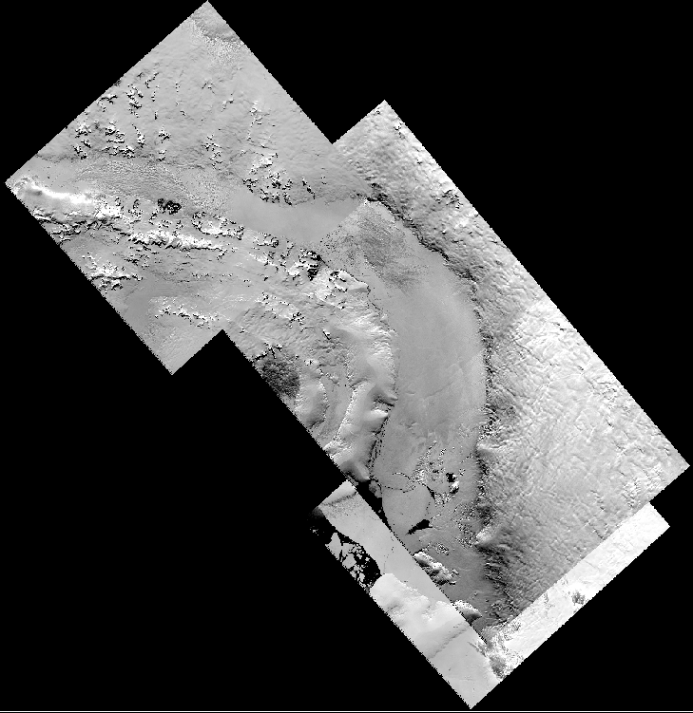
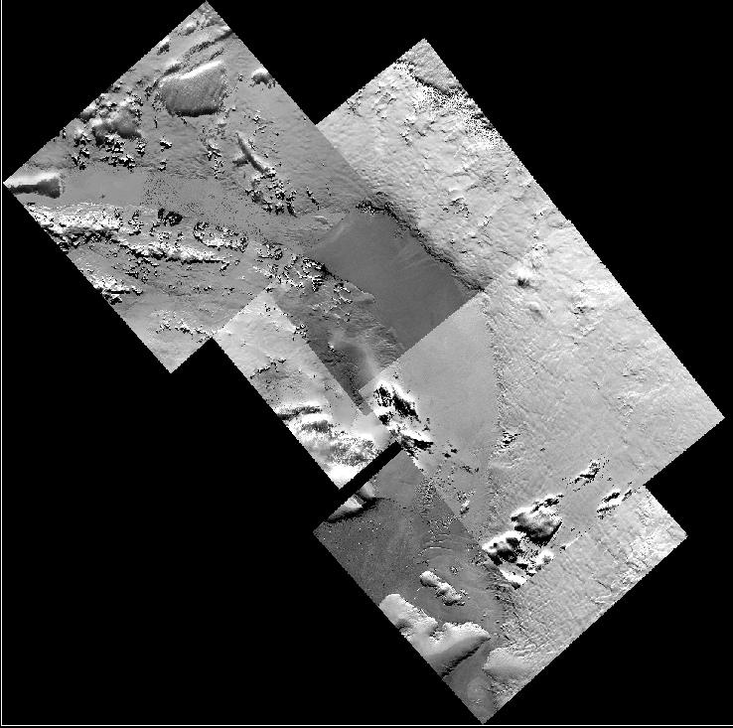
Mosaics

Slide 13
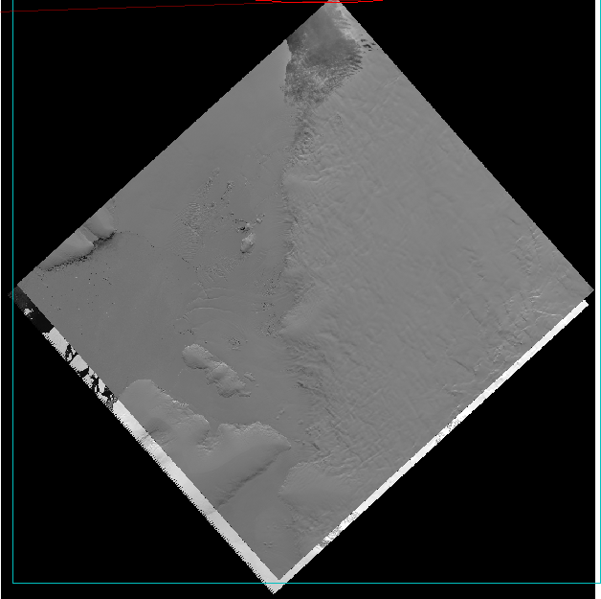
Link/Warp Images

Slide 14
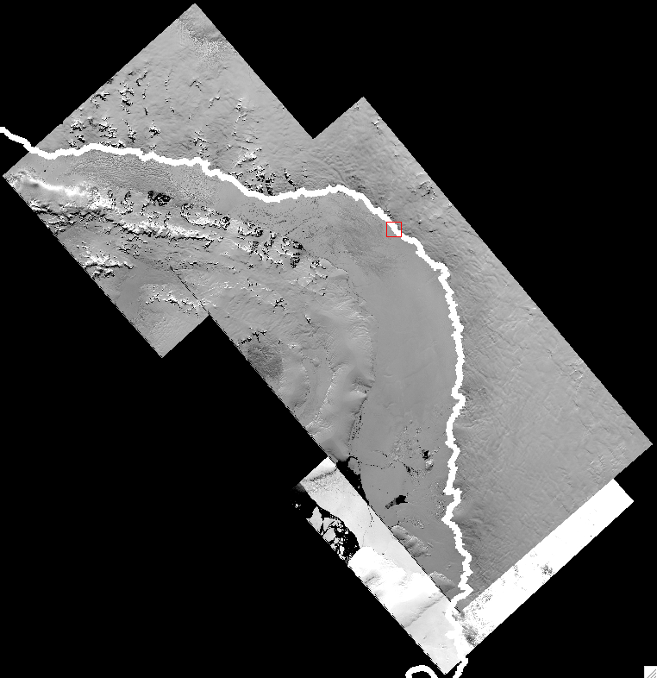
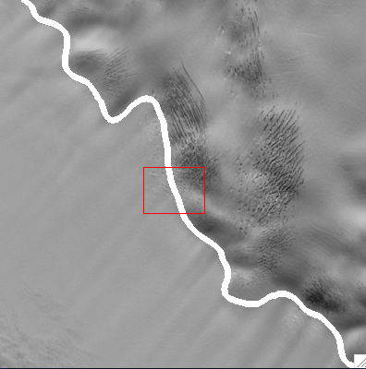
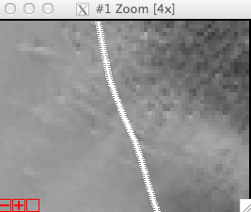
Validation of BSB along George IV Ice Shelf

Slide 15
Results

Slide 16
Conclusions
The team conducted the validation of the ASIAD BSB (ABSB) vs. the natural BSB (NBSB) along the George VI Ice Shelf using standard zoom of ~x4 or greater.
The team also concluded that the location of the BSB has been stable over the19-year study period.

Slide 17
Future Work
Validate Abbot Ice Shelf
Speed up ENVI
Separate BSB Text file

Slide 18
Acknowledgements
Mentor: Michael Jefferson Jr.
Principle Investigator: Dr. Linda B. Hayden
Jeff Wood
CReSIS

Slide 19
Questions?
Questions?

