Slide 1
TeraScan
Brought to you by Courtney Farmer
Created by Courtney Farmer and Kalyx McDonald

Slide 2
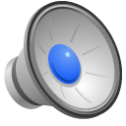
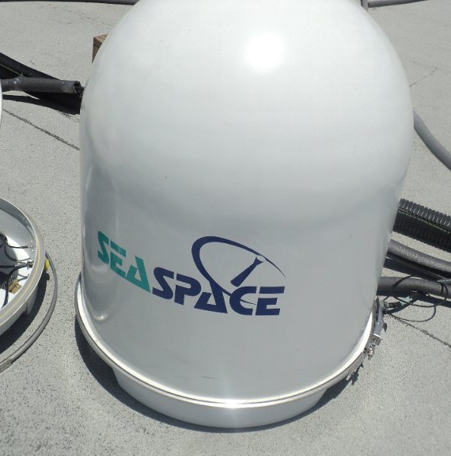
SeaSpace1
2
Notes:
Created in 1982, SeaSpace is one of the worlds leading remote sensing companies. Their work allows ground station images to be captured for further research.

Slide 3
TeraScan3
It is an integrated system software designed for reception of data from environmental satellites for processing data into images.
TeraScan
A interface
Bit synchronizer
Frame synchronizer
Antenna for satellite signal
Uninterruptible power supply (UPS)
Global Positioning System (GPS) antenna
Computer workstations with TeraScan software
A receiver for tuning to the correct satellite and the sensor data
Notes:
In order for your TeraScan operating system to work affectively, you will need this list of things:
A interface
Bit synchronizer
Frame synchronizer
Antenna for satellite signal
Uninterruptible power supply (UPS)
Global Positioning System (GPS) antenna
Computer workstations with TeraScan software
A receiver for tuning to the correct satellite and the sensor data

Slide 4
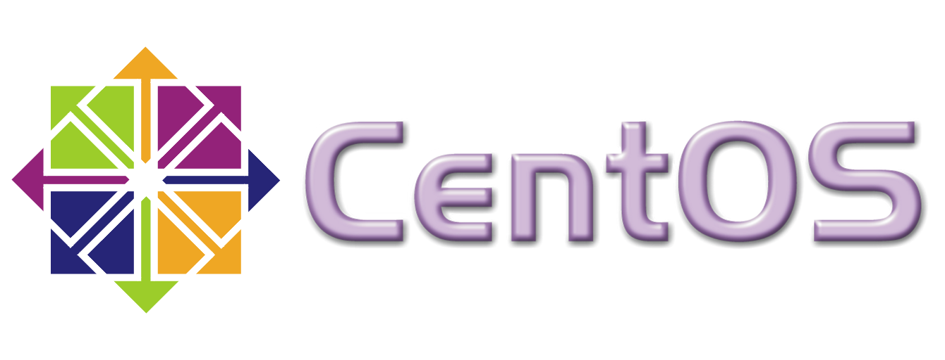
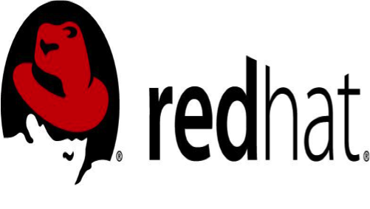
Operating Systems
8
4
9
Notes:
SeaSpace supports TeraScan on two platforms which are CentOS & Redhat Enterprise Linux

Slide 5
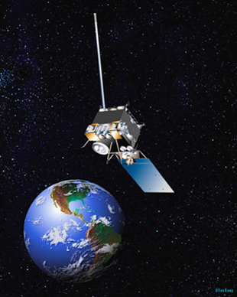
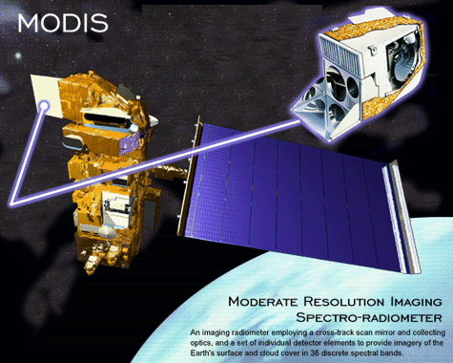
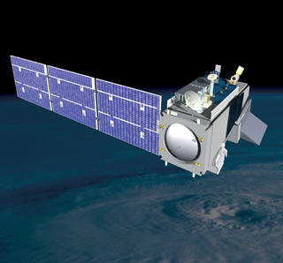
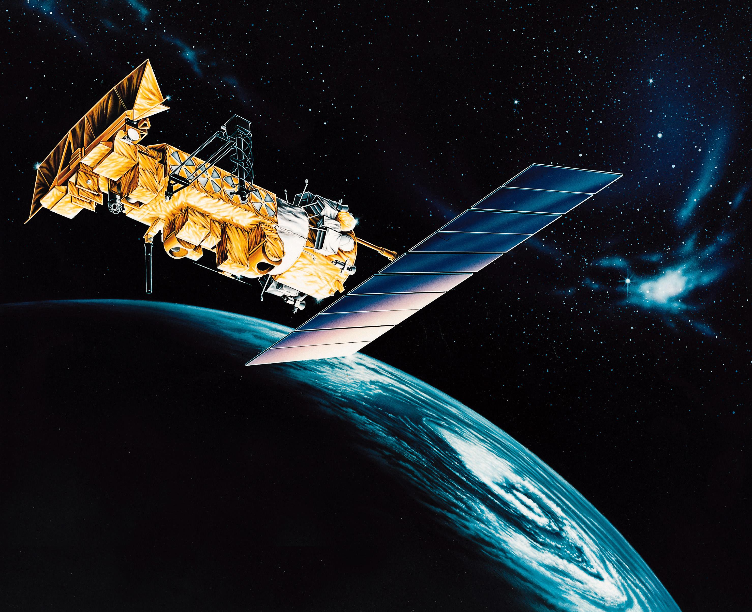
Data
GOES
NOAA
NPP
Notes:
TeraScan system can receive data through the x-band, c-band, and L- band from various temletries including GOES, MODIS, NOAA(noah) EOS, NPP, TERRA, AQUA, AND LANDSAT

Slide 6
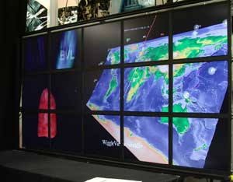
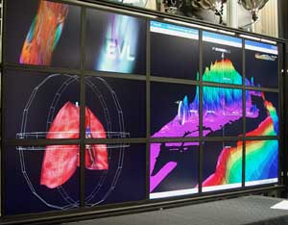
Software
10
Notes:
TeraScan software is based on the Linux operating system which consist of :
TeraScan Data Format (TDF)
A set of daemons and services
A set of reference files and databases
600 or more command- line functions
A set of graphical user interfaces (GUIs)

Slide 7
Reference Data
TeraScan software includes many reference files and databases which supply the information that TeraScan needs to run all of its operations. Some include:
Orbtial elements
Sensor-definition files
Climatology databases
Satellite- definition files
Sea WIFS color-processing table
Three geopolitical boundary databases
Color palette and enhancement look-up tables
List of ARGOS DCS plaforms with their location and calibration data
Notes:
Climatology databases: required for processing NOAA TOVS data, DMSP Special Sensor data, and SeaWiPS data

Slide 8
TeraScan Data Format (TDF)
1
Notes:
TERASCAN DATA FORMAT OR TDF PROVIDES METADATA INFORMATION ON TDF FORMAT TO USE FOR INGESTION INTO THIRD PARTY SOFTWARE
It takes a multi layered data format that also contains geo-referenced information. Although TDF is the recommand format to use with TERAVISION, TeraScan is capable of exporting more common formats as well.
Some examples are KML, PNG AND GEOTIFF

Slide 9
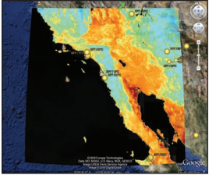
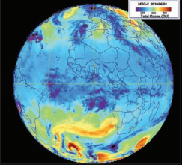
Key features
11
Notes:
Some key features are:
Advance Dvorak Technique : it is the standard method for estimating tropical cyclone intensity
Automated Data Retrieval: Automated data retrieval from NASA LAADS
COMS Functions: Ingest and process geostationary data from the Korean COMS satellite
Doppler Radar Import: displays radar imagery along the side of satellite imagery for improved analysis
GOES Ingestion: added ingest capability for updates to post –launch calibrations
MODIS: Batch processing has added a new product using MODIS data
PULSE: pulse provides a graphical display of the status information found in the processing log file
Shapefile Import: Import ArcGIS shape files into teraScan for display over satellite data

Slide 10
Commonly used commands
Primary TeraScan commands that group the reception & processing of satelllite data are:
thelp
lauchpad
listsched
trackeye full
stu
pulse
tvis
Lspass
ac (return)
Notes:
Some of TeraSan commands are listed on this side. Now I will explain each one of them

Slide 11
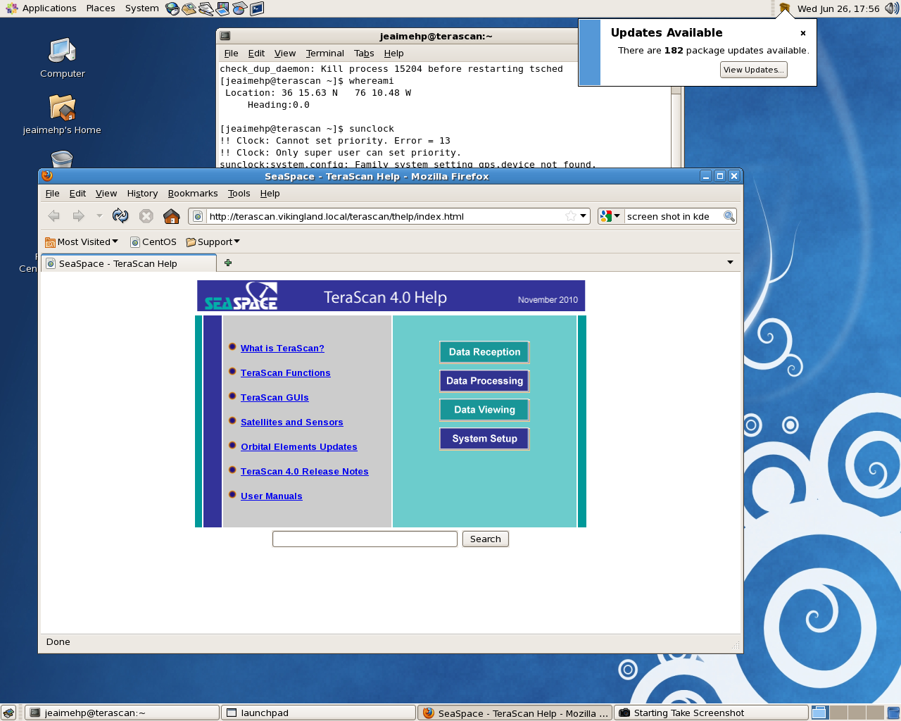
thelp
Notes:
The command thelp is used to open the help center, which provides the TeraScan Manual

Slide 12
LaunchPad
Notes:
Launchpad leads to access of buttons to get to other software packages

Slide 13
Listsched
Notes:
List schedule or listsched command is used to view the satellite schedule

Slide 14
Trackeye full
Notes:
Trackeye full is used to watch a satellite pass come in.

Slide 15
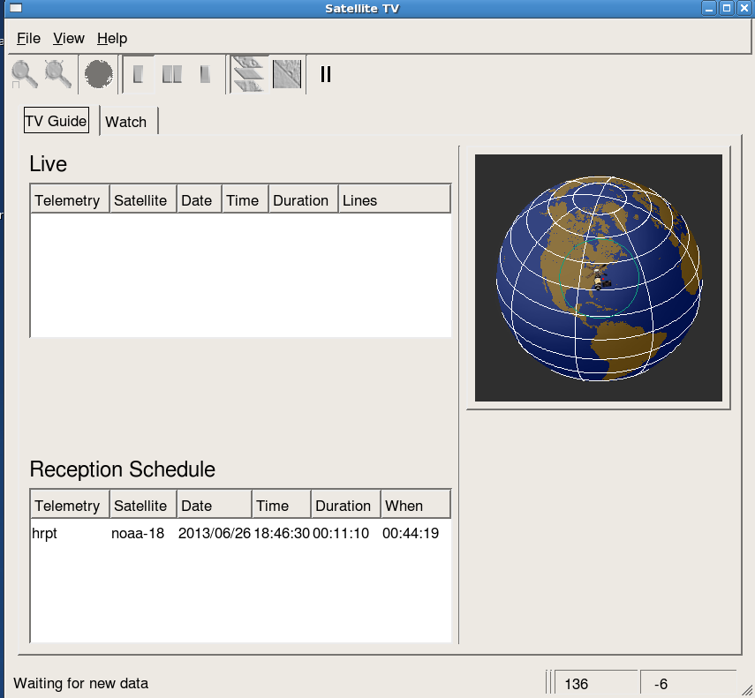
stv
Notes:
Satellite tv or Stv allows you to watch the data coming in raw and unreferenced.

Slide 16
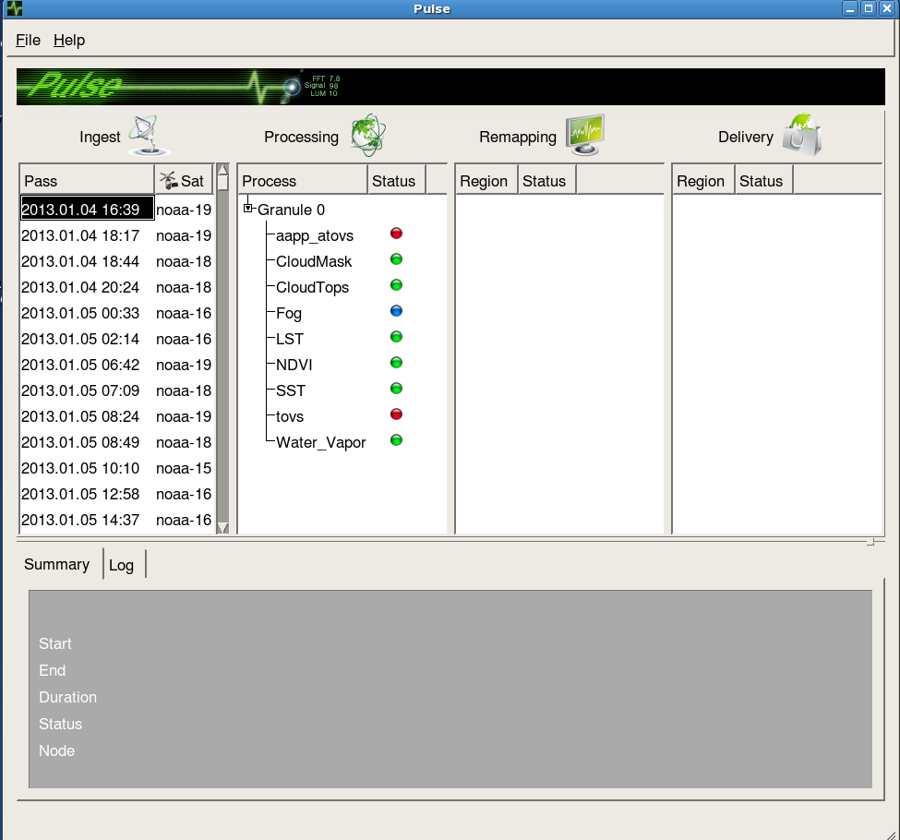
Pulse
Notes:
The command pulse is a display of information found in the processing log file

Slide 17
Ac
Notes:
AC gives you ground stations location and system information

Slide 18
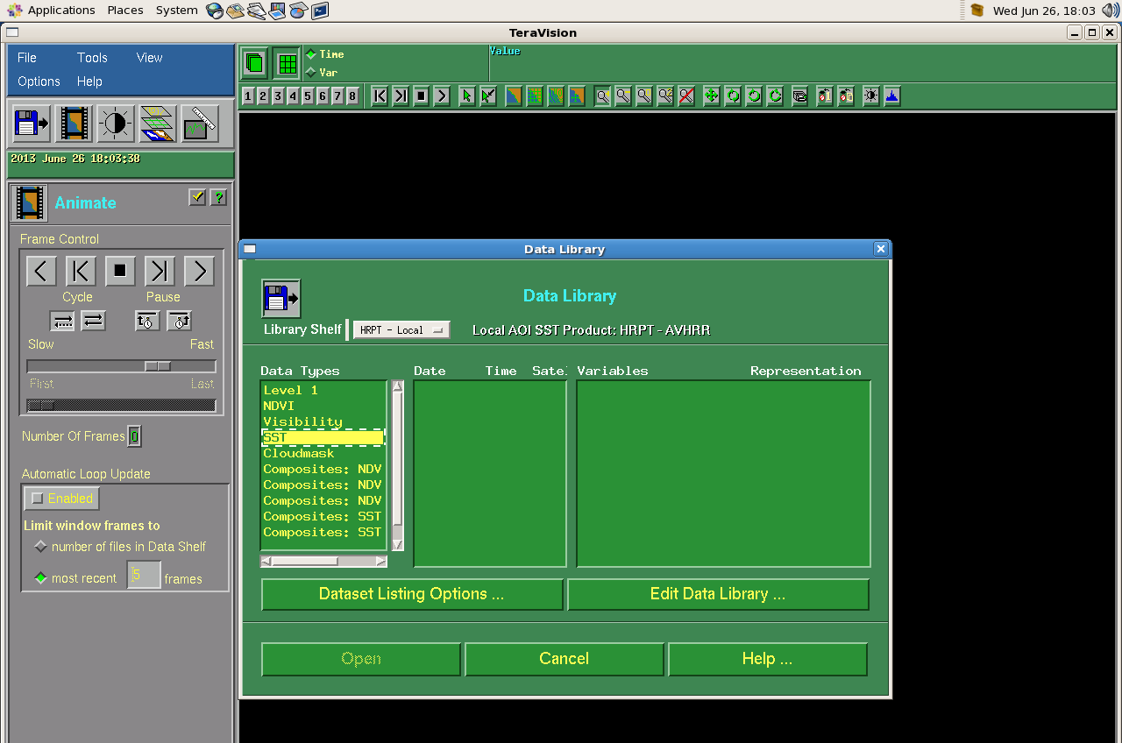
tvis
Notes:
The Tvis command will open the TeraVision software package

Slide 19
lspass
Notes:
List pass or Lspass gives you a list of recent data recordings

Slide 20
References
1. http://www.seaspace.com/corporate.php
2.http://www.sandiegoivdec.org/default.aspx?pageID=6&pagename=home
3. http://psbcw1.nesdis.noaa.gov/terascan/home_basic/what_is_terascan.html
4.http://www.linux.org/article/view/distro-red-hat
5. http://www.coastalwiki.org/wiki/Waves_and_currents_by_X-band_radar
6. TeraScan training guide
7. https://aws.amazon.com/marketplace/seller-profile?id=16cb8b03-256e-4dde-8f34-1b0f377efe89
8. http://kleanpc.com/cms/services/linux-implementations/
9. http://www.evl.uic.edu/cavern/teranode/teravision
10. http://seaspace.com/docs/terascan40_flyer.pdf

Slide 21
You can find more information at the following site
CERSER
http://cerser.ecsu.edu/

