Slide 1
Using CReSIS airborne RADAR to constrain ice-volume influx across the lateral margins of the Northeast Greenland Ice Stream
Notes:
Good afternoon, we are the Penn State team and we will be presenting our research project titled “using cresis airborne radar to constrain ice volume influx across the lateral margins of the northeast greenland ice stream.

Slide 2
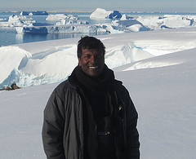
Team Members
Michael Chamberlain
University of California, Berkeley
Emma Reeves
Hamline University
Mentors
Sridhar Anandakrishnan
Pennsylvania State University
Peter Burkett
Pennsylvania State University
Notes:
My name is michael chamberlain, and im a junior at the university of california at berkeley. This is Emma Reeves and she is a senior at Hamline University in Minnesota. Our mentors from Pennsylvania state were Peter Burkett and Sridhar Anandakrishnan.

Slide 3
Abstract
The Greenland Ice Sheet (GIS) is one of the largest ice sheets on Earth. Movement of large volumes of ice from stable interior regions to rapidly flowing, calving, or melting margins of this ice sheet can have a significant impact on sea level. The Northeast Greenland Ice Stream (NEGIS) is an unusual ice stream that extends farther inland than any stream on the GIS. NEGIS is widening downglacier due to an influx of ice across its shear margins. The margins of NEGIS are underlain by de-watered zones that restrict the volume of entering ice and maintain the stream’s relative stability. Removal of these restricting bands could lead to a major influx of ice into NEGIS and a significant drawdown of GIS. Through the use of airborne RADAR, we develop a method to quantify the ice-volume influx across the stream’s lateral shear margins. These constraints on ice-volume influx establish a baseline for future studies interested in monitoring NEGIS’ margins and understanding its stability.
Notes:
The Greenland Ice Sheet (GIS) is one of the largest ice sheets on Earth. Movement of large volumes of ice from stable interior regions to rapidly flowing, calving, or melting margins of this ice sheet can have a significant impact on sea level. The Northeast Greenland Ice Stream (NEGIS) is an unusual ice stream that extends farther inland than any stream on the GIS. NEGIS is widening downglacier due to an influx of ice across its shear margins. The margins of NEGIS are underlain by de-watered zones that restrict the volume of entering ice and maintain the stream’s relative stability despite its unusual widening geometry. Removal of these restricting bands could lead to a major influx of ice into NEGIS and a significant drawdown of GIS. Through the use of airborne RADAR, we develop a method to quantify the ice-volume influx across the stream’s lateral shear margins. These constraints on ice-volume influx establish a baseline for future studies interested in monitoring NEGIS’ margins and understanding its stability.

Slide 4
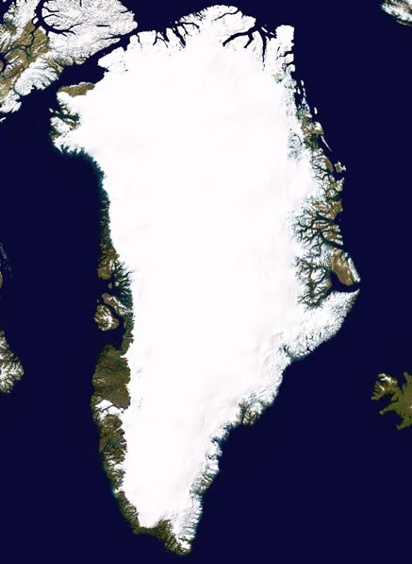
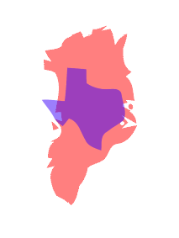
Introduction
The Greenland Ice Sheet (GIS) and the Antarctic Ice Sheet are the two largest ice sheets in the world
GIS is 3.11 times the size of Texas
Annual snowfall makes the ice sheet grow in volume
At the margins of the sheet, ice melts and breaks off
Ice streams move large volumes of ice quickly
Image: NASA
Image: MapFight
Notes:
The Greenland Ice Sheet is one of the world’s two major ice sheets, covering 1.7 million square kilometers, the size of three Texases. The ice sheet’s total volume is governed by annual snowfall, which increases the volume, and ice loss along the margin of the sheet, which decreases the volume. Ice streams are localized areas of fast flowing ice, caused by melt at the bed of the ice stream which acts to lubricate and promotes flow. These streams are important because they are able to move large volumes of ice towards the sheet’s margins much more quickly than the surrounding slow-flowing ice is able to.

Slide 5
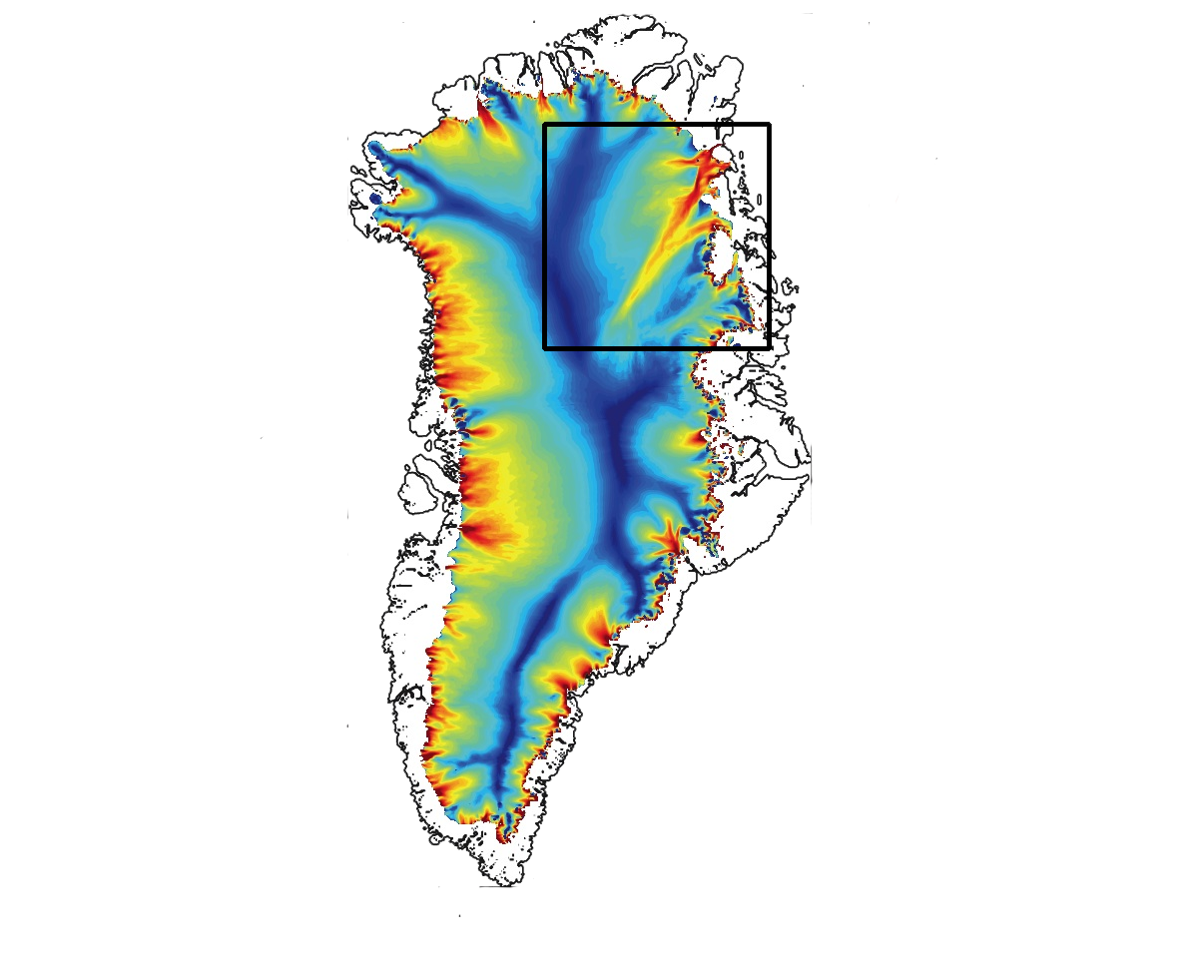
Northeast Greenland Ice Stream (NEGIS)
Velocity map of Greenland Ice Sheet from satellite
NEGIS initiates further inland than any other stream
Widens downstream
Notes:
In this study we looked at the Northeast Greenland Ice Stream, NEGIS. This image shows ice velocities on the Greenland Ice Sheet, where warm colors represent faster moving ice and cooler colors represent slower ice. Because ice streams move much faster than the rest of the ice sheet, velocity maps are an easy way to locate streams. NEGIS is an unusual ice stream for a couple reasons:1. it initiates much further inland than any other stream on the Greenland ice sheet, and 2. it widens downstream rather than narrowing.

Slide 6
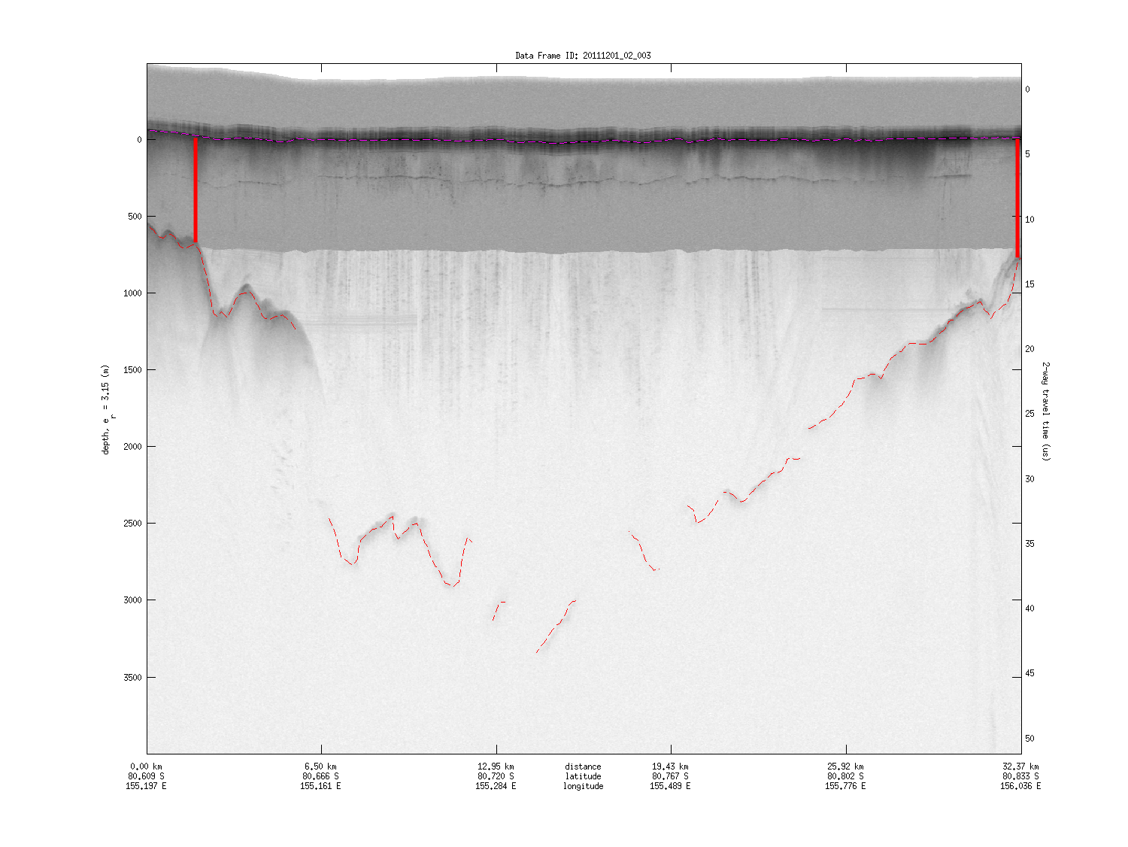
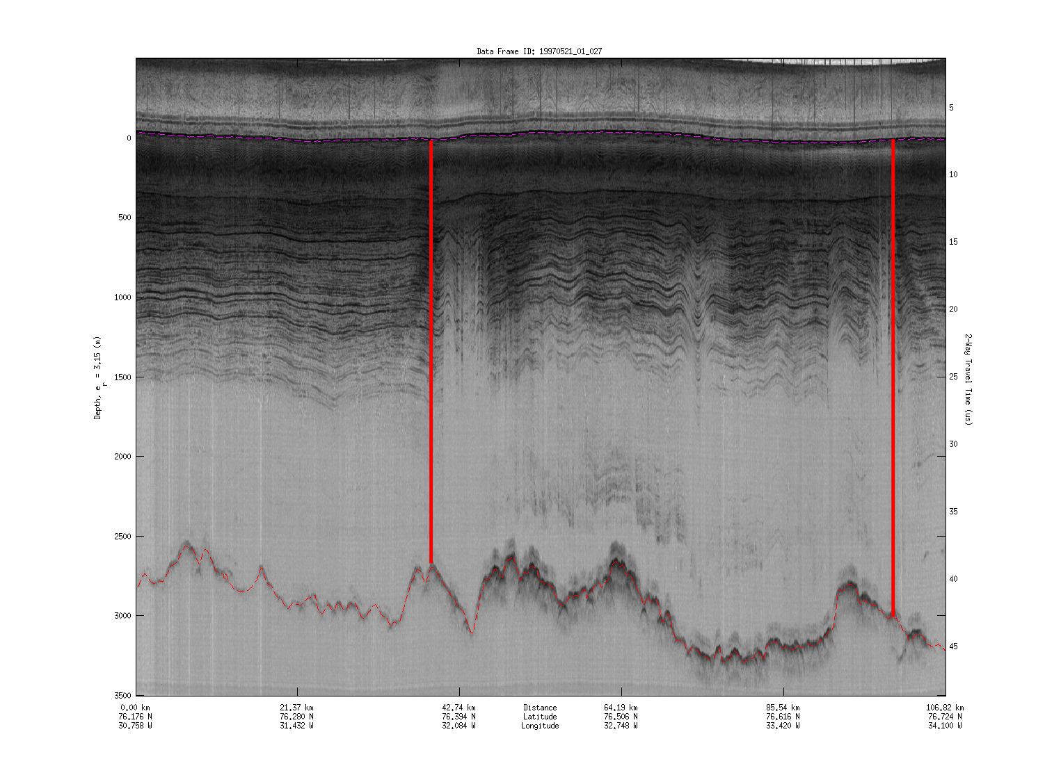
NEGIS: An unusual stream
Notes:
The edges of an ice stream are called the shear margins. At these margins, the velocity changes drastically over a short distance causing massive strain on the ice. In the picture on the right, you can see evidence of the deformation caused by this strain just inside the margins.
Ice streams usually follow a low in ground topography as can be seen in the image on the left. Friction at the base of the ice sheet causes ice to melt. This melt acts as a buffer between the ice and ground allowing the ice to flow. In the case of NEGIS however, the lubricating melt is created by a hotspot near the center of the ice sheet. This melt spreads out from its source, flowing downstream in a plume. The plume widens as it goes, bringing ice across the shear margins and giving NEGIS its unique widening geometry. Our research addresses the widening of the stream and develops methods that allow us to quantify how much ice enters across these shear margins.

Slide 7
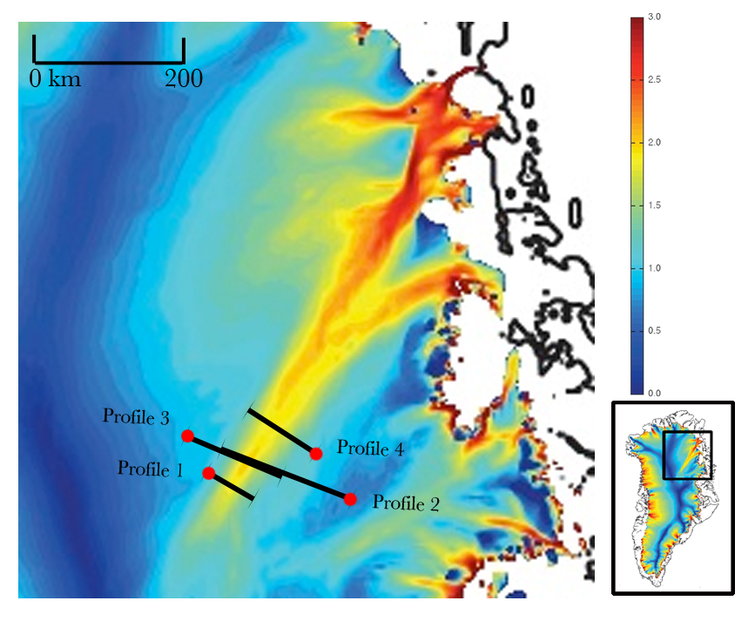
Methodology
Image: Glacierchange
Notes:
To begin our project, we searched CReSIS data archives to locate flight paths that crossed the upstream region of NEGIS nearly perpendicular to the direction of ice flow. We then checked each flight path’s RADAR image to find the profiles with the best resolution and clearest internal layering. We only selected a profile if it had a number of prominent, continuous layers. The flight paths of the four profiles we chose are mapped over a velocity overlay of NEGIS in this image. The red dots show the start of each flight path, corresponding to the left side of that profile’s radar image.

Slide 8
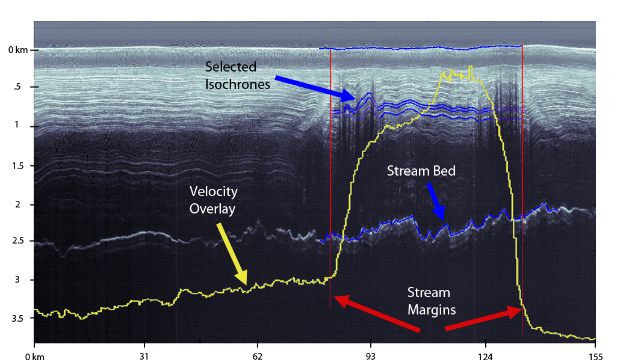
Methodology: Picking isochrones and margins
Blue: picked isochronous layers (isochrones)
Yellow: velocity overlay
Red: Shear margin outer edges defining stream extent
Image: CReSIS
Notes:
In this image, you can see a number of white layers varying in intensity. These layers are called isochrones and each represents a relatively short period of time. Higher contrast between two layers means that there is a greater difference in electrical conductivity as detected by the radar. Electrical conductivity differences occur due to changes in snow composition or volcanic events that deposit ash across a major area. Therefore, an identifiable layer seen in multiple profiles can be used as marker representing a point in time. For the purposes of this study, we picked the same 3 prominent layers as well as the bed and surface of the glacier in each of our 4 profiles. These layers are displayed in blue in the picture shown and were traced using a program developed at St. Olaf college in Minnesota.
The yellow overlay shows the ice velocity along the radar profile. In this cross section, ice flow is into the page and the relative height of the yellow overlay represents velocity ranging from 2 to 40 meters per year. The shear margins are defined where the high ice velocity in the stream drops to the slower ice velocity of the surrounding sheet. We used this overlay to define the lateral extent of the stream, shown in red in this image.
If anyone asks about scale: The horizontal axis is approx. 110km and vertical depth is approx. 4km.

Slide 9
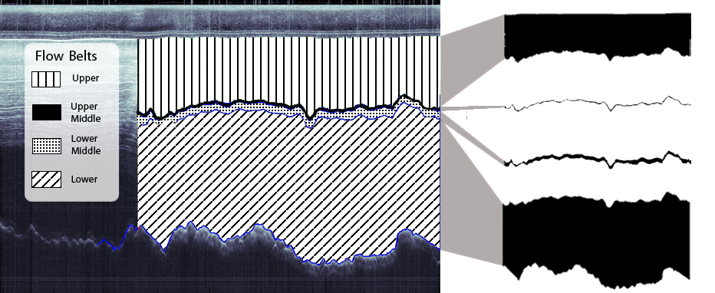
Methodology: Masking
Notes:
The stream edges and the selected layers define four cross sectional areas, or flow belts. We masked the flow belts in Adobe photoshop as can be seen in the image on the left. ADINative software from Digital Earth Watch calculated the ratio of pixels masked to the total amount of pixels in the image. Using this ratio, we were able to find the areas of the four flow belts in each profile. As stated earlier, this study is interested in looking at the volume flux trend along NEGIS. The volume flux is the amount of ice that travels through a cross sectional area in a year and we use the areas of the flow belts found through this masking process to calculate this.

Slide 10
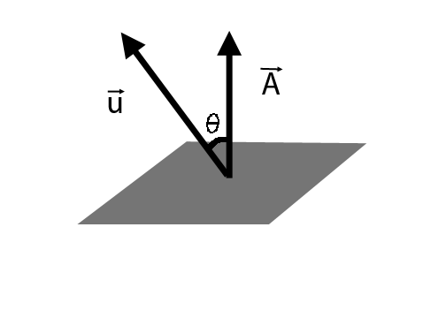
Methodology: Ice-volume flux calculations
Notes:
The volume flux through each profile’s flow bands is found using the formula shown. In this formula u is the average velocity vector and A is the area vector (which points normal to the area).
The velocity vector was obtained from CReSIS and was contained in two parts, a magnitude vector and a direction vector. Because the velocity vector was not parallel to the area vector at each point along the stream, we wrote a Matlab script to calculate only the needed component.
We then multiplied the average of this adjusted velocity by the flow belt areas to find the volume flux through each belt.

Slide 11
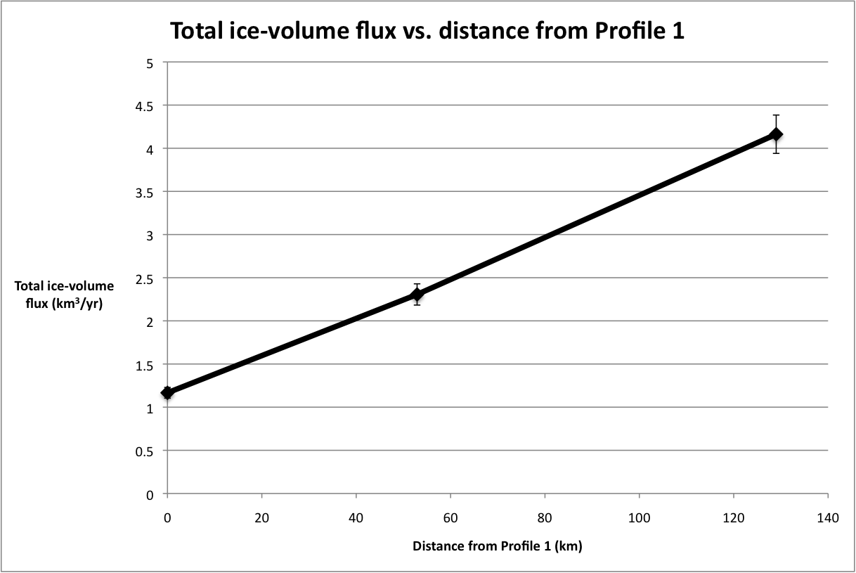
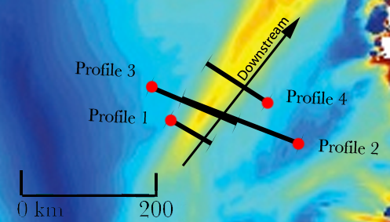
Analysis: Total ice-volume flux increase
Ice-volume flux increases from 1.17 to 4.16 km³ from Profile 1 to Profile 4
Notes:
Our analysis shows an approximately linearly increasing trend of volume flux from profile 1 to profile 4. The flux through Profiles 2 and 3 has been averaged because they lie across the same geographic extent, shown in the inset map. It is clear that this volume flux trend corresponds to the downstream widening seen in satellite images of NEGIS. This data quantifies the amount of ice entering NEGIS across it’s lateral shear margins between Profiles 1 and 4, showing an overall increase in volume flux from 1.17 cubic kilometers per year in Profile 1 to 4.16 cubic kilometers per year in Profile 4, which lies 130 km downstream.
Such a large increase in volume flux is not usually observed in the upstream regions of ice streams. Nearly all ice streams maintain a roughly constant mass flux, narrowing and speeding up progressively downstream. NEGIS however both widens and speeds up allowing ice to cross the shear margins and contribute to the overall volume flux.

Slide 12
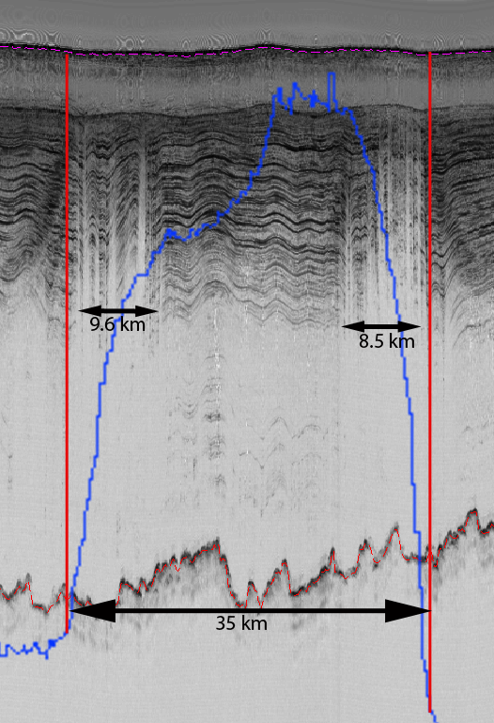
Analysis: Evidence of relict margins
Shear margin deformation is expected to cover ~30% of stream’s lateral extent (Echelmeyer et. al)
Deformed margins of NEGIS, up to 52%
May include relict margins
Notes:
Although we know that NEGIS gets progressively wider downstream, the question remains of whether the stream is stable or if its margins are slowly moving.
Within radar images of NEGIS, we see heavily deformed regions that appear to be shear margins. These margins are about 10km wide as you can see in the image. However, for an ice stream of this lateral extent, about 30km, deformed regions are expected to be only 4-5km wide.
We believe that these wide regions of deformation include a signature of relict, or past, margins. In addition, these relict margins exist far inside the present margins. This suggests that the stream has widened and may continue to widen.

Slide 13
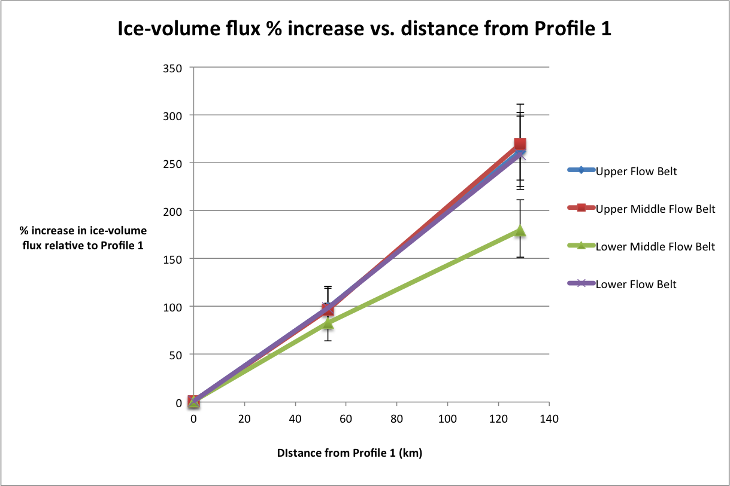
Analysis: Reliability of isochrone picks
Notes:
The graph displayed shows the increasing trend in volume flux through each of the four flow belts. This increase is shown as a percent increase from Profile 1. The volume flux through each of the four flow belts is shown in different colors on the graph.
There is a consistent, increasing trend in the ice-volume flux through each flow belt with the Lower Middle belt being slightly anomalous. Since we expect the volume flux increase to be distributed evenly throughout the layers, we can tell that our picking method was able to reliably select isochrones. This method of defining flow belts was effective in determining volume flux through a chosen area within multiple, geographically varying, radar cross-sections and could be useful in future radar-based ice stream research.

Slide 14
Error Analysis
Notes:
To show the significance of our data, we performed a representative error analysis. Our isochrone picks, margin delineations, and masking procedure were all sources of error.
To account for these sources of error, we compared the overlapping profiles 2 and 3. These profiles cover the same stream extent so the volume flux through each flow belt should be the same. The differences we found provided us with an error of 5.4%.
This same method of error analysis could not be used to address the error in Profiles 1 and 4 because we did not have an overlapping profile for either. Instead, we applied the same error of 5.4%. Profiles 1 and 4 may have additional error that is not accounted for, but we determined this error of 5.4% as the most representative error obtainable from our data. In the future, overlapping profiles at 1 and 4 could be used to obtain a more accurate error and show a Lower Middle trend more consistent with the other flow bands.

Slide 15
Conclusion and Future Direction
Notes:
This study has placed reasonable constraints on the downstream-increasing ice-volume flux in NEGIS that can be attributed to influx across its shear margins. We observe what we believe to be relict stream margins in the radar images, indicating that the stream may also be widening with time.
Understanding the stability of NEGIS is important to understanding the future of the Greenland Ice Sheet. Its far-reaching inland extent gives NEGIS the potential to tap a larger area than any other ice stream on the sheet. By constraining the rate of mass influx through the shear margins along the upstream extent of NEGIS, this study provides data that can help in understanding its current and future stability.

Slide 16
Sources
Christensen, John. ADINative. Computer software. Software-Digital Earth Watch. The Lawrence Hall of Science- University of California, Berkeley.Web.
Christianson, Knut, Alley, Richard B., Peters, Leo E., Anandakrishnan, Sridhar, Jacobel, Robert W., Riverman, Kiya L., and Muto, Atsuhiro. “Self-stabilizing ice-stream flow in Northeast Greenland.” Unpublished manuscript, St. Olaf College, Northfield, MN and The Pennyslvania State University, University Park, PA. (2013).
Echelmeyer, K. A., W. D. Harrison, C. Larsen, and J. E. Mitchell. "The Role of the Margins in the Dynamics of an Active Ice Stream." Journal of Glaciology 40.136 (1994): 527-38. Web. 5 July 2013.
Ng, Felix and Conway, Howard. "Fast-flow signature in the stagnated Kamb Ice Stream, West Antarctica." Geology 41.7 (February 2004): Web.
Notes:
These are the sources we used for our study. (leave up for a lil bit)

Slide 17
Acknowledgements
We would like to thank:
Elizabeth City State University and the Research Experience for Undergraduates in Ocean, Marine and Polar Science (REU-OMPS) for hosting and funding us.
Peter Burkett and Sridhar Anandakrishnan of Pennsylvania State University for mentoring us on this project.
Nick Holschuh of Pennsylvania State for finding NEGIS velocity data for our profiles.
Je’aime Powell and Jeffrey Wood for helping us develop professional materials and improve our presentation.
The Center for Remote Sensing of Ice Sheets (CReSIS) for sponsoring this research.

Slide 18
Questions?

