Slide 1
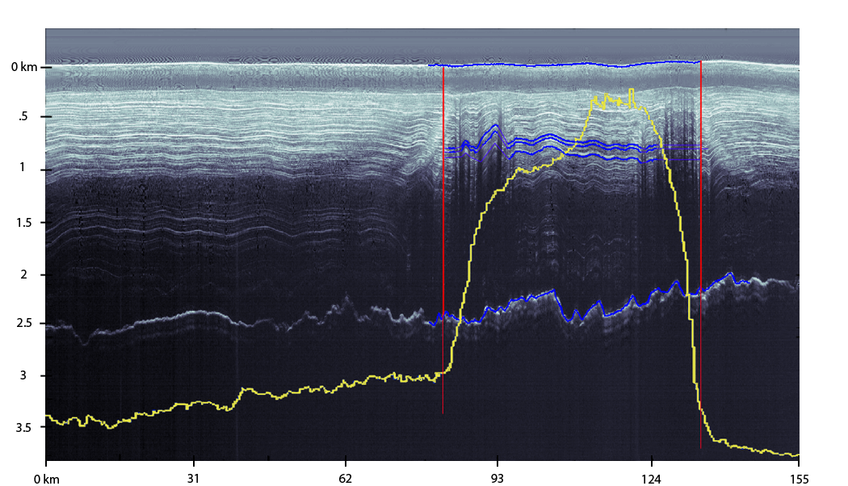
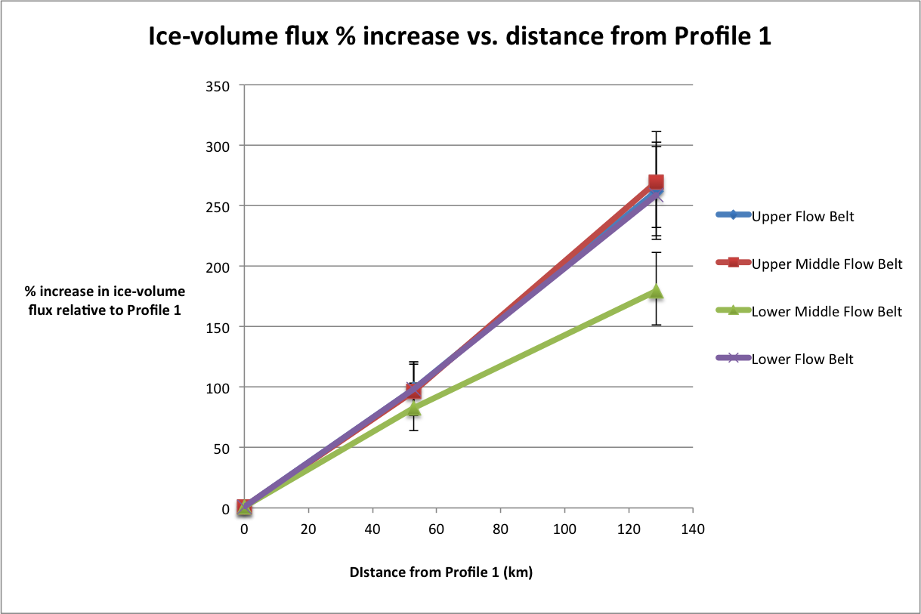
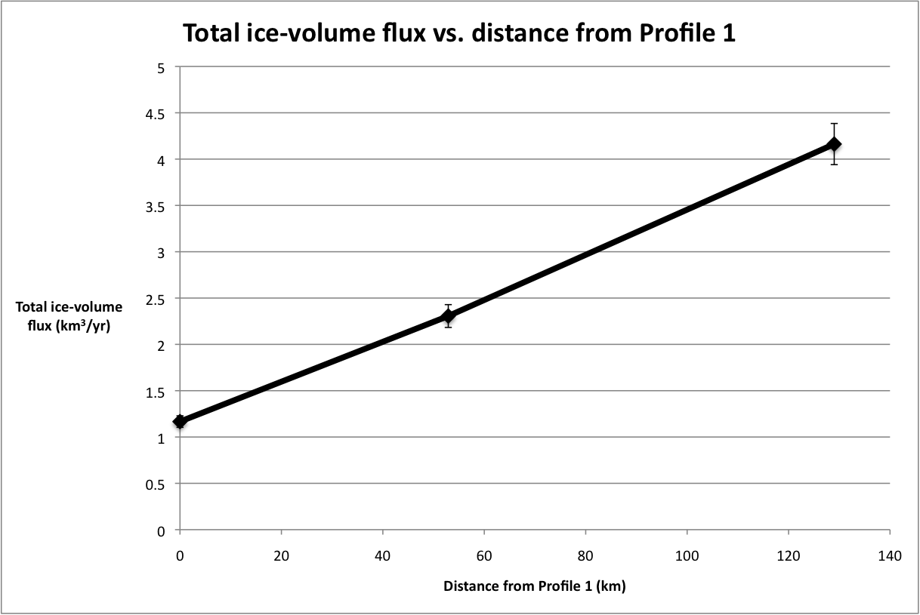
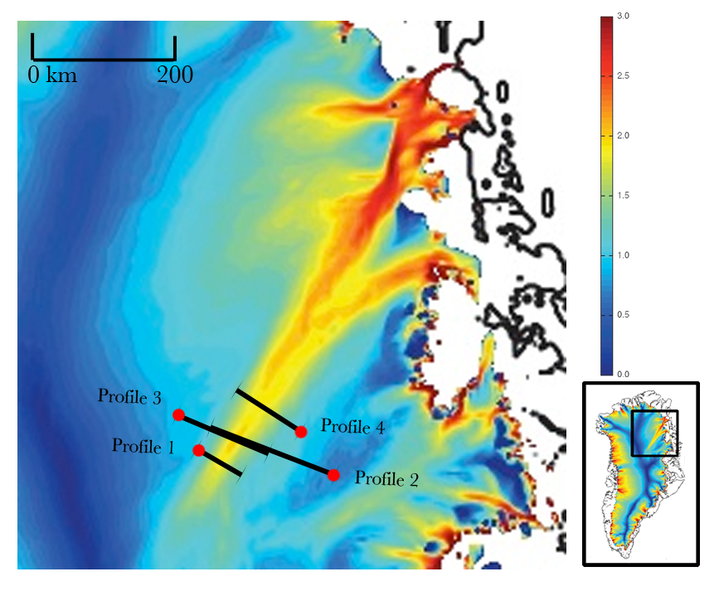
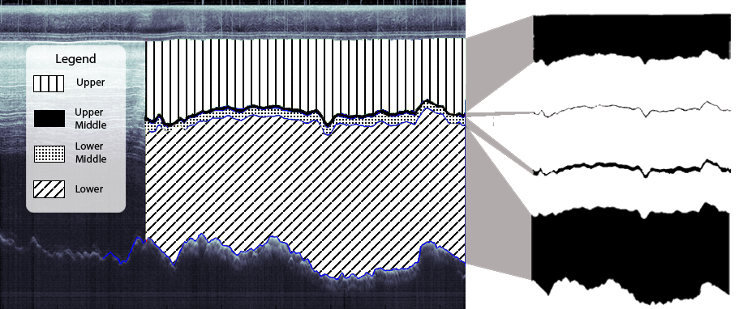
Using CReSIS airborne RADAR to constrain ice-volume influx
across lateral shear margins in the Northeast Greenland Ice Seet (NEGIS)
Michael Chamberlain (UC Berkeley), Emma Reeves (Hamline) Mentors: Mr. Peter Burkett (PSU), Dr. Sridhar Anandakrishnan (PSU)
Abstract
The Greenland Ice Sheet (GIS) is one of the largest ice sheets on Earth. Movement of large volumes of ice from stable interior regions to rapidly flowing, calving, or melting margins of this ice sheet can have a significant impact on sea level. The Northeast Greenland Ice Stream (NEGIS) is an unusual ice stream that extends farther inland than any stream on the GIS. NEGIS is widening downglacier due to an influx of ice across its shear margins. The margins of NEGIS are underlain by de-watered zones that restrict the volume of entering ice and maintain the stream’s relative stability. Removal of these restricting bands could lead to a major influx of ice into NEGIS and a significant drawdown of GIS. Through the use of airborne RADAR, we develop a method to quantify the ice-volume influx across the stream’s lateral shear margins. These constraints on ice-volume influx establish a baseline for future studies interested in monitoring NEGIS’ margins and understanding its stability.
Methodology
Isochrones were chosen if they were continuous across more than 80 percent of the stream’s lateral extent and could be easily identified in all four Profiles. The stream’s edges, or shear margins, were defined at the points where the change in ice flow velocity begins to approach zero on either side of the stream (Fig. 2).
Using this criterion, we picked three layers, the surface and the bed (five layers in all), which we then traced using a software package developed at St. Olaf College in Northfield, Minnesota. The four areas constrained by these layers and the shear margins, or flow belts, were masked and calculated using Adobe Photoshop and the ADINative software [3] (Fig. 3).
We looked at the ice-volume flux (km³/yr) through these flow belts. The volume flux through a cross-sectional area is calculated by u ⋅ A, where u is the average velocity vector and A is the area vector of the cross section. Masked area was converted to an area vector in square meters, while stream velocity, u, was projected normal to the flux gate so as to include only the component parallel to the area vector.
Introduction
The Greenland Ice Sheet (GIS) covers 1.7 million square kilometers and is one of the largest and most dynamic ice sheets on Earth. Ice sheet volumes fluctuate due to annual snowfall and a complex system of melting, calving and ice flow. The Northeast Greenland Ice Stream (NEGIS) initiates farther inland than any other glacier or ice stream on the GIS and its catchment covers a large region. We suggest that, because of its extent, NEGIS acts as a major control on the surrounding ice sheet’s total ice volume.
NEGIS exhibits unusual flow dynamics that have not been observed in other ice streams. Glaciers in Greenland typically form within a topographic low. NEGIS, however, does not conform to its basal topography. This lack of basal constraint is likely the cause of NEGIS’ unusual widening-downstream geometry [1]. The unusual widening and high flow velocities of NEGIS, up to 100 times faster than the surrounding ice (Fig. 1), lead to its ability to move significant volumes of ice into the Greenland Sea over a short period of time. Though presently a relatively stable stream, the future stability of NEGIS remains unclear. Understanding the behavior of flow in NEGIS is therefore important in determining the fate of the GIS.
Fig. 2 The shear margins, in red, were defined at the point where the ice velocity, in yellow, levels off to that of the surrounding ice. The blue lines are the isochrone picks used to mask the flow belts (Fig. 3). Deformed regions believed to be relict margins can be seen just inside the present shear margins.
Fig. 4 A percent increase in ice-volume flux from Profile 1 is shown for four flow belts, at Profile 1, Profile 2/3 average, and Profile 4. The consistent trend seen in all four flow belts confirms the reliability of our flow band selection method.
Fig. 5 This graph displays the total ice-volume flux through Profile 1, the Profile 2/3 average, and Profile 4 against distance from Profile 1. The total ice-volume flux is the sum of the flux through the four flow belts at each Profile.
RADAR Data
RADAR Echo-Strength profiles collected by the Center for Remote Sensing of Ice Sheets (CReSIS) show laterally continuous, harmonic layering. These layers represent horizons of equal age (isochrones) because low-frequency RADAR reflections in ice are due primarily to electrical conductivity contrasts inherited from snow deposition or volcanic events [2]. Layers with a larger difference in electrical conductivity are thus easier to identify in radar images. A distinct intensity signature, coupled with its relative depth, allows for consistent identification of a layer in RADAR data collected at multiple geographic locations.
Analysis and Discussion
Our analysis shows a clear increase in ice-volume flux downstream in the inland part of NEGIS. Between Profiles 1 and 4, we found that ice-volume flux rose from 1.17 km³ /yr to 4.16 km³ /yr, a 257% increase (Fig. 4). A constant-volume flux is usually assumed for ice streams. This is because typical ice streams narrow downstream as the ice accelerates, preventing additional ice from entering across the shear margins. The significant ice-volume increase observed in NEGIS is therefore an indicator of some unusual stream characteristic.
Error between these Profiles arises from uncertainty when tracing isochrones across deformed regions in the RADAR images, restrictions on margin delineation due to ice velocity resolution, and technical limitations of masking and calculating areas in Adobe Photoshop and ADINative. We compared the ice-volume flux through the four flow belts defined in both Profiles. The errors we found ranged from 2.7% to 5.4%, and the 5.4% error was applied to all data points. Because overlapping profiles could not be used to calculate individual errors in Profiles 1 and 4, these Profiles may have additional error due to radar resolution. However, without access to these overlapping profiles, we determined 5.4% to be the most representative error obtainable.
Shear margins are heavily deformed bands of ice at the edges of an ice stream, and are marked by a sharp change in ice velocity. RADAR images reflect this deformation as chaotic columns of distorted internal layering (Fig. 2). Within our velocity-defined stream edges, we observed columns of significant deformation. We believe these deformation regions to be relict shear margins. This, coupled with the lack of deformation at present-day margins, indicates that these margins are relatively young and have widened over time. This outward evolution of the stream’s shear margins and its downstream-widening geometry leads us to accept explanation 1 as the more likely scenario.
In this study, we examined RADAR images from the upstream region of the Northeast Greenland Ice Stream (NEGIS). We identified a set of isochrones in RADAR images for four sections across NEGIS (Fig. 1). These isochrones act as a reference for measuring cross-sectional area which, when compared to known stream velocities, will give an estimate of mass influx in the upstream region.
To ensure the validity of our calculated flux, we account for measurement error inherent in our method. We compare the cross sectional area from two overlapping profiles, Profiles 2 and 3. These Profiles cover the same geographic extent across the stream and should have the same volume flux (Fig. 1).
There is a consistent, increasing trend in the ice-volume flux through each flow band with the Lower Middle band being slightly anomalous due to the radar resolution error in Profiles 1 and 4 discussed above (Fig. 5). Since we expect the volume flux increase to be distributed evenly throughout the layers, we can tell that our picking method was able to reliably select isochrones. Future radar-based ice stream research could use this approach to determine volume flux through radar cross-sections.
Conclusion
Understanding the stability of NEGIS is important to understanding the future of GIS. Its far-reaching inland extent gives NEGIS the potential to tap a larger catchment area. This study uses RADAR to quantify the change in ice-volume flux along the stream and provides evidence indicating that the stream may be widening with time. Continued monitoring of NEGIS’ margins and ice-volume flux in its upstream extent could improve understanding of the stream’s dynamics and stability.
We examine two explanations for the observed progressive increase in flux. These explanations assume flow dominated by a basal layer of lubricating, water-saturated till originating at the stream source. (1) The downstream ice-volume flux increase is caused by ice entrainment across shear margins. This is a reasonable conclusion that would explain the gradually increasing downstream trend. (2) A gradual decrease in the volume of ice entering NEGIS at its upstream source causes a relative downstream-widening appearance.
Acknowledgements
We would like to thank Elizabeth City State University for hosting us, Peter Burkett and Sridhar Anandakrishnan for mentoring us, Nick Holschuh for providing us with NEGIS velocity data, Je’aime Powell and Jeffrey Wood for helping us develop and improve our project, and the Center for Remote Sensing of Ice Sheets (CReSIS) for sponsoring this research.
References
[1] Christianson, Knut, Alley, Richard B., Peters, Leo E., Anandakrishnan, Sridhar, Jacobel, Robert W., Riverman, Kiya L., and Muto, Atsuhiro. “Self-stabilizing ice-stream flow in Northeast Greenland.” Unpublished manuscript, St. Olaf College, Northfield, MN and The Pennyslvania State University, University Park, PA. (2013).
[2] Ng, Felix and Conway, Howard. "Fast-flow signature in the stagnated Kamb Ice Stream, West Antarctica.” Geology 41.7 (February 2004): Web.
[3] Christensen, John. ADINative. Computer software. Software-Digital Earth Watch. The Lawrence Hall of Science- University of California, Berkeley.Web.
[4] Echelmeyer, K. A., W. D. Harrison, C. Larsen, and J. E. Mitchell. "The Role of the Margins in the Dynamics of an Active Ice Stream." Journal of Glaciology 40.136 (1994): 527-38. Web. 5 July 2013.
Fig. 1 Four Profiles were chosen. These Profiles cross approximately perpendicular to the direction of stream flow. The GPS coordinates of the endpoints are 75.70°N 36.70°W, 75.46°N 34.42°W (1); 75.43°N 30.59°W, 76.11°N 35.60°W (2); 76.42°N 38.38°W, 75.80°N 33.19°W (3); 76.18°N 30.76°W, 76.72°N 34.10°W (4). The red dot seen on each Profile signifies the first listed GPS coordinate and corresponds to the leftmost edge of each RADAR image. This map shows ice velocity, with faster flow appearing in red. Inset shows the location of NEGIS on GIS.
Fig. 3 Four flow belts were defined laterally by the present shear margins and confined vertically by isochrone picks. The flow belts expanded to the right show the masking process used to calculate area. In this process, we converted the percent masked area found by ADINative software to actual cross sectional area.

