Slide 1
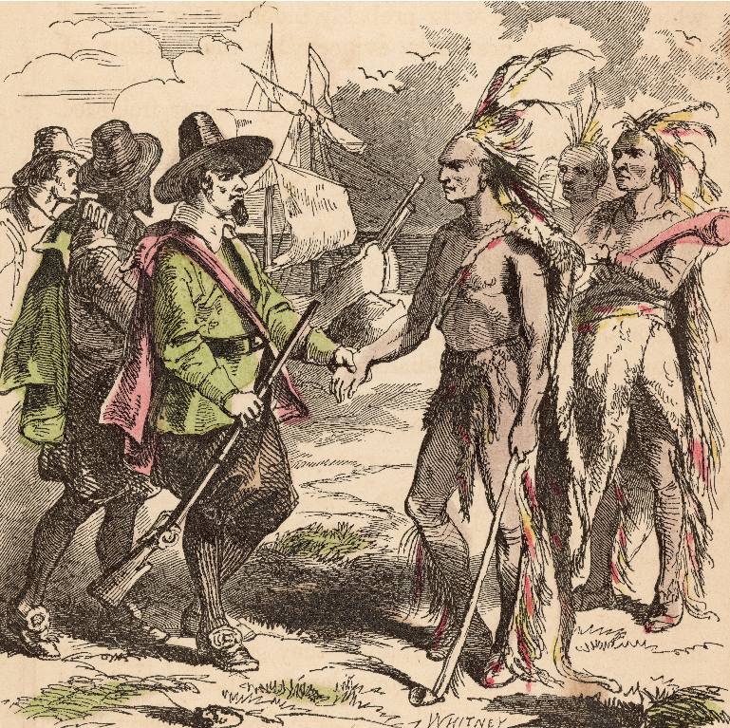
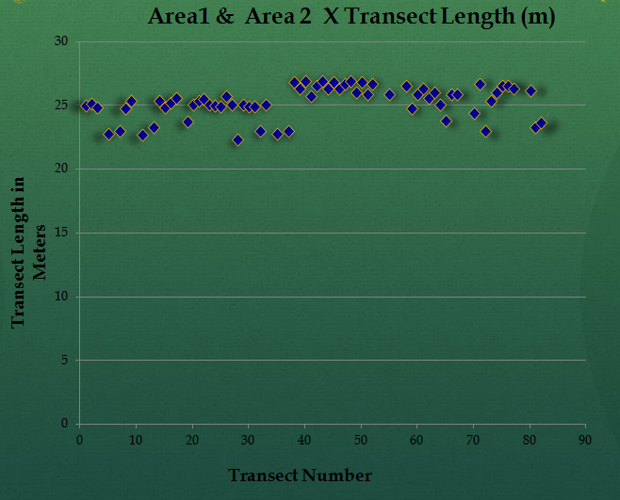
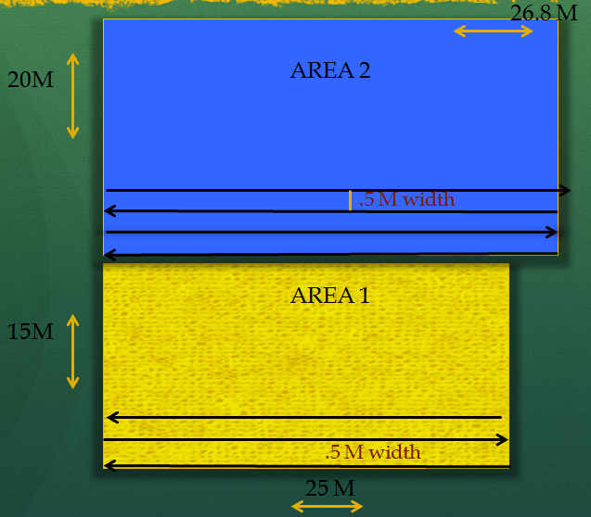
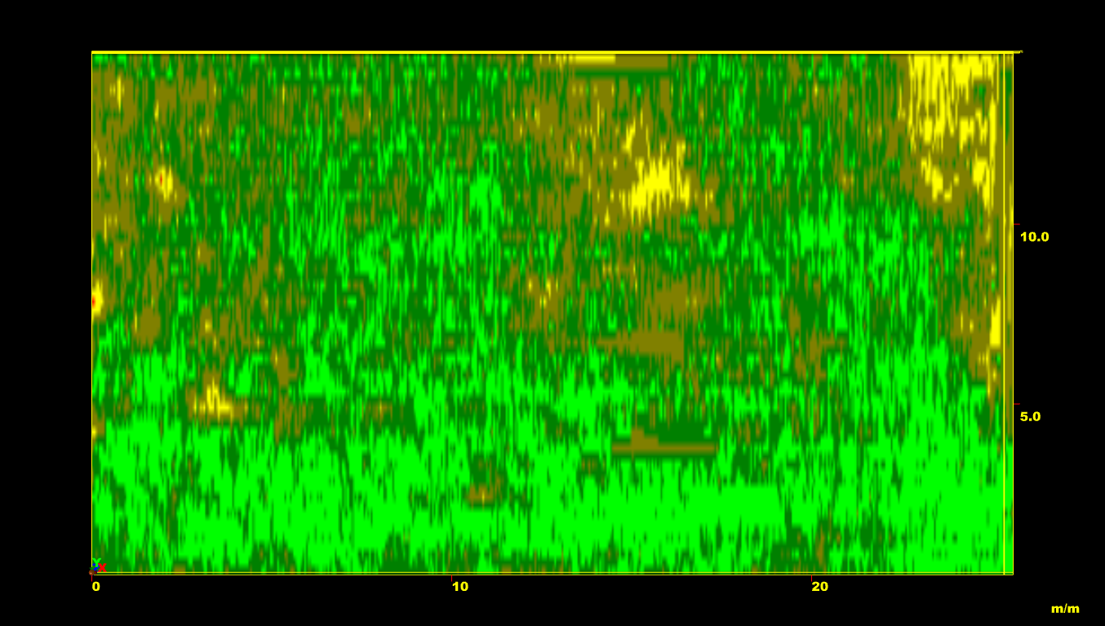
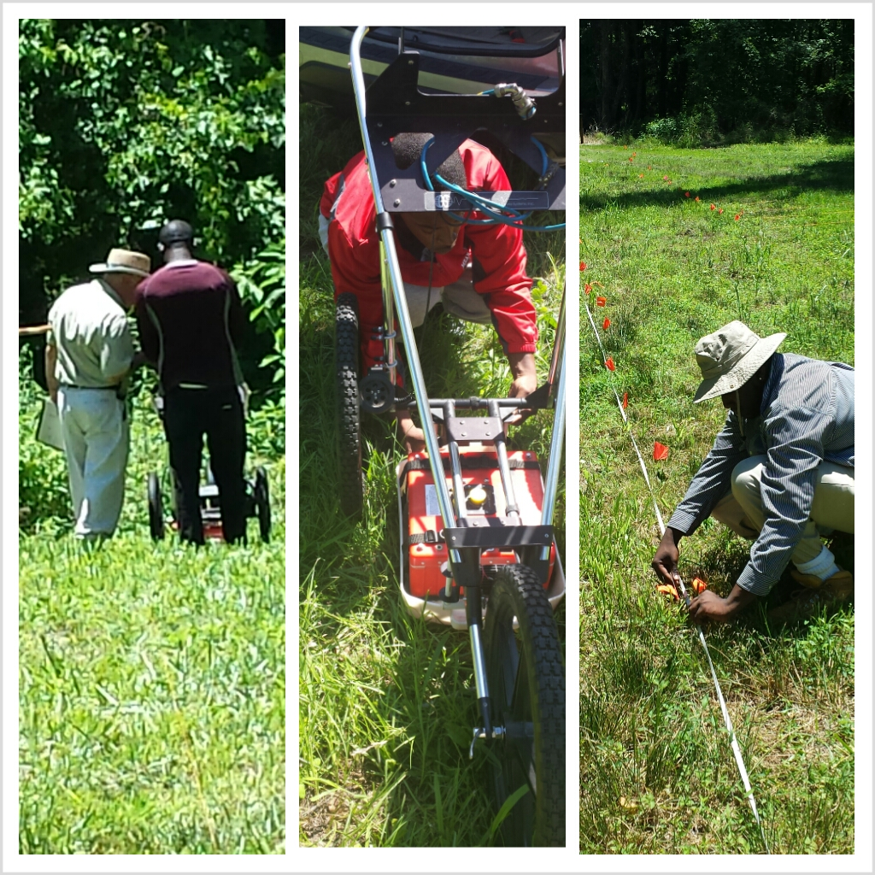
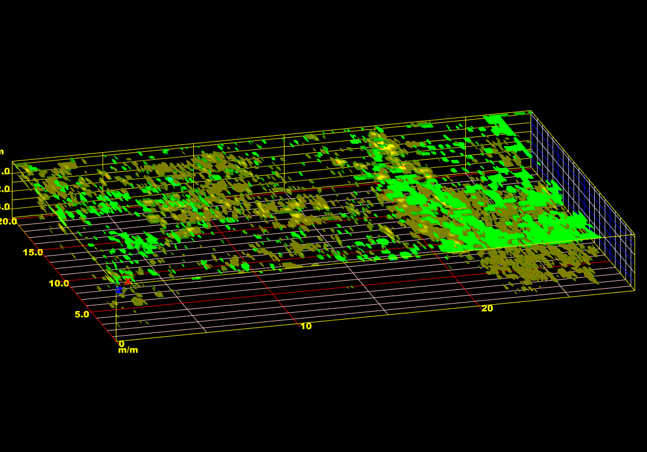
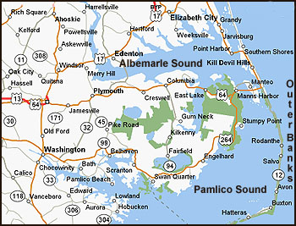
Early North Carolina Colonial and Native American Ground Penetrating Radar Site Surveyal
Researchers
Rashad Williamson
Mathematics
Mississippi Valley State University
Michael Cobb
Chemistry
Elizabeth City State University
Kelechi Onyiriuka
Pharmaceutical Science and Biology
Elizabeth City State University
Mentor
Dr. Malcolm LeCompte
Elizabeth City State University
ABSTRACT
Introduction
Methodology: Materials and Procedures
Results
Figure 6.0 is a graphical display of the combined transect length of both area one and area two. The plotted points helps display accuracy, and it helps pin-point transects that were affected by trees.
The earliest English colonial populations in the new world spread rapidly through southeastern Virginia and northeastern North Carolina in the late 16th and early 17th centuries. These peoples had to overcome insufficient food sources, threat of attack by hostile indigenous peoples and even hostile European powers. Early, mutually beneficial, contact and relations with non-hostile Native Americans were often sought by European colonists as a survival strategy. Sites characterized by close proximity between colonists and natives are well known in Northeastern North Carolina.
Opportunities for expanded archaeological investigations of early historic colonial sites became possible with a collaborative research effort undertaken with the Museum of the Albemarle (MOA) and the Elizabeth City State University’s Center of Excellence in Remote Sensing Education and Research (CERSER) in June, 2012. Students in a summer research program for undergraduates engaged in a Ground Penetrating Radar (GPR) survey of a site related to the Culpeper rebellion of 1677.
This summer, in collaboration with MOA, a high-resolution GPR survey will be performed of a known Native American settlement site that existed in close proximity to early colonial N 6.6 data processing software. It will perform a Ground Penetrating Radar survey at 0.5-meter spatial resolution of the most promising areas for colonist and Native American interaction as defined by prior MOA archaeological studies in collaboration with the museum’s archaeologist. Data collected will be processed and examined for any evidence of buried structural features. Surveying such sites with GPR is important due to modern threats to the maintenance of their pristine state. Threats to such sites include agricultural and forestry operations, commercial and residential development, and increasing shoreline erosion.
Ground penetrating radar (GPR) is a geophysical method that uses radar pulses to examine the subsurface of an area. This method uses electromagnetic radiation,
found in the microwave band of the spectrum, and detects the reflected signals from subsurface structures. This equipment can quickly and accurately locate buried archaeological features, artifacts, and important cultural strata in the near surface. In this research, we used GPR for various purposes, including detecting and mapping subsurface archaeological artifacts, features, and patterning. The goal of our research was to determine if there is any existence of Native American or colonial structures buried in the sites that we examined. In order to accomplish this, we strategized the use of the ground penetrating radar equipment to advance our search in this research. Before the GPR was used, a detailed location was mapped out for measurement to insure accuracy and precision.
The site that was selected has been predetermined to be a refuge for Native Americans, and perhaps colonial habitation. The location of the site along the Chowan River makes it an ideal location for a settlement to thrive, promoting the possible collaboration between the natives and colonial people. A quick look before any experiment was conducted on this site resulted in some archaeological artifacts and stones that were estimated to be 600-2000 years old.
Our main point or purpose for the research was to determine whether the area we mapped out is promising to the possibility of having any buried evidence of Native American or colonial structural artifacts. In order for us to proceed in our research, we cooperated with the Museum of the Albemarle. Through the efforts of the Museum of the Albemarle archaeologist Clay Swindell, we were allowed to gain access to the early colonial Native American site near the Chowan River in Bertie County. With his effort, Clay Swindell gained permission by the landowner for us to explore and examine our intended sites and location.
The survey in this study will be designed in a way that it will reveal the presence of any buried remnant structures, artifacts, and even patterning that could indicate or suggest any espousal of Native Americans cultural features or colonial life such as defensive fortifications, or structures that may have served either as a religious or commercial purpose. After we use the GPR surveyal system, the data collected will be uploaded in the RADAN 6.6 data processing software. RADAN also helps the GPR data to be filtered, viewed and manipulated in multiple interactive 2D and 3D views. This software will play a major role in our experiment because it will help us determine if our intended area possesses a more solid chance of having any of the sought structures.
The first step in the archaeology team research experiment involved the analysis of the satellite imagery of the intended location. The team obtained imagery for the purpose of locating the site and figuring out an approach to collect true and accurate data. In order for the research to be carried out successfully there were some essential materials that were needed. The main piece of technological equipment was the GPR and RADAN 6.6 software. Other materials utilized during the process include: graph paper, a meter stick, rope, a GPS and flags. The research can be looked at as having two main components: field work, and image processing.
Area One
The team was convinced that the depth of 1.15 meters, as displayed in figure 4.0, held substantial evidence to suggest that area one contains some sort of structure. The image at 1.15 meters depth is very interesting because there seems to almost be an even spacing between colors. This theory is not conclusive because future work needs to be done on this area to determine if in fact area one has something actually buried there.
.
Conclusion and Future Work
After the completion of this research, we have compiled solid data that has led the archaeology team to determine that there is in fact an abundance of subsurface materials in both surveyed areas; the question is, what is it? Since the material responded positively to the electromagnetic waves of the GPR, we archaeology team is positive that the subsurface material present is magnetic; this means that some component of the material is composed of iron, nickel, or cobalt. The next step will be presenting this information to the appropriate archaeological personnel so that they can decide if enough relevant information has been formulated to promote further processing of the site.
Figure 3.0 above shows a composite view of the areas surveyed , their dimensions, and the data collection pattern used.
Figure 4.0 shows a processed image of Area One at a depth of 1.15 meters.
Field Work
The most important part of the research experiment was visiting the site to collect data. This required the archaeology team to visit the site in Bertie County, North Carolina with the intention of collecting data and determining if the location held evidence of the possibility of having any buried Native American, or colonial structures. While on the site, the team implemented a grid system on two area plots. The grid was implemented marking out a baseline for tapes, ropes, and other planning tools to aid the GPR plan. Several flags were placed to insure that the entire area was included in the data collection. Ropes were tied horizontally to flags to insure smooth and accurate data collection while using the GPR system. The area of the first plot was 15 by 25 meters and the second plot was 20 by 26.8 meters. After measurements were done, we ran the GPR system in both plots in a raster pattern. This pattern of scanning insured that all areas in both plots the team anticipated to experiment on where covered. The team made careful navigation around trees in the areas, but there was still some possible error due to the trees being located in the path of the GPR. The use of the GPR system was very crucial because the system worked by sending a tiny pulse of energy into a material via an antenna. An integrated computer records the strength and time required for the return of any reflected signals.
Area Two
The processing of area two revealed even more intriguing information. This area showed great potential of having some sort of structure in the subsurface area due to the information received from the graphical data. The graphical data of area two showed an abundance of subsurface materials that promotes the need of future research to be done on this area. The archaeology team evaluated area two using the RADAN 6.6 software as presented in Figure 5.0. The team came to a conclusion that there was a higher probability of recovering something from area two than area one.
Acknowledgements
The authors Michael Cobb, Rashad Williamson, and Kelechi Onyiriuka, would like to thank Dr. Malcolm LeCompte for being an amazing mentor to the team; he encouraged us in numerous capacities, even outside of our research. We also would like to extend a thank you to Edward Clay Swindle for his assistance with helping or giving us the opportunity to participate in such a program that allowed our minds to engage us obtain access to the research site. We warm-heartedly would like to thank Dr. Linda Hayden fin learning, exploring, and developing a new understanding of science, technology, engineering, and mathematics (STEM)concepts that will benefit us greatly along our road to success.
Figure 1.0 below shows a map or northeastern North Carolina; the surveyed site was located in the shaded area depicted on the map.
Figure 2.0 below shows the team working during various parts of the research process.
References
Imaging and Image Processing
Several images were collected after the use of the ground penetrating radar system. The first area was 15 by 25 meters, and the team collected 37 files, while the second area had dimensions of 20 by 26.8 meters, and 44 files were collected from that area. The RADAN 6.6 software, developed by Geophysical Survey System, Inc (GSSI) was used to process the data. This software greatly benefited the archaeology team by giving us the ability to look at the collected images in three-dimensional display. The RADAN 6.6 software allows the archaeology team to process the data in three important aspects, which are: zero correct, migration, and gain control.
Daniels DJ (2004). “Ground Penetrating Radar” (2nd ed). Knoval (Institution of Engineering and Technology).
RADAN 6.6 Users’ Manual, “The Difference is in the Data” 2005. Published by Geophysical Survey System, Inc.
Figure 5.0 shows a complete 3D image of Area Two

