Slide 1
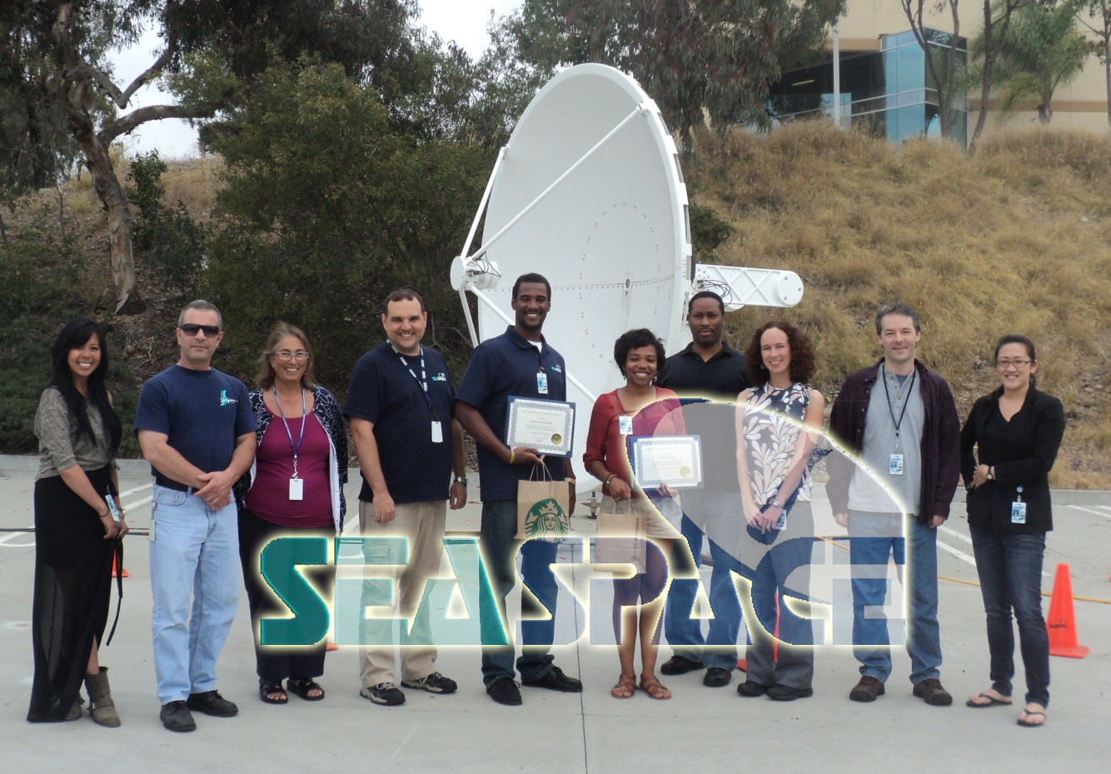
Analyzing Long-term Summer Drought Effects on Temperature and Vegetation Using Aqua-1 Satellite Data

Slide 2
Team Members
Autumn Luke
Junior – Computer Science
Mentor: Mr. Eric Baptiste (SeaSpace)
Director of Civil Space & Special Projects
Andrew Brumfield
Senior - Engineering
Mentor: Je’Aime Powell
ECSU Grid Manager

Slide 3
Abstract
According to the State Climate Office of North Carolina, since 2007 the northern coastal plain of North Carolina has been experiencing a long-term summer drought. The primary goal of this research was to find a correlation between land surface temperature and vegetation due to long-term drought using satellite data. The team collected imagery data through the SeaSpace TeraScan system in order to produce land surface temperature and normalized difference vegetation index products. The data products were averaged into monthly and yearly composites so that the team could use TeraVision to depict the differences of values for the products.

Slide 4
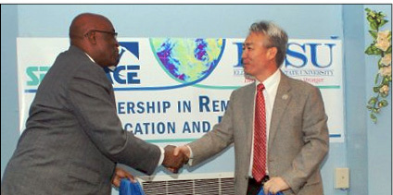
Overview
Memorandum of Understanding Signing
Dr. Willie G. Gilchrist Chancellor Elizabeth City State University
Mr. Hyong Ossi President/CEO SeaSpace

Slide 5
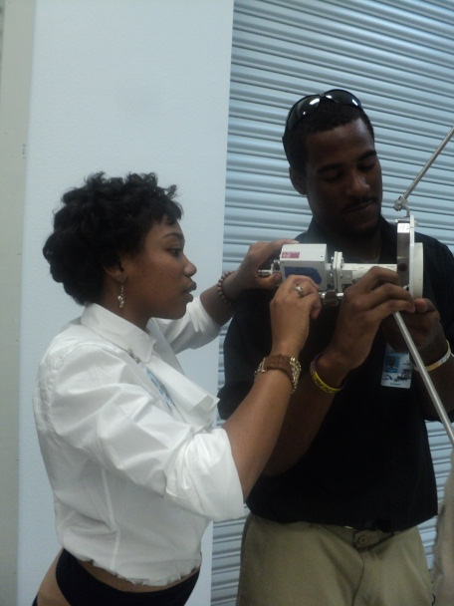
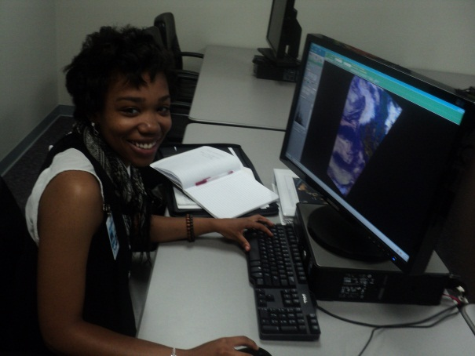
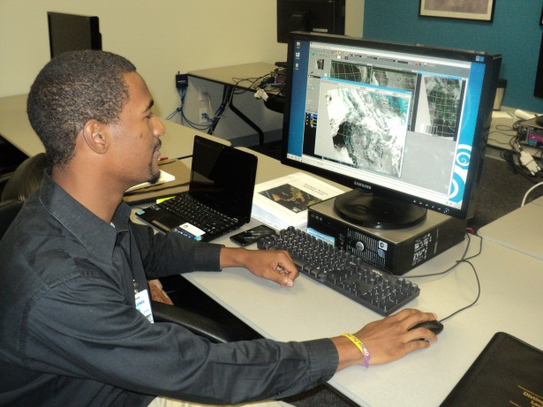
SeaSpace Corporation

Slide 6
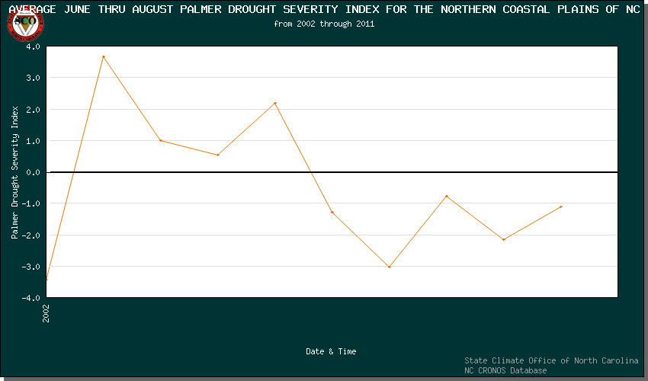
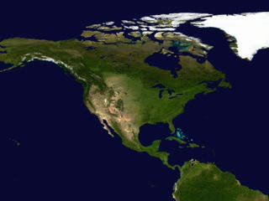
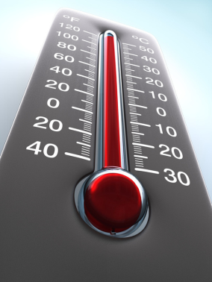
Purpose
2007

Slide 7
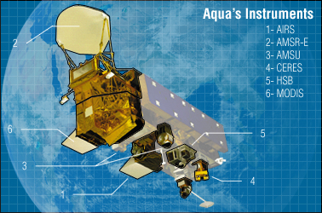
Aqua-1
Studies Water
6 Instruments
AIRS
AMSR-E
AMSU
CERES
HSB
MODIS
Operator | NASA
Satellite of | Earth
Launch date | May 4, 2002

Slide 8
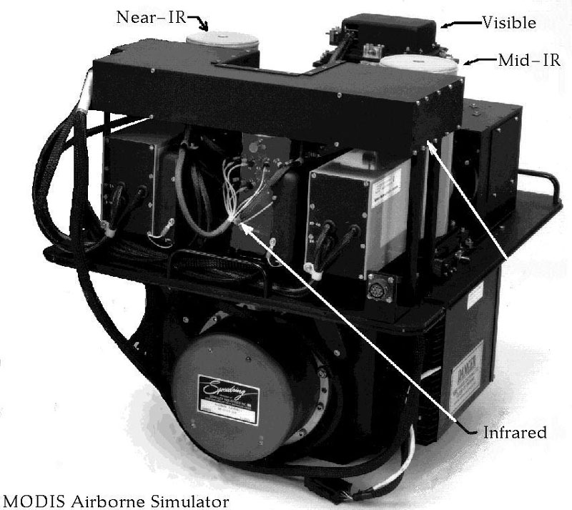
Moderate Resolution Imaging Spectrometer (MODIS)
Spatial Resolution
250 m (bands 1-2)
500 m (bands 3-7)
1000 m (bands 8-36)
Swath
2330 km (cross track) by 10 km
Design Life
6 years

Slide 9
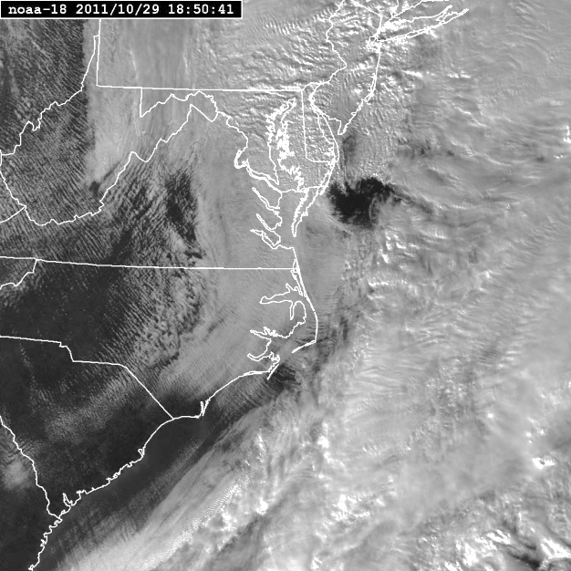
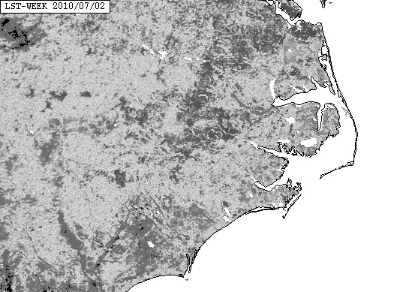
TeraScan Masters
Master Area
N 36 W 76
Coverage
GlobalECSU
LocalECSU
Area of Interest
Pasquotank County
Gates County

Slide 10
Land Surface Temperature
Composited Images of 2010-2011 of July thru August

Slide 11
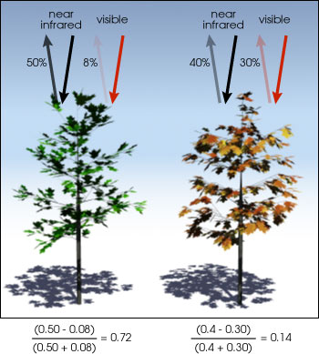
Normalized Difference Vegetation Index (NDVI)

Slide 12
Methodology
Laads_search
Laads_fetch.sh

Slide 13
Methodology
Making Composites:
Viewing Composites:
composite
Monthly
Yearly
tvis - TeraVision
tview - TeraView

Slide 14
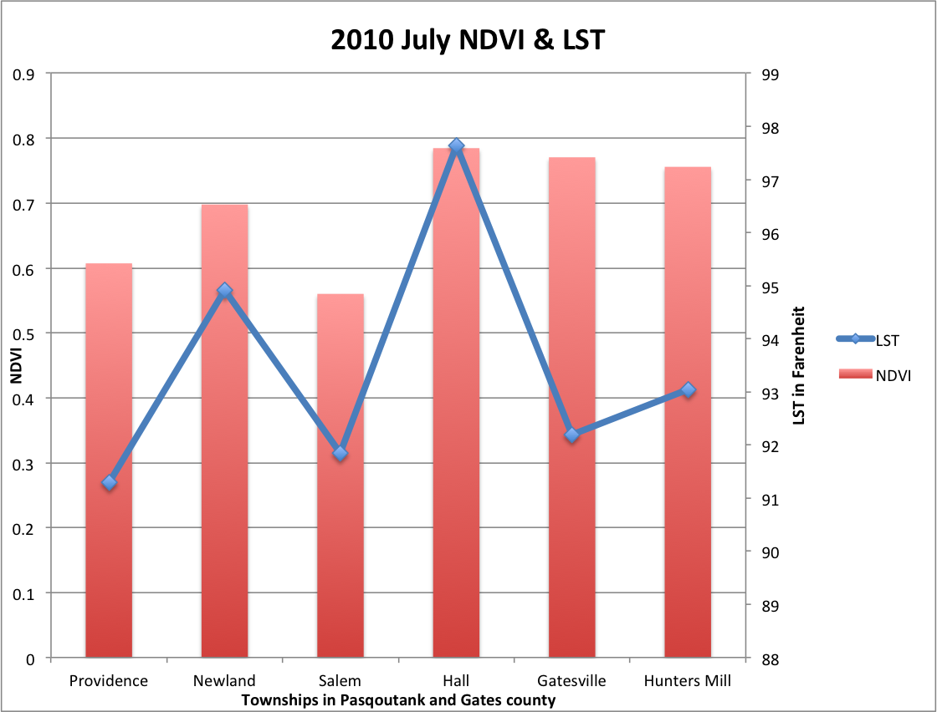
Analysis

Slide 15
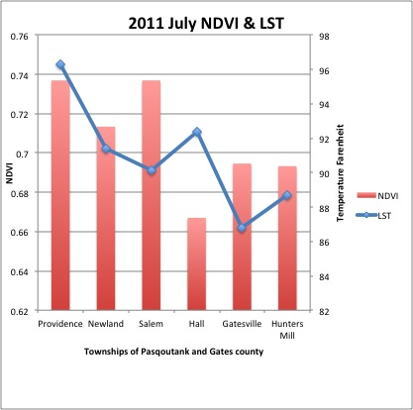
Analysis

Slide 16
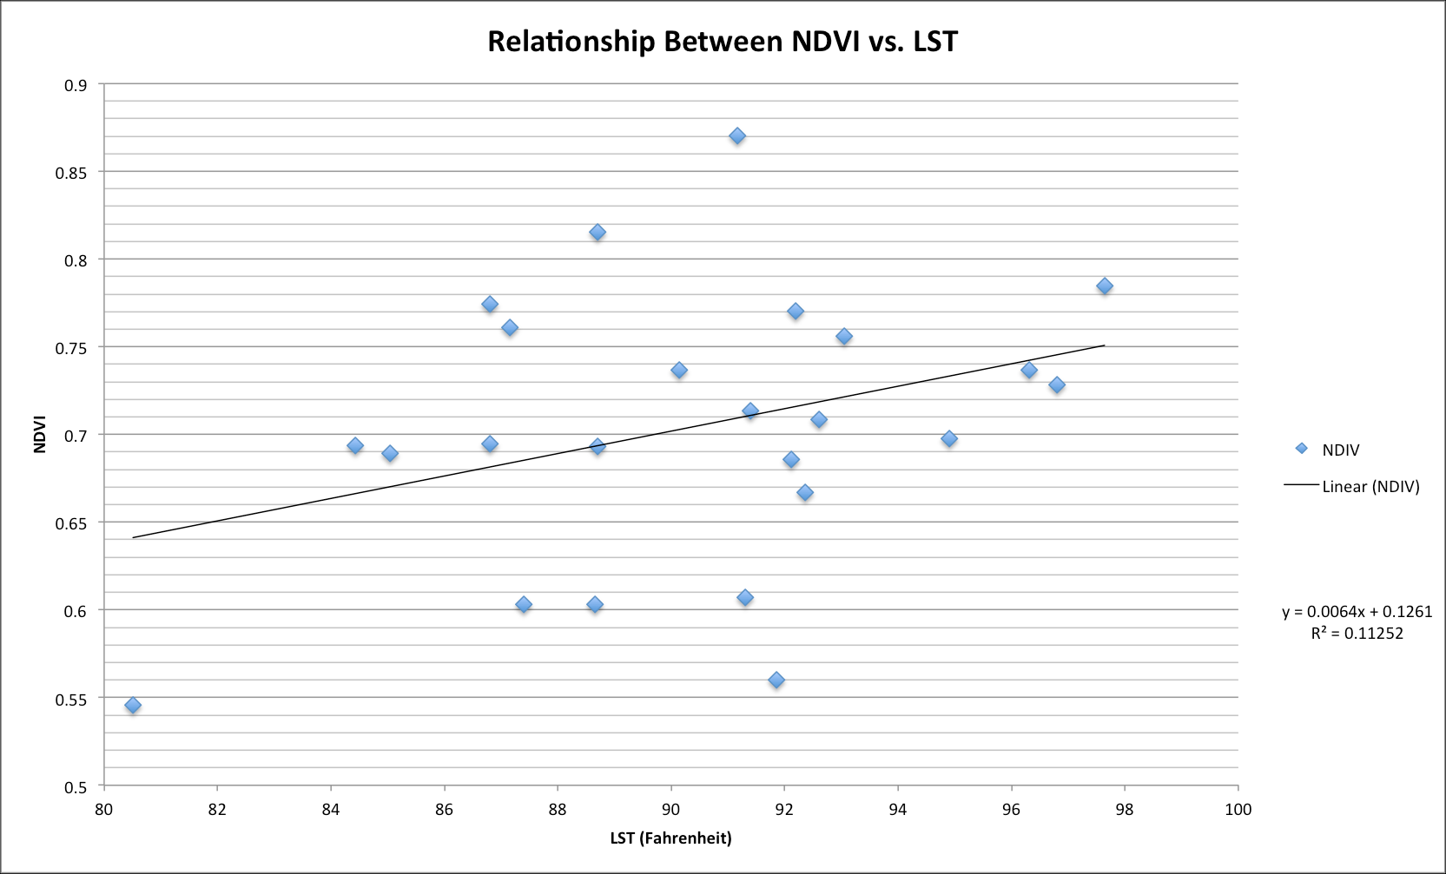
Analysis

Slide 17
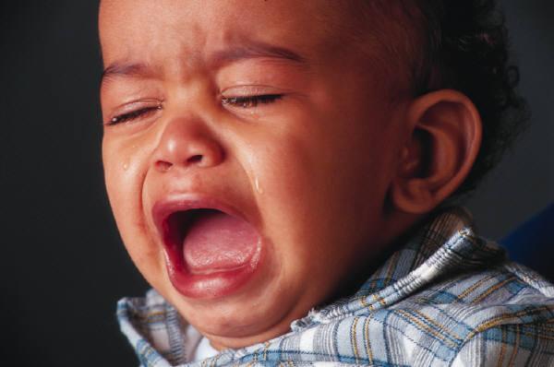
Conclusion
Little to no correlation between LST and NDVI
R² value ⁼11%
Additional Factors
Data

Slide 18
Future Work
Increased Data Set
Minimum 15 passes per month
Add years 2007 - 2009
Include June
Google Earth Layer
TeraScan System Update

Slide 19
Questions

