Slide 1
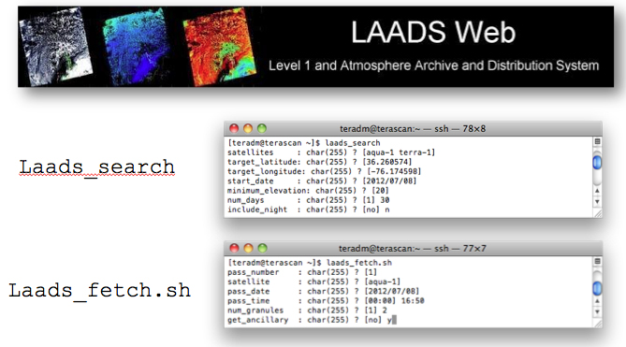
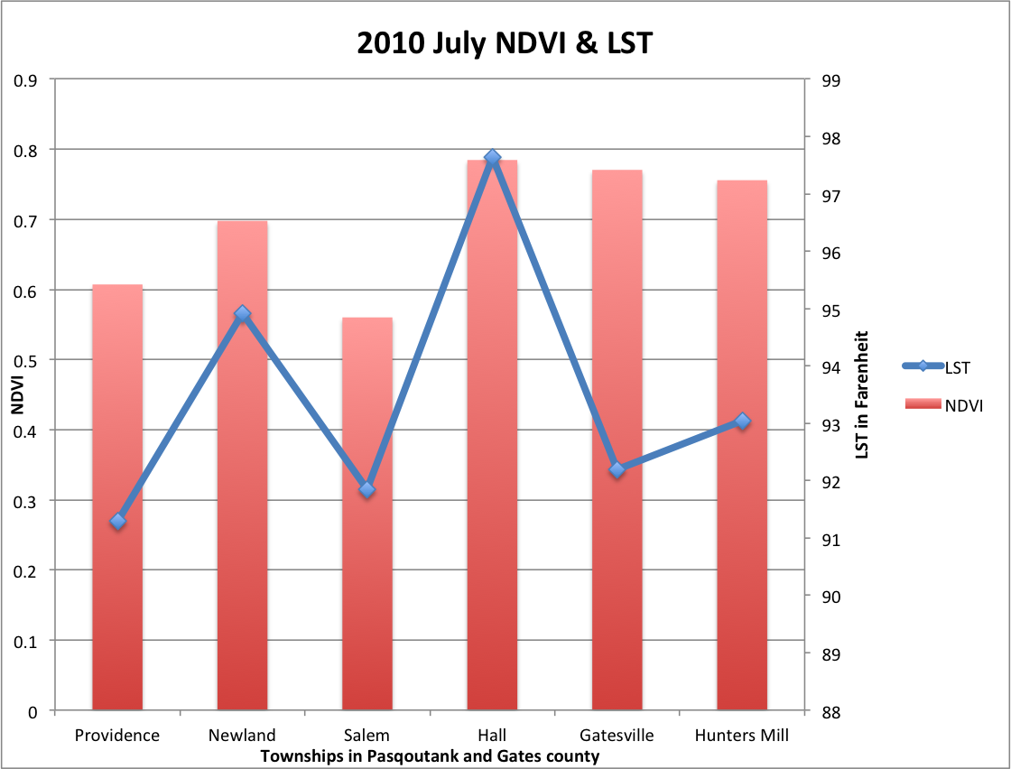
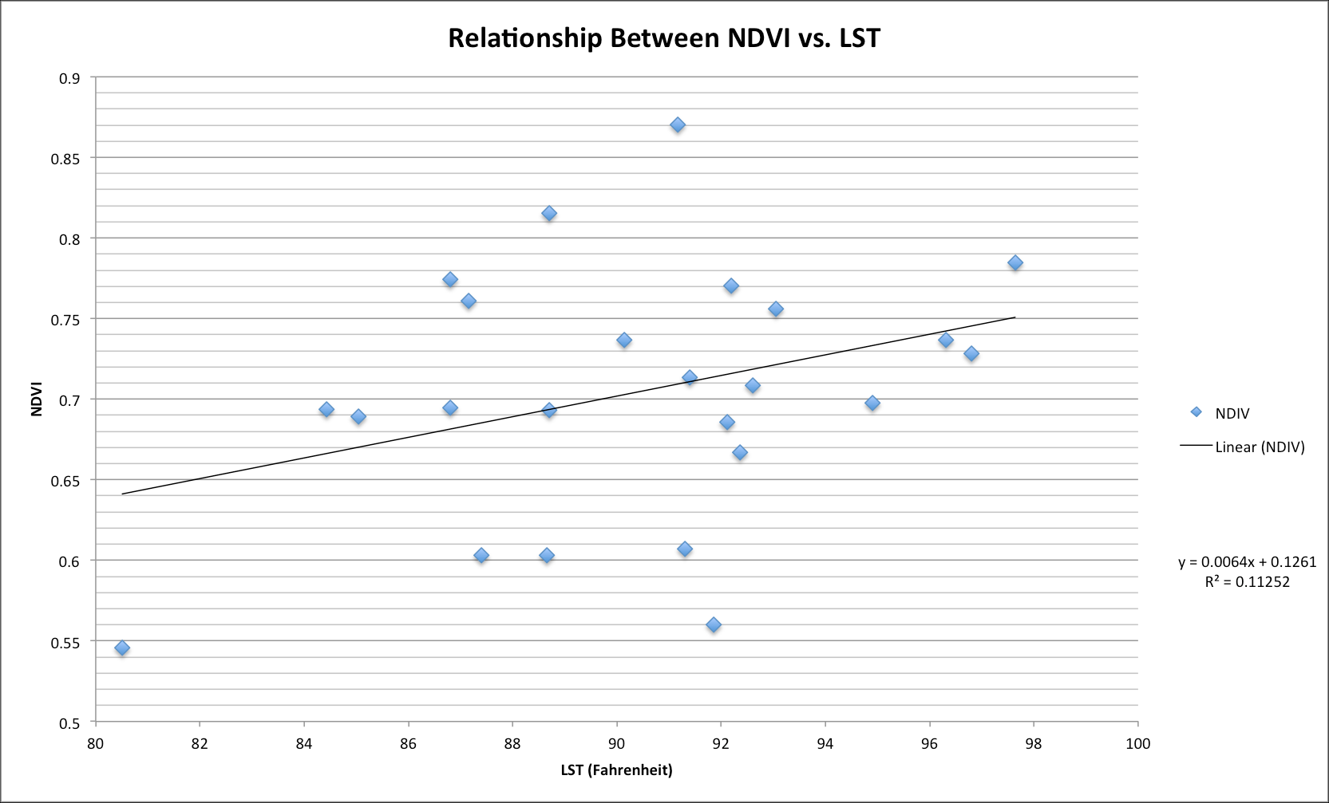
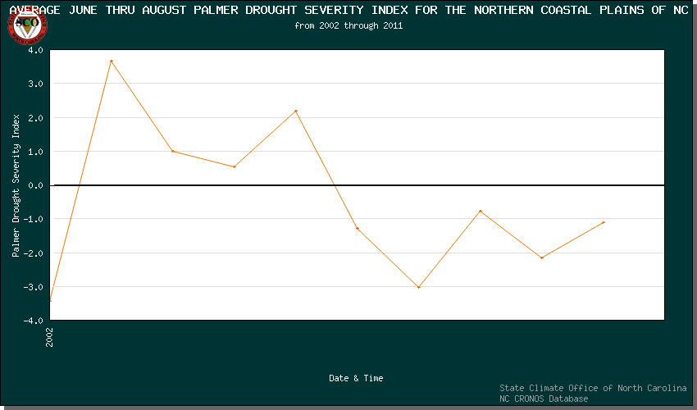
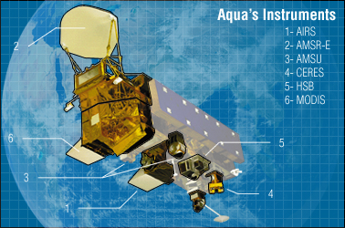
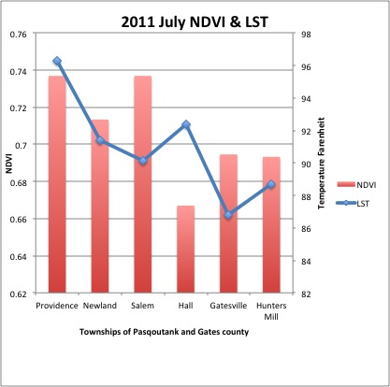
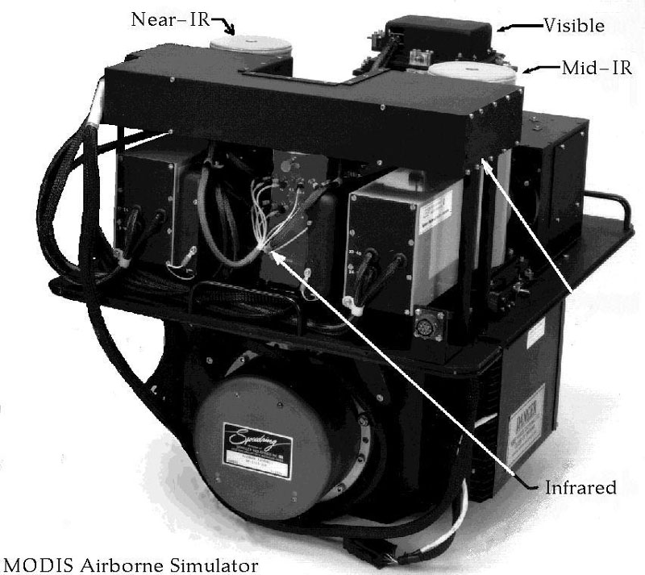
Analyzing Long-term Summer Drought Effects on Temperature and Vegetation Using Aqua-1 Satellite Data
Team Members: Autumn Luke (ECSU), Andrew Brumfield (ECSU) Mentor: Mr. Eric Baptiste (SeaSpace Corp.), Je’Aime Powell (ECSU Grid Manager)
METHOD
The question has been raised as to whether or not the long-term drought has an effect on temperature and vegetation. The team collected Aqua-1 passes along with the ancillary data in the period of 2002 to 2011 to determine if there was a change. Using LAADS website the team was able to access to MODIS, shown in Figure 2, Level 1 data for LST and NDVI products for July and August of 2010 and 2011. The used two commands in the terminal called “Laads_search” and “Laads_fethc.sh” to retrieve this data. Laads_Search presents a prompt with questions such as, the satellite name, lat/long locations, and the start date. Then it will ask for minimum sun elevation, the team’s data requires sunlight for the channels to gather data in NDVI and LST. To obtain good data passes the team set the lowest elevation at 50/55 and the set the amount of days of data needed (30 Max). (shown in Fig 2.)
Manipulating LST & NDVI
Viewing the data in terascan helps to see what's going on. Since there was no previous data shelf in terascan for LST and NDVI, the team must add them to the data shelf to be able to view and take info. Adding to the Data Library first select “Edit Data Library”, next select “Private Shelves” and click “New”. Find the Directory where the saved composite is located and click “Accept”. Name the Shelf “LST Month Year”, click “Accept”. Now move the cursor to “Data Types” then click “New”. Make sure the Data is Visible under “Files” and click “Accept”. Continue until all months for each year is in the “Data shelves” and begin to load all months of data in the same frame. Terascan default is to have LST values displayed in Kelvin Units and in Black & White. In order change kelvin units to Fahrenheit go to layers tool and select the layer with LST in the name. Click on edit to change units color scheme. To show the difference in temperature values, the palette blue, green, red, and yellow was used. Still in the layers tool, add land borders and current location. Then to add legends for the color palette, and add text uses the Annotate tool. To find a trend of LST /NDVI patterns in the summer months of July and August The team will take the values at lat/long locations in Pasquotank and Gatesville County. The townships chosen were Providence, Newland, and Salem in Pasquotank, Hall, Gatesville, and Hunters Mill Townships in Gates County. By using the survey tool the team then use the "Go to Cursor" to position the mouse over the townships lat/long location and record the value into Excel to generate a graph shown in Figure 3.
Analysis
The data shows that when the line of regression for LST decreases NDVI increases showing an in-constant inverse relationship between temperature and vegetation. July of 2011 LST values is greater than 2010 (shown in Figures 4 thru 5)and the LST value is greater in August of 2010 in comparison to 2011 shown in Figure 4.
Conclusion
There has been a question raised whether the severe long-term drought since 2007 in the Northern Coastal Plains of North Carolina has an effect on land surface temperature and vegetation. According to the team’s data analysis using linear regression NDVI and LST has 11% accuracy(Shown in Figure 6). Therefore the team concluded that there is no correlation between land surface temperature and vegetation due to long-term drought based on the data that was retrieved.
ABSTRACT
According to the State Climate Office of North Carolina, since 2007 the northern coastal plain of North Carolina has been experiencing a long-term summer drought. The primary goal of this research was to analyze the effects of long-term drought on land surface temperature and vegetation using satellite data. The team collected imagery data through the SeaSpace TeraScan system in order to produce land surface temperature and normalized difference vegetation index products. The data products were averaged into monthly and yearly composites so that the team could use TeraVision to depict the differences of values for the products.
INTRODUCTION
After observing the Palmer Drought Severity Index (PDSI) data sets for summer 2002-2011, provided by the State Climate Office of North Carolina Climate Retrieval Observations Network Of Southeast (CRONOS) Database, the team observed that there has been a long-term drought since 2007 in the Northern Coastal Plains of North Carolina [1] . The State Climate Office of North Carolina NC CRONOS defines that long-term drought as being cumulative, and their data representative of weather patterns of the current months in compared with previous months as shown in Figure1. Therefore the PDSI attempts to measure the duration and intensity of the long-term drought-inducing circulation patterns without including man made changes. The Palmer Z Index denotes dry and wet spells on a scale between -6 to 6, respectively as shown in Figure 1. After 2006 all PDSI values were negative, indicative of drought during the entire period.
The team’s objective is to analyze how long-term drought in summer months’ effects vegetation and land surface temperature in the Pasquotank and Gates county areas. The team chose to focus on the summer months, July through August, so that data results will not be skewed due to fall, winter, or spring seasonal conditions. Vegetation would be in various stages of change dependent on the season.. The polar orbiting satellite that carries a Moderate Resolution Imaging Spectroradiometer (MODIS) sensor that was chosen to retrieve data from was Aqua-1 [4]
Figure 2: Terascan commands for accessing LAADS website Database
Fig. 6
Figure 4-5: Excel Graph of 2010 & 2011 July NDVI & LST
FUTURE WORK
There are other objectives that the team can fulfill in this project to receive better results. A comparison of five years would better illustrate a pattern. Future work will include retrieving Aqua-1 Level 1 for the duration of the years 2007-2009 and combined it with the results from 2010-2011 by conducting a LAADS search as stated in the methodology. In the original comparison June had to be taken out of the analysis because all the products would not download. Therefore, in addition to including more years the team will also include the month of June. Future works for the project will include installing MODIS on the CERSER TeraScan system in Dixon Hall located on ECSU’s campus. Future work also includes the “kmz” files of LST and NDVI products of 2007-2011 downloaded on Google earth.
Figure 1: The Palmer Drought Severity Index attempts to measure the duration and intensity of the long-term drought-inducing circulation patterns.
Spatial Resolution
250 m (bands 1-2)
500 m (bands 3-7)
1000 m (bands 8-36)
ACKNOWLEDGEMENTS
We, the Seaspace Team would like to give a special thanks to Dr. Hayden, Mr. Je’Aime Powell our mentor, and The Staff at SeaSpace Corporation. Thank you.
References
1. State Climate Of North Carolina, (n.d.). US Drought Monitor of North Carolina. Retrieved from http://www.nc-climate.ncsu.edu/climate/climdiv.php
2. Zeer, J. (2012, June). Interview by CReSIS ECSU [Personal Interview]. Terascan training. , SeaSpace. , Retrieved from www.seaspace.com
3. Wiscombe, W., & Przyborski, P. (n.d.). Measuring Vegetation (NDVI & EVI) Retrieved from http://earthobservatory.nasa.gov
4. Dubey, K. (2012, June). Interview by CReSIS ECSU [Personal Interview]. Terascan training. , SeaSpace. , Retrieved from www.seaspace.com
5. Level 1 and Atmosphere Archive and Distribution System, (n.d.). Data Search. Retrieved from http://ladsweb.nascom.nasa.gov/data/
6. MODIS Land Surface Temperatur an Emissivity Algorithms and Products By Zhengming Wan University of California, Santa Barbara
Figure 3: LST shown from Teraview application in the TeraScan system

