Slide 1
Spectroscopic Image Signature Classification of Land Cover Types using Multi-Spectral Data within a Neural Network
Notes:
Char

Slide 2
Team Members
Bernard Aldrich Jr.
Charniece Huff
Mr. Je'aime Powell
Notes:
Char first
Good evening, my name is Bernard Aldrich Jr. and I am a rising JUNIOR at Jackson State University and my major is Computer Science.
Char last

Slide 3
Abstract
Through improvements in technology, high resolution multi-spectral imaging allowed new capabilities to become available in the remote sensing field. Spectral signature classification technologies existed in the chemical spectroscopy field to identify minerals by way of active systems [1]. The theory of this paper surrounded the premise that passive systems can provide spectral signatures of objects within images from satellite platforms. Specifically this paper targeted land cover types from the Kittyhawk, North Carolina area. Multi-spectral signals presented up to seven individual readings per pixel. As the decision support system, a neural network was trained to decide the type of land cover based on the band readings. In an effort to determine specific land cover types based on need, ground truthed spectral readings were also classified using a linear model to convert the readings into approximate satellite readings. The converted readings were then classified by the trained neural network. A minimal r-squared valued of 86% was required to be considered a viable method of image classification.
Notes:
Char

Slide 4
Introduction
Remote Sensing
Ground Truth
Landsat
Spectral Band
Spectrum
Spectral Signature
Spectrometer
Linear Regression
Neural Network
Multilayer Perceptron Function
Notes:
Char

Slide 5
Overview
Basic Concept
How to develop a sensor platform housing lab spectral equipment enabling use for field work?
What would be the best possible workflow to collect data using available equipment?
What correlation exists between Landsat readings and spectrometer readings if any?
How can a neural network be utilized to perform land cover classifications?
Can a Neural Network classify land cover types with at least 86% accuracy?
Notes:
The basic concept of our project was to gather ground-truthed spectral readings and match them to Landsat band data
to feed them into a neural network in order for that neural network to classify spectral signatures of two land cover types with at least 86% accuracy.
How to construct a sensor platform to house lab sensor equipment.
Design a workflow for quick data gathering in the field.
The correlation between Spectral Readings and Landsat Band Data.
How to train a neural network to be able to classify land cover types with at least 86% accuracy.

Slide 6
Software
Ocean Optics SpectraSuite
Google Earth
KMLCSV Converter
Creative Live! Central 3
Exelis ENVI 5.0
Google Spreadsheet
Microsoft Excel
The University of Waikato’s WEKA
Notes:
Used Ocean Optics Spectrasuite to take spectral readings.
Google Earth to import GPS coor. of a GPS system and save them as keyhole markup language files.
KMLCSV Converter to convert the kml files to comma separated value files.
Creative Live! Central 3 to capture reference images.
Exelis Envi 5.0 to obtain Landsat band data from the GPS coor.
Google Spreadsheet to enter in the data in one organized place.
Microsoft Excel to perform a linear regression on the spectral readings and Landsat band data.
And the University’s of Waikato’s WEKA to classify the land cover types.

Slide 7
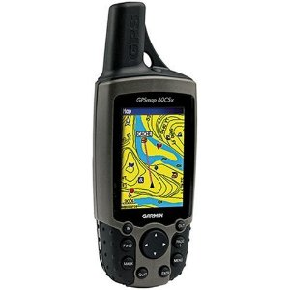
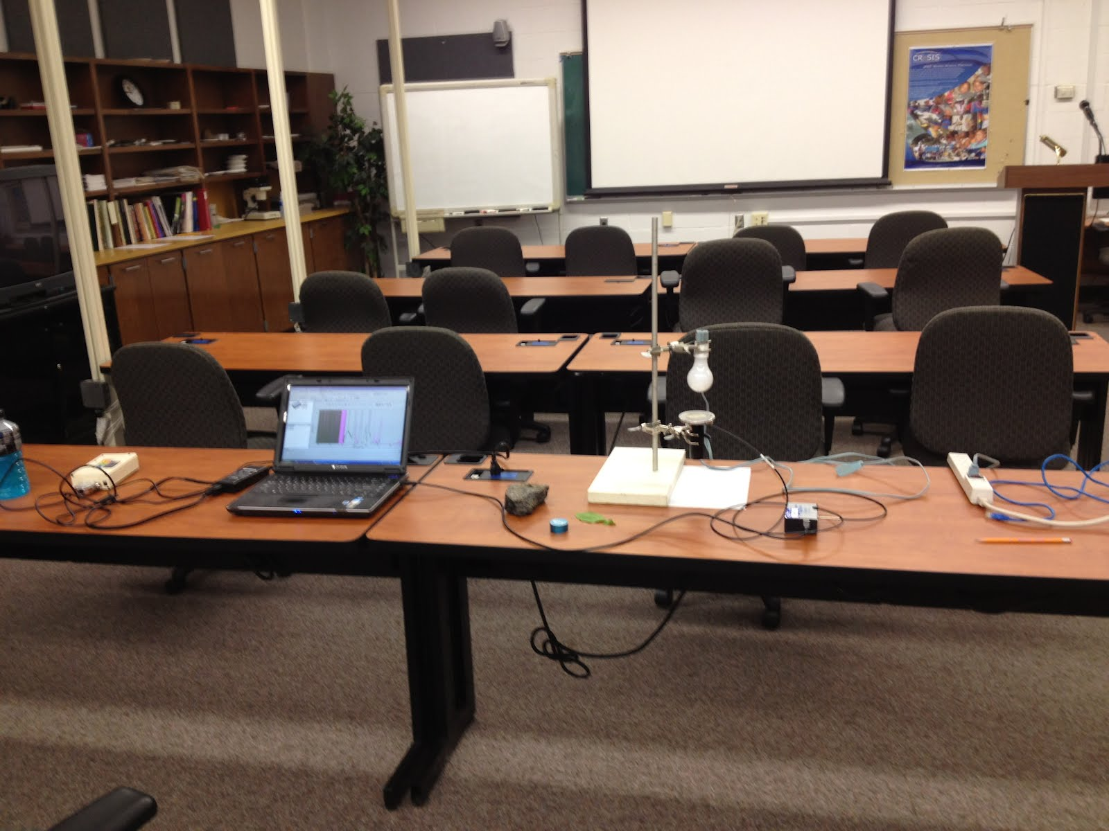
Hardware Materials
Ocean Optics Spectrometer
Creative Webcam
Garmin GPS 60CSX
ASUS Eee Netbook
Sensor Platform Instrumentation
Notes:
The Ocean Optics Spectrometer was used in order to gather the spectral readings.
Creative webcam to take the reference image of the sample location.
A Garmin GPS 60CSX system to mark and track the GPS coordinates.
An ASUS Triple E netbook to gather and store our data.
(Look and wait for Char to finish speaking)

Slide 8
Spectator Instrumentation Platform
Design Process
Sensor Platform
Field Use
Mobility Upgrades
Creative Commons Licensing
Notes:
Char

Slide 9
Initial Workflow
SpectraSuite
Google Earth
Fwink
Notes:
The initial workflow software included Google Earth, which was used to import, track, and mark the GPS coordinates;
Fwink, a webcam software that allowed the team to capture reference images of the sample locations;
and Ocean Optics SpectraSuite, which allowed the team to record spectral readings.
The picture shown in the bottom left corner of the slide is how we initially chose the sample locations.
We covered five sample locations, four on the outer corners and one in the middle, in order to stay inside of one pixel.

Slide 10
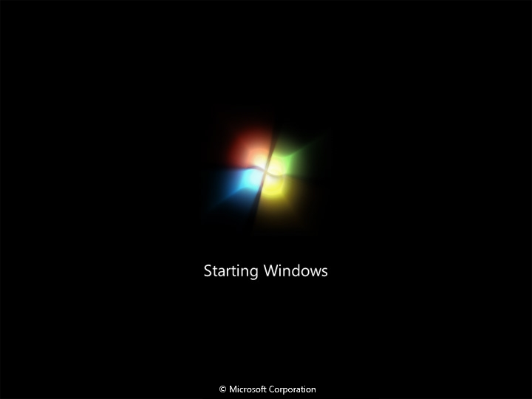
Initial Workflow Problems
GPS
Webcam
Saving/Opening Spectrum
Spectrometer Readings Maxed Out
ASUS Eee Netbook
File System
Notes:
Some of the problems with the workflow included Google Earth marking the exact same GPS coor. on different locations,
The webcam software Fwink had poor resolution and did not have a way of identifying the data that matched with the images,
The spectral readings would not open because the spectrum was not correctly saved,
The spectrometer reached the maximum of its readings, which was 65535
Every time the netbook was turned on, it would run updates to the Windows OS system,
And the file system was not accurate and the collected data would be unorganized.

Slide 11
Solutions
GPS mark
Google Earth for Import/Export GPS
Creative Live! Central 3
Exported to Tab Delimited
Changed the Integration Time
Turned OS updates off
Google Drive
Google Spreadsheet
Notes:
We used a Garmin GPS system to mark our coordinates,
Used Google Earth to import and export the GPS coordinates,
Creative Live! Central 3 to capture the image and turned on time-stamping,
Exported the spectrum files to tab delimited,
Changed the integration time and how much light the spectrometer was picking up,
And used Google Drive, specifically Google Spreadsheet, to enter in our data.

Slide 12
Final Workflow
Research Permits
Take Reference Image
Mark GPS
Save Spectrum
Add Data to Google Spreadsheet
Notes:
Char

Slide 13
Analysis
Step 1
Maximum Wavelength range of each Band
Step 3
Linear Regression
Step 4
Conversion
(Ex. 𝐿𝑎𝑛𝑑𝑠𝑎𝑡 𝐵2=.0032∗𝐵2+7.0011)
Used ENVI to gather Landsat Band Data
Step 2
Notes:
The maximum wavelength range of each of the four bands utilized was taken and recorded for each sample point.
The team then entered the GPS coor. into ENVI to gather the Landsat band data of each location.
The max ranges were then used with the Landsat data in order to perform a linear regression.
From this linear regression, a trendline was used in order to gather a conversion formula to convert spectral readings into Landsat band data in order to feed it into a nn.
The picture shown below is a sample of the data entered into the spreadsheet that was used to feed into the neural network.
The picture shown does not display all of the data of the locations, because there was much data that went with one location.

Slide 14
Linear Regression Graph
Function: y = 0.0023x + 44.322
R² value: R² = 0.8851
Notes:
This is an example of a linear regression graph that the team had to perform.
It compares spectrometer band illuminants to Landsat Brightness Values.
Also the line on the graph is the trendline of the data points that are displayed on the graph.
Under the graph, the function that the trendline produced, along with the r-squared value of the line are included.
The r-squared value is used to determine if the function is accurate and if it can be trusted.
The function would then be used to convert the spectral readings into Landsat band data.

Slide 15
Neural Network ARFF File
@relation classification
@attribute B1 real
@attribute B2 real
@attribute B3 real
@attribute B4 real
@attribute class {grass, sand}
@data
165.405684, 185.112108, 241.324249, 114.986068, sand
153.253059, 167.109644, 214.329759, 108.087694, sand
156.993043, 174.305388, 228.3534, 110.91757, sand
Notes:
Char

Slide 16
Neural Network Results
Sand
Grass
Notes:
Char

Slide 17
Conclusions
How to develop a sensor platform housing lab spectral equipment enabling use for field work?
What would be the best possible workflow to collect data using available equipment?
What correlation exists between Landsat readings and spectrometer readings if any?
How can a neural network be utilized to perform land cover classifications?
Can a Neural Network classify land cover types with at least 86% accuracy?
Notes:
How to house all of the sensors? Constructed an instrumentation platform called “The Spectator.”
How to design a workflow? Save the spectrum as tab delimited files,
mark and name the GPS coordinates on the GPS system, used Creative Live! Central 3 to take reference image, imported GPS coor. and save as kml files, converted files to csv files, entered data, and GPS to recover band data.
Correlation between landsat and spectral? Took max of each of 4 bands utilized, illuminants to brightness values.
Train Neural network? Use arff file and WEKA’s Multilayer perception function.
Yes, WEKA can classify land cover types.

Slide 18
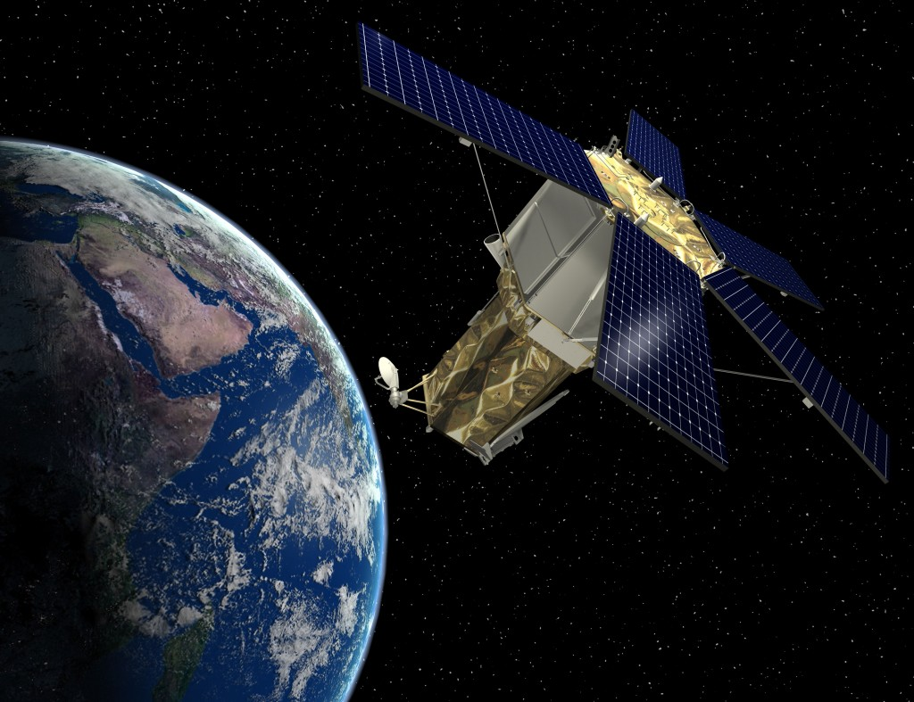
Future Works
Satellite
Hyper-spectral
Resolution
Increase data set
Mixed land cover types
Software Development
Notes:
Char

Slide 19
Questions?
Questions?
Notes:
Both answer Questions.

