Slide 1
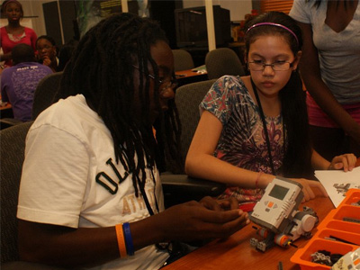
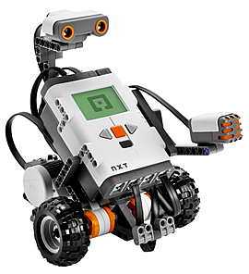
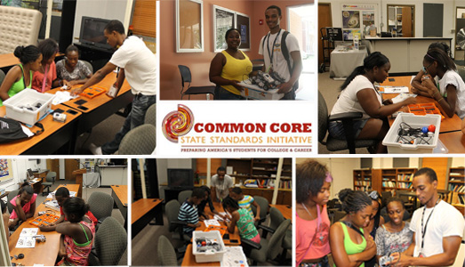
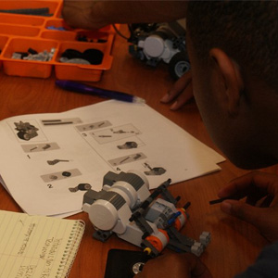
Applying Common Core Standards at the K-12 Academic Levels Using LEGO Robotics
Dezerae Little (Saint Augustine’s College), Derrick Jones ( Mississippi Valley State University) Mentor: Dr. Darnell Johnson ( Elizabeth City State University) Dr. Linda Hayden, Principal Investigator
Abstract
Common Core Standards includes critical content for all students in American education. Forty-eight of the fifty states have adopted the standards as of 2012. Previously, every state had its own set of academic standards and students in each state were learning at different levels. In the new global economy, all students must be prepared to compete with students from around the world. Students are expected to develop a deeper mastery of content and demonstrate what they know through writing and other projects. Changes to curriculum and instruction are more student-centered with greater focus on skills, abilities, and a shift towards more performance assessments. This research was designed to apply mathematical processes of the Comm.on Core Standard in a lesson plan for fourth through tenth grade students. The REU Mathematics team used NXT LEGO® Robotics to teach various scientific, mathematical, and design concepts, through designing, bprogramming the robots at each level. The students’ received hands on experience uilding, and with physics, mathematics, motion, environmental factors, and used problem solving in a collaborative group setting. The data was collected through observations.
Introduction
The North Carolina Mathematics Standard Course of Study is organized in five strands or goals for K-12: Number and Operations, Measurements, Geometry, Data Analysis and Probability, and Algebra. These are the objectives for each goal in competencies at each grade level and throughout the high school courses. It is the framework upon which classroom instruction and assessment should be planned. It is the ultimate guide for textbook selections and the foundation of the North Carolina testing program. On June 2, 2010, North Carolina adopted the Common Core State Standards in K-12 Mathematics and K-12 English Language Arts released by the National Governors Association Center for Best Practices and the Council of Chief State School Officers. [2]
The Common Core State Standards Initiative is a state-led effort coordinated by the National Governors Association Center for Best Practices (NGA Center) and the Council of Chief State School Officers (CCSSO). The standards were developed in collaboration with teachers, school administrators, and experts, to provide a clear and consistent framework to prepare our children for college and the workforce. The Common Core Standard is designed to build upon the most advanced current thinking about preparing all students for success in college and their careers. [2]
The mathematics education team applied the standard on grades four through ten. The team’s project was designed to teach the students how to build NXT LEGO® Robotics and program them to complete an obstacle course using the 5E (Engagement, Exploration, Explanation, Elaboration, and Evaluation) style lesson plan. The 5E teaching style is inquiry-based learning. In an inquiry-based classroom, the teacher's role becomes less involved with direct teaching and more involved with modeling, guiding, facilitating, and continually assessing student work. The team worked with three different groups of students: elementary, middle and high school students. Within every section, the students were randomly grouped (3 to 6 members) with peers. The students used basic mathematical, problem solving, and teamwork skills to complete the task given to the group. The members of the mathematics education team took the role of teachers. The team followed the guidelines written out in the Common Core Standard as well as using the 5E lesson plan method.
Results
The Common Core State Standards Initiative is a state-led effort coordinated by the National Governors Association Center for Best Practices (NGA Center) and the Council of Chief State School Officers (CCSSO). The standards were developed in collaboration with teachers, school administrators, and experts, to provide a clear and consistent framework to prepare our children for college and the workforce. The Common Core Standard is designed to build upon the most advanced current thinking about preparing all students for success in college and their careers.
Future Work
This study was completed during several one-hour sessions for each grade level of K-12 student groups. The research further determined the success of the study but a longer time frame of one semester is strongly recommended. A period of at least eight three hour sessions on Saturday workshops or academies would allow in depth instructional time with robotics. The amount of data needed to measure enhanced student learning would be acquired as well.
A second recommendation would be to obtain one NXT LEGO® Robot per every two students. On the average, there were four students to a NXT LEGO® kit per team operating one robot. This process compromised equal time in robot assembly for each student. Installation of the NXT LEGO® Robotics software on laptop computers would be required for instruction purposes. The mathematics team experienced problems finding a definite location to teach the class, assemble and program the robots.
The final recommendation for future research would include a work session for per-service educators as well as teachers at the elementary and middle levels.
Using the 5E Lesson Plan
The 5Es represent five stages of a sequence for teaching and learning: Engage, Explore, Explain, Extend (or Elaborate), and Evaluate.
Engagement
The purpose for the engagement stage is to peak student interest and get them personally involved in the lesson, while pre-assessing prior understanding.
Exploration
The purpose for the exploration stage is to get students involved in the topic, providing them with an opportunity to build their own understanding. Through self-designed or guided exploration students make hypotheses, test their own predictions, and draw their own conclusions.
Explanation
The purpose for the explanation stage is to provide students with an opportunity to communicate what they have learned so far and figure out what it means . Explain is the stage at which learners begin to communicate what they have learned.
Elaboration
The purpose for the elaboration stage is to allow students to use their new knowledge while continuing to explore its implications. At this stage students expand on the concepts they have learned, make connections to other related concepts, and apply their understandings to the world around them in new ways.
Evaluation
The purpose for the evaluation stage is for both students and teachers to determine how much learning and understanding has taken place. Evaluate, the final "E", is an on-going diagnostic process that allows the teacher to determine if the learner has attained understanding of concepts and knowledge
Figure 1. Shows the male to female comparison in the Elementary Group as well as the students attending
Figure 4. Shows the minutes taken assembling and Programming of the robots for each level of students
Figure 2. Shows the male to female comparison in the Elementary Group as well as the students attending
Acknowledgements
The 2012 Mathematics Team would like to thank Principal Investigator, Dr. Linda B. Hayden, for making the Research Experience for Undergraduate in Ocean, Marine, and Polar Science. The team would also like to give a special thanks to teachers; Mr. Daron Moore, Mrs. Veronica Williams, and Mrs. XXX in their support of the project. The team would also like to thank Dr. Darnell Johnson for being an incomparable mentor and a very special thanks to Mr. Je'aime Powell for constantly installing the NXT LEGO Robotics software.
Conclusion
The main focus of this research project was to apply the principles of the Common Core Standard adopted by the state of North Carolina while using the 5E lesson plan format and inquiry-based learning. The overall goal of this project was to examine the effectiveness of this Standard as it is implemented in the classroom setting. Observations were done at the elementary, middle, and high school levels to perceive how the students learned and responded to the Standard. The teaching strategies used assessed the students’ independent learning abilities, enhanced thinking skills, and produced cooperation in the group setting. Further research on the applications of the Common Core Standards in mathematics needs to be done to on this project to get a clearer analysis of the effectiveness of The Common Core Standard.
References
[1] (2012) Center for Remote Sensing of Ice Sheets (CReSIS) [Online]. Available: https://www.cresis.ku.edu/
[2] (2012) Common Standards [Online].Available: http://www.corestandards.org/
[3] (2011, August 22) Advantages and Disadvantages of OOP [Online]. Available: http://www2.tcl.tk/13398
[4] (2012, February 24) 5Es Overview: “The 5E instructional model” Available: http://www.nasa.gov/audience/foreducators/nasaeclips/5eteachingmodels/index.html http://www.nasa.gov/audience/foreducators/nasaeclips/5eteachingmodels/index.html
[5] (2010) North Carolina Essential Standards Physics [Online]. Available:http://www.ncpublicschools.org/docs/acre/standards/new-standards/science/physics.pdf
[6] (2009, March 4) Crosswalk of the Common Core Standards and the Standards for the 21st-Century Learner [Online]. Available: http://www.ala.org/aasl/guidelinesandstandards/commoncorecrosswalk
Figure 3. Shows the male to female comparison in the High School Group as well as the students attending

