Slide 1
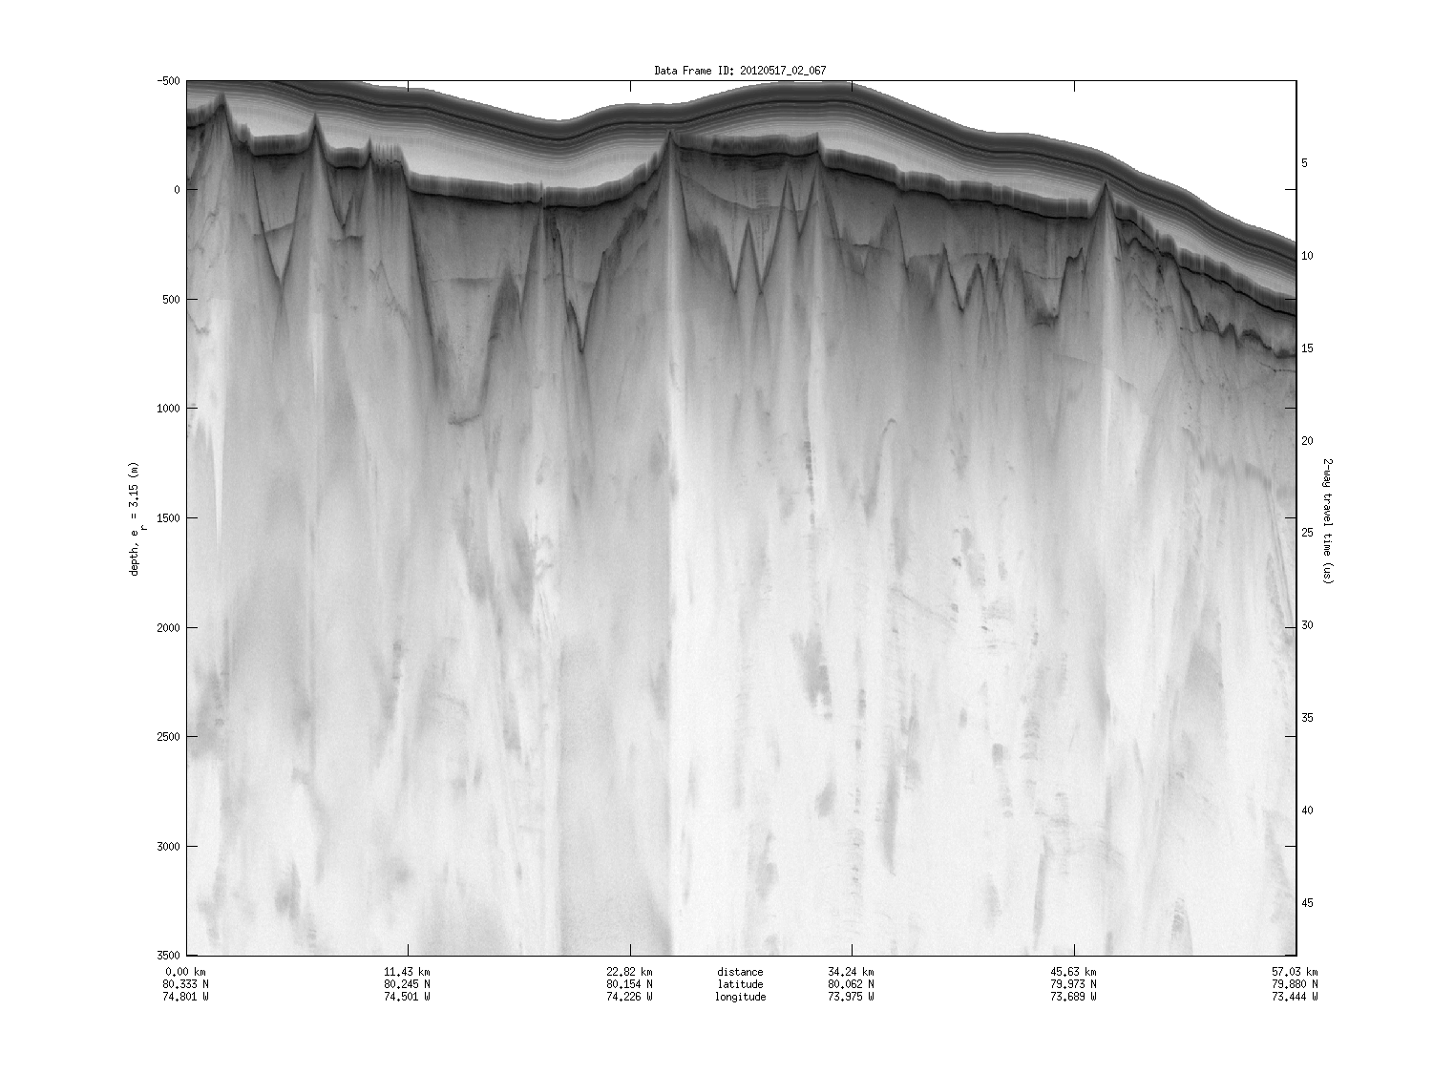
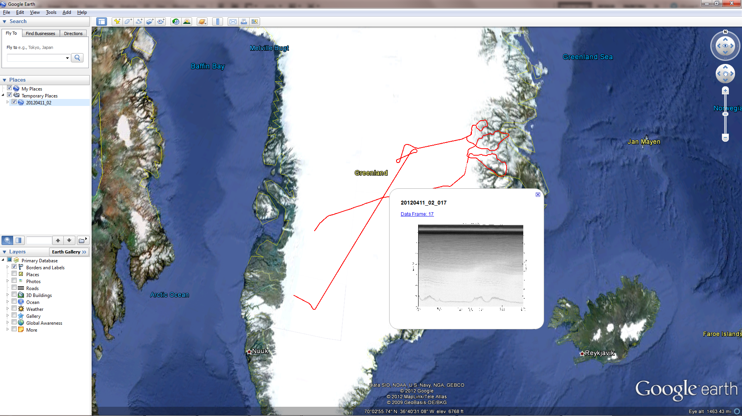
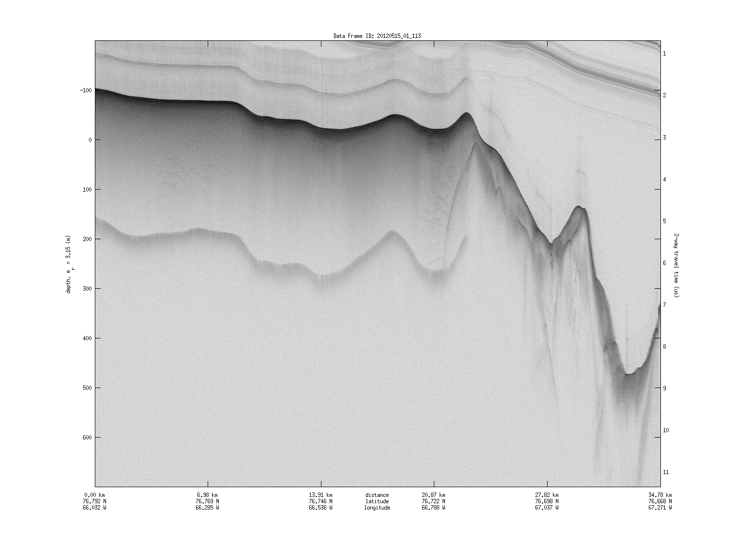
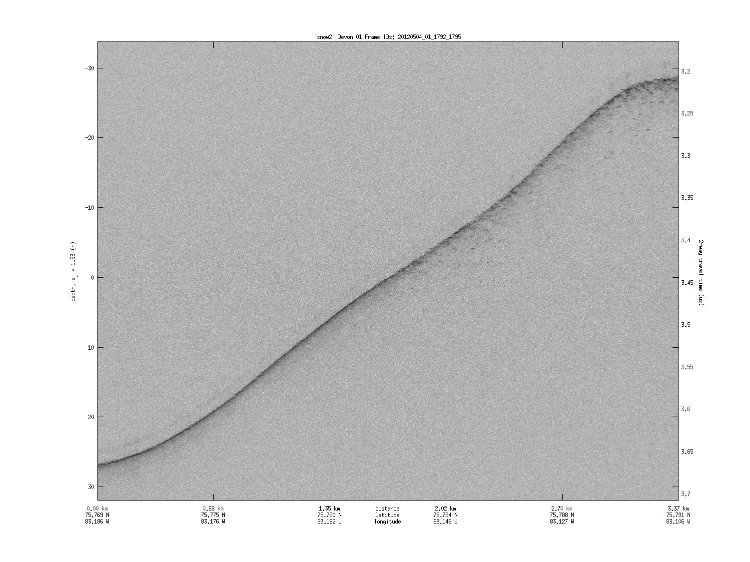
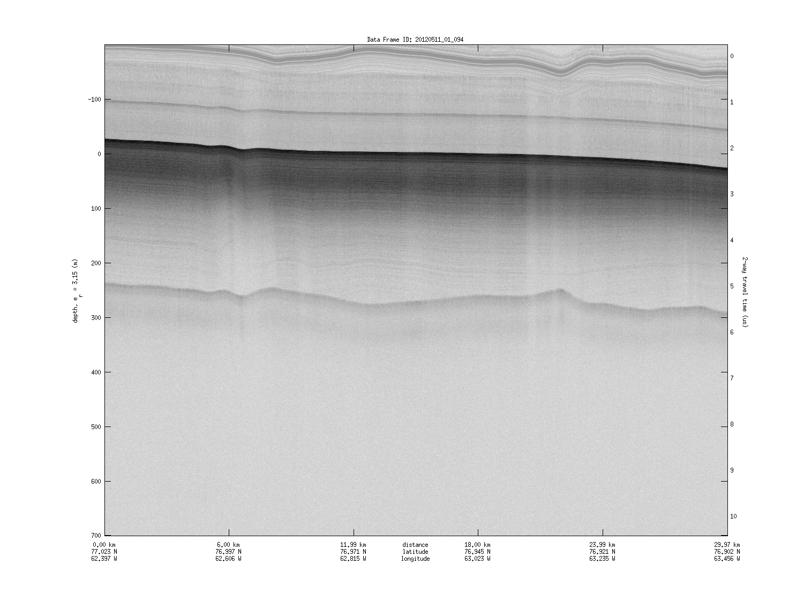
Utilizing Various Data Sets from the CReSIS Data Archives to Visualize Echo Information at Specific Locations in Google Earth
Shaquia Johnson (Mississippi Valley State University ), Maya Smith (Winston Salem State University) , Mentor: Mr. Jeff Wood (Elizabeth City State University ), Principle Investigator : Linda B. Hayden
ABSTRACT
Since 1993, the Center for Remote Sensing of Ice Sheets (CReSIS) has been gathering ice thickness data in Greenland. This information is in various formats such as: Postscript Document Format (PDF), Joint Photographer Expert Group (JPEG), Keyhole Markup Language (KML), and Comma Separated Values (CSV). These formats display data in individual visualizations while another format; Matrix Laboratory (MATLAB) will display multiple sources of data, but in the proprietary software application only. The goal of this project was to combine the non-MATLAB visualizations into one window utilizing the PHP Hypertext Preprocessor scripting language and Google Earth. These product files would be simple in their construction, easily adaptable to new data formats, and provide continued display of newly acquired data. The PHP Hypertext Preprocessor language was used to modify the Keyhole Markup Language files to add description tags in order to display data from other formats. The combined files were displayed in the geographical program Google Earth available as a free download to users.
EXTENSIBLE MARKUP LANGUAGE DOCUMENT OBJECT MODEL
Extensible Markup Language Document Object Model (XML DOM) defines the objects and properties of XML elements, and the methods to access them. XML DOM is a standard for how to get, change, add, or delete XML elements, which are called nodes. The PHP core provides access to XML DOM parser functions removing the need for any additional software installations.
The XML DOM views an XML document as a tree-structure. There are several different types of nodes, such as: element nodes, attribute nodes, comment nodes, and node-trees. Their contents can be modified or deleted, and new elements can be created. The node tree shows the set of nodes, and the connections between them. The nodes in the node tree have a hierarchical relationship to each other. The terms parent, child, and sibling are used to describe the relationships. The top node is called the root and any node (Parent) can have an infinite number of children. A leaf is node with no children whereas sibling nodes all have the same parent.
CONCLUSION
XML DOM PHP scripting is a valid tool to be used in modifying and visualizing KML data files from CReSIS. More work needs to be done in order to increase the amount of data that can be viewed in this manner. Better organization, scripting reviews and rewriting, and the provision of more presentation software applications will enable developers to quickly present information to users as needed. Developers should continue to focus on Google Earth as a main presentation software, but move to Google Maps or other mapping software when able. The use of the PHP XML DOM configuration of development enabled quick development of the commands needed and produced a small file to complete the task.
FUTURE WORK
In this research the information that was utilized was from the 2012 Greenland expedition using the P3 aircraft. The data type that is displayed within this research is JPEGs images of echograms. Future projects should look at adding other data types (CSV, PDF) to description tags for display will be needed.
To overcome of the obstacles with the research project, the team had to create a text file for each location of echograms because the echograms and maps are located in the same file. In the future, creating a code that will locate the echogram file on the CReSIS site will be more useful. Creating code that passes the flight selection and images into variables instead of creating individual pages for each flight will also be work for the future teams.
To view the results of research, Google Earth has to be downloaded to the user's workstation. Implementing the code in Google Maps for online access without downloading the Google Earth application or giving the user the options to open with Google Maps or Google Earth would assist users who do not have the permission to install software.
At the current time the years from 1993 to 2011 data are not being used. In the future researchers should be able to work with older KML files, which display points instead of segments and also utilize the older data. The team also had a difficult time with matching the echograms to the flight path files. Researchers should work with CReSIS to better organize their data files and provide better consistency as to how the data is presented.
Figure 3 – Radar Depth Sounder
Figure 6
DATA MANIPULATION
The PHP/KML modification file starts with the definition of the function "output_file." This function reads the modified file and supplies the mime type to the browser so that the KML file is opened in the Google Earth application. This function was copied from the website "How To Force File Download With PHP "[2] and modified to include the KML+XML mime type. The first step of the actual modification process was to import the URLs to the echogram images on the CReSIS web site. These URLs were packaged into a CSV file due to their storage directory also containing other files. These URLs were then placed into an array to be called later in the file. The next step in the modification file was to import the contents of the current KML file from the CReSIS site. This involved the use of the PHP command "file_get_contents" to place the contents into a variable. Once the data from the CReSIS KML file is downloaded and the CReSIS KML file is closed, a local temporary file: tempKMLflight.kml, is opened. The data from the CReSIS KML file is then loaded into the temporary file and the file is closed.
Once the reading section of the code is complete, the modification section begins. First a new DOM document is created to hold the structure of the temporary XML document previously created. The temporary file is loaded into a variable and the first node is located. This node is the root node and all other elements within the file are contained within this node. The next step is to locate and count each of the "Placemark" elements, as these are the
elements, which separate each of the strings of coordinates, which are linked to a particular echo image. Now that the data has been loaded and the "Placemarks" located, a loop is begun to perform the actions of building the value for the new "description" element for each "Placemark" element. This value includes PHP variables and HTML code for displaying a reduced version of the echogram image and a link to the actual image. Once this value is assembled, a new node titled "description" is created. This is repeated for each "Placemark" within the temporary KML file.
Once the loop is completed, the tempKMLflight.kml file is saved. A call is then made to the function "output_file" with the parameters "name", "path", and "mime-type" which downloads the tempKMLflight.kml file and attempts to open the application Google Earth. This function will not override mime a setting on a local computer set by a user and behaves in different manners with different browsers. Some browsers will simply download the file (Chrome) while others (Safari, Firefox, Explorer) will download and prompt you as to whether you would like to save or open the file.Examples of modification files at work can be found at: http://nia.ecsu.edu/reuomps2012/teams/data/x/. The files listed are representative of those flights that had corresponding data available in the correct format (PNG).
Figure 1- Accumulation Radar
Figure 4 – Snow Radar
RESULTS
The final PHP files developed were able to import data from two separate sources and combine them into one visualization. This visualization enables users to view both the flight path and the radar echogram images in one window with a minimal amount of coding taking place. The final script, including comments, was 52 lines with only two inputs needing change if a new flight is desired (CReSIS KML File location, Echogram image URL text file). Though various other methods and scripting languages were attempted, the use of the XML DOM application-programming interface (API) allowed the most versatile and minimal amount of programming to accomplish the goal of data integration. Figure 6 displays the overall results of this project.
ACKNOWLEDGEMENTS
The 2012 Database Team would like to thank Principal Investigator, Dr. Linda B. Hayden, for making the Research Experience for Undergraduate in Ocean, Marine, and Polar Science. We would also like to thank CReSIS for making the data available. In addition we would like to thank Mr. Jeffrey Wood for being an exceptional mentor.
References
[1] (2012, June 29) PHP: strpos - Manual [Online]. Available: http://www.w3schools.com/php/func_string_strpos.asp
[2] (2007, August 12) How To Force File Download With PHP [Online]. Available:http://w-shadow.com/blog/2007/08/12/how-to-force-file-download-with-php/
[3] (2012, February 24) KML Tutorial [Online]. Available: https://developers.google.com/kml/documentation/kml_tut
[4] (2012, June 29) PHP Document Object Model [Online]. Available: http://php.net/manual/en/book.dom.php
[5] W3C Tutorials and Reference [Online]. Available: http://www.w3schools.com/dom/default.asp
[6] (2012, June 29) PHP: fgetcsv - Manual [Online]. Available: http://us3.php.net/manual/en/function.fgetcsv.php
[7] PHP Tutorial - File Write [Online]. Available: http://www.tizag.com/phpT/filewrite.php
[8] L. Welling and L. Thompson, PHP and MySQL Web Development, (4th ed.). Addison Wesley, 2009.
[9] PHP XML DOM [Online]. Available: http://www.coursesweb.net/php-mysql/php-xml-dom
[10] CReSIS Data [Online]. Available: https://www.cresis.ku.edu/data
[11] PolarGrid GIS Server [Online]. Available: http://gf2.ucs.indiana.edu/
[12](2000, November 13) P. Le Hégaret, L. Wood, and J. Robie. “What is the Document Object Model?” [Online].http://www.w3.org/TR/DOM-Level-2-Core/introduction.html
Figure 2 – KU Band Radar
Figure 7 – 52 Lines of code

