Slide 1
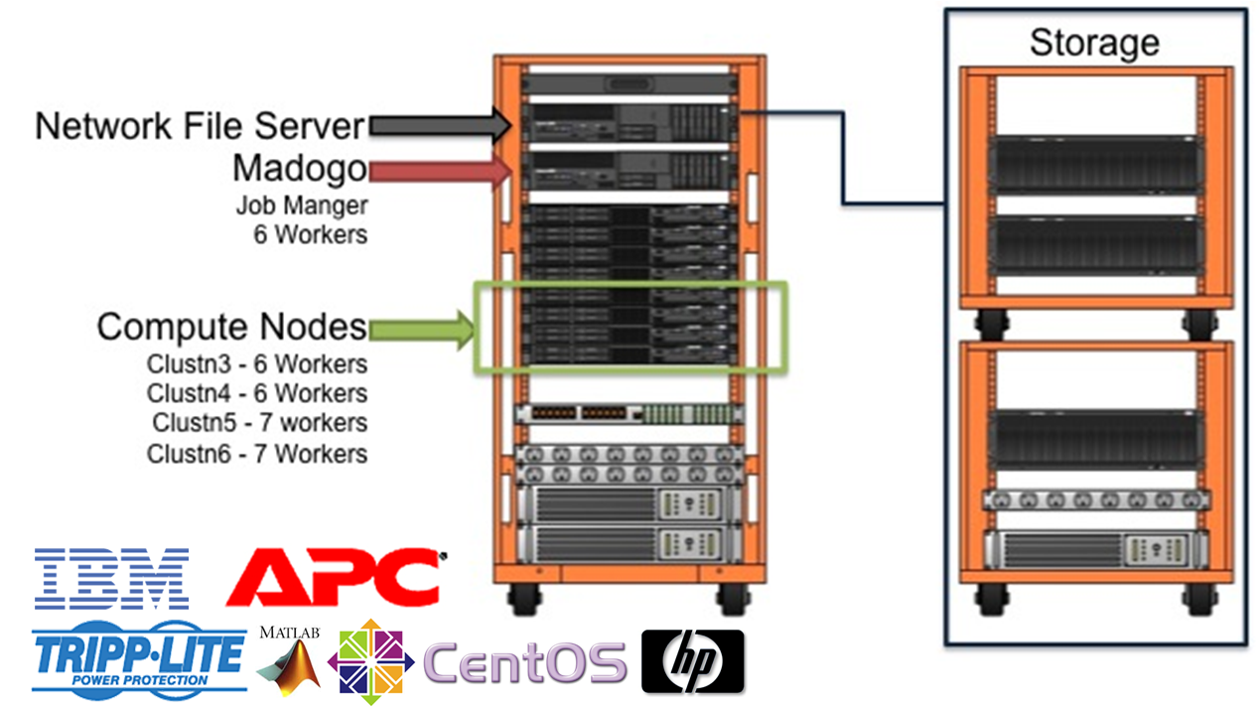
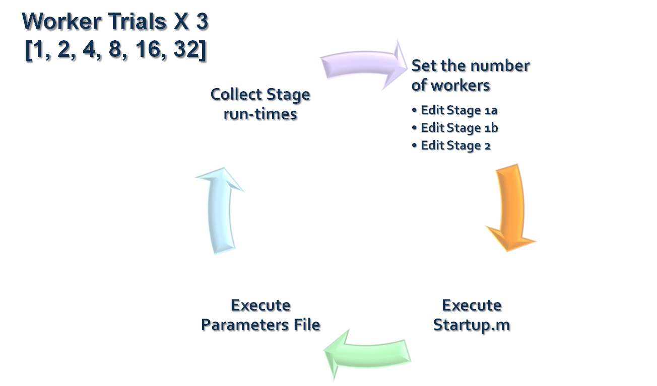
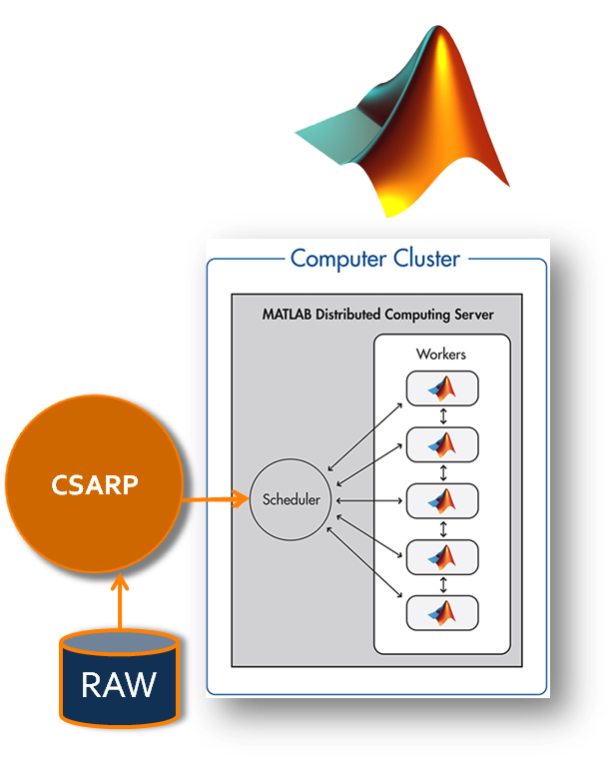
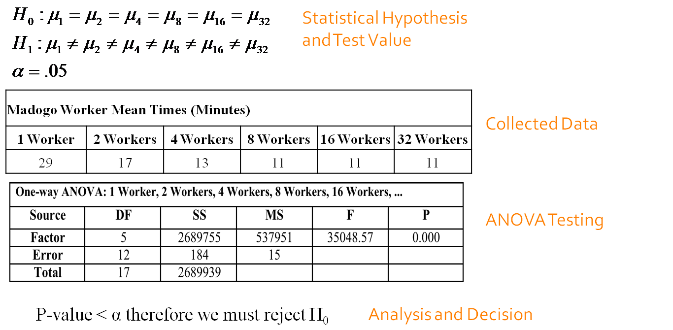
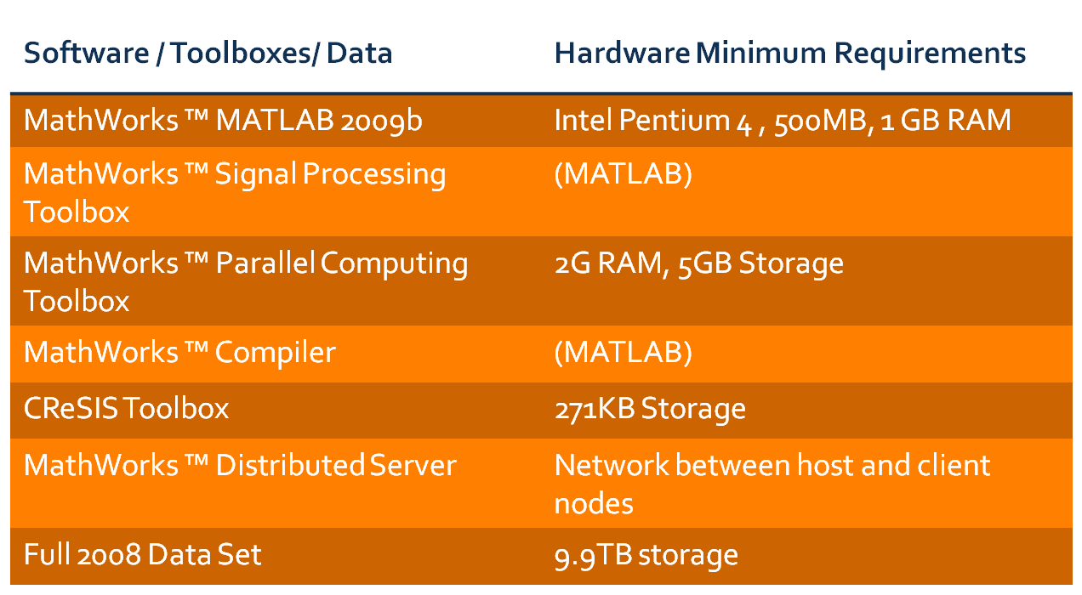
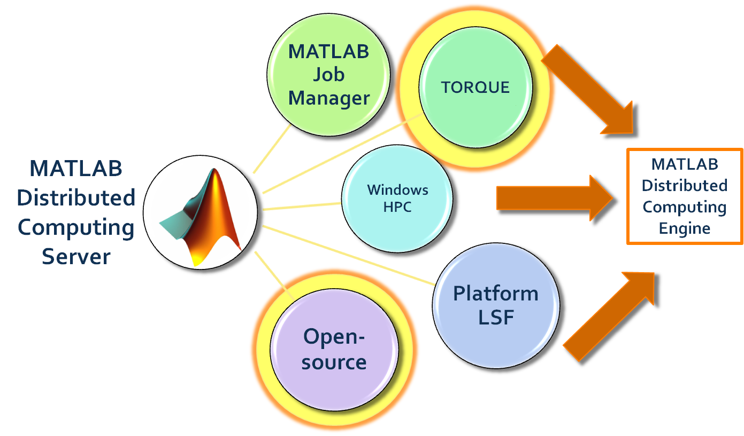
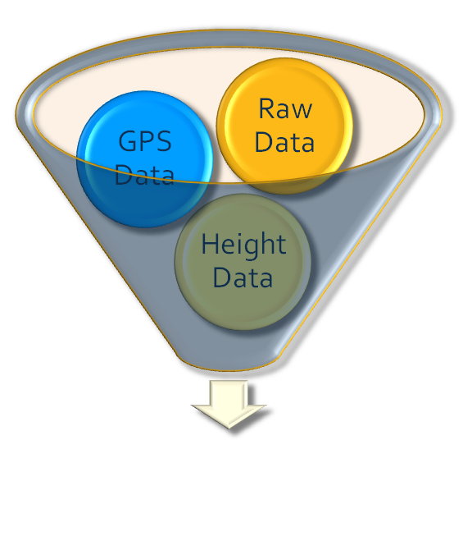
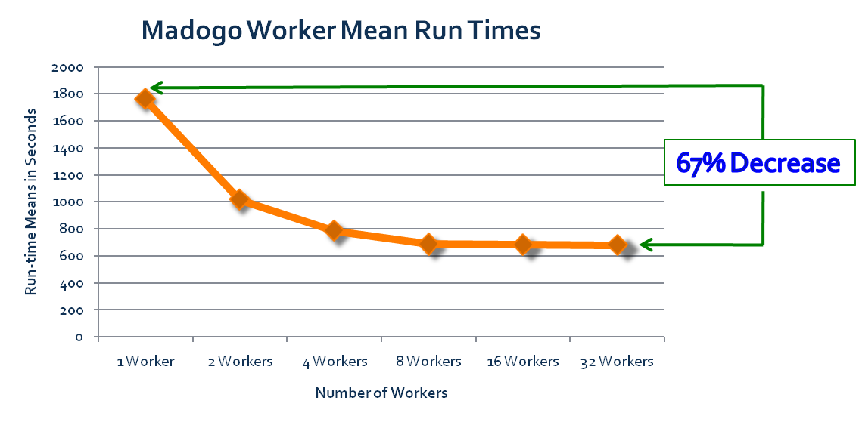
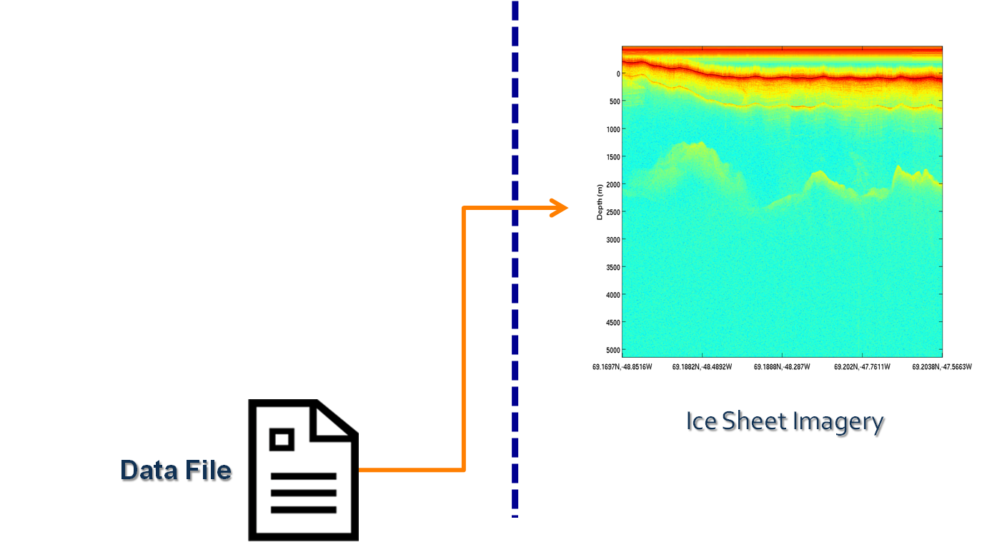
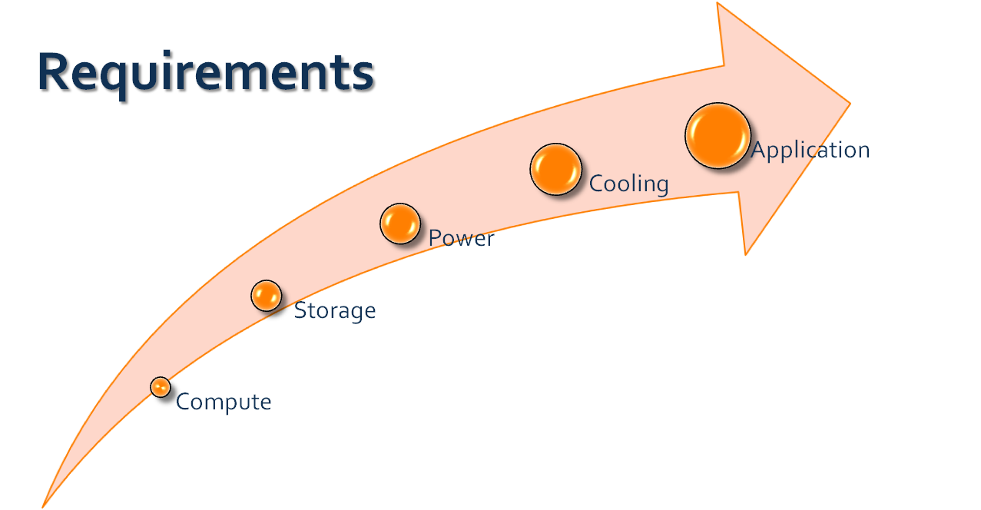
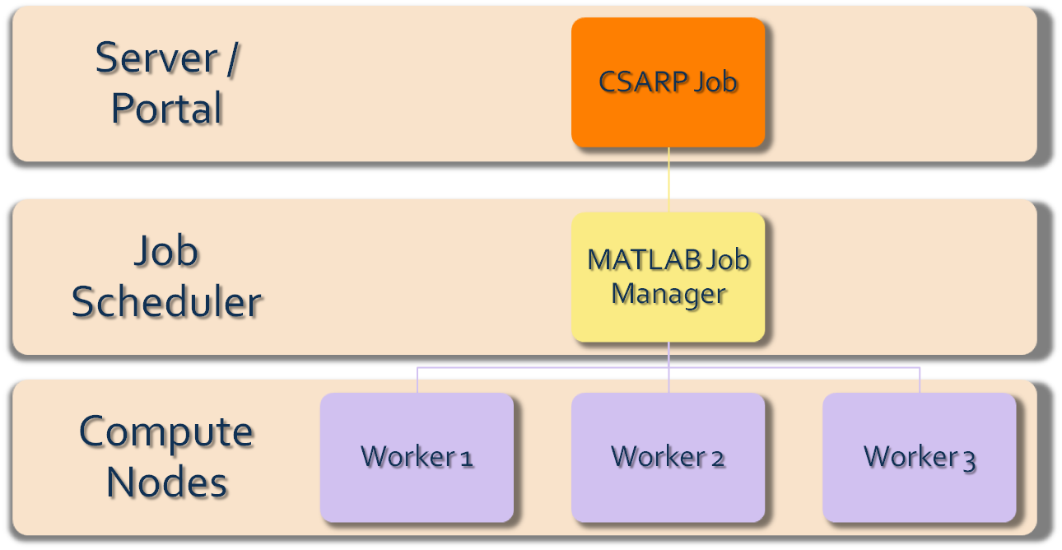
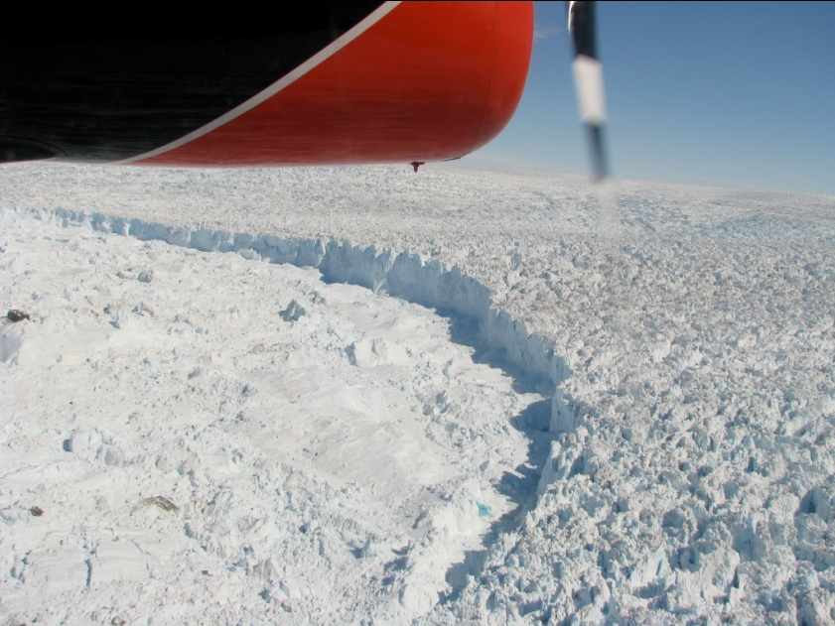
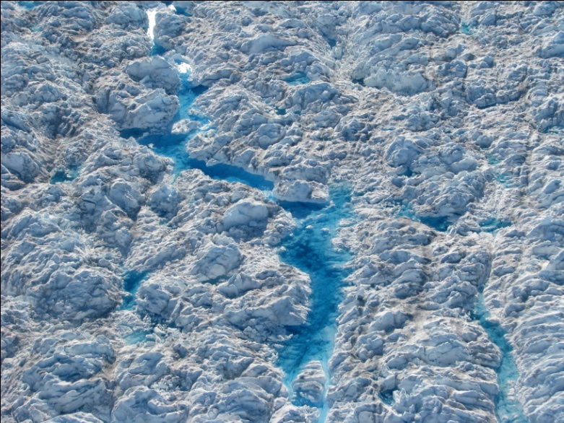
Multi-Channel Radar Depth Sounder (MCRDS) Signal Processing: A Distributed Computing Approach
Je’aime Powell¹, Dr. Linda Hayden¹, Dr. Eric Akers¹, Richard Knepper² [1] Elizabeth City State University, Elizabeth City, North Carolina [2] Indiana University, Bloomington, Indiana
ABSTRACT
In response to problems surrounding measuring ice sheet thickness in high attenuation areas of Greenland and the Antarctic, the Center for the Remote Sensing of Ice Sheets (CReSIS) created a Multi-Channel RADAR Depth Sounder (MCRDS). The MCRDS system was used to measure ice thicknesses of up to five kilometers in depth. This system produced large datasets, which required greater processing capabilities in the field. The purpose of this project was to test processing performance on a 32-core cluster through distributed computing resources. Testing involved a six-node cluster with an attached storage array and use of the CReSIS Synthetic Aperture RADAR Processor (CSARP) through the MATLAB Distributed Server Job Manager. Performance testing was derived from average run times collected once CSARP jobs completed. The run times were then compared using an ANOVA test with a five percent significance level.
Madogo Cluster
Conclusions
Does this study prove within a 5% level of significance that the addition of computing cores increases the performance of the CSARP algorithm?
There was significant evidence to indicate there was a difference in the performance times of CSARP due to the inclusion of additional workers within a 5% level of significance. Moreover the run time difference from ~30 minutes with one worker to ~10 minutes with 32 workers constituted an ~67% increase in performance.
What hardware requirements are necessary to store and process CReSIS collected data?
In respect to the 2008 field season a minimum of ~10TB of space was required to store the data. In reference to computing hardware needs, the minimum requirements of the MATLAB Distributed Server must be met which were an Intel Pentium 4 processor, 1GB of memory, and any necessary network connection equipment between server and clients.
What facility environmental requirements are there to house a cluster with 32-cores to process a data set?
Including networking, storage and computing, a total of 9.7kW of power was required with a minimum of 2.7 tons of cooling for the cluster.
What is the process to prepare a cluster from a middle-ware stand-point?
In terms of the MATLAB Distributed Server (MDS) as the middleware solution, a Flex license manger credentials had to be appended to the site license. MDS was then installed on the head-node. Included in this step was the addition of the MATLAB Distributed Computing Environment to the startup processes of the unit. MDS was then installed on all client machines. The Job Manager included in MDS was then started and client machines added to complete the preparations.
What MATLAB toolkits and/or expansion kits are necessary to run CSARP?
The required toolboxes for CSARP were MATLAB 2009b, the Signal Processing Toolbox, the Parallel Computing Toolbox, the MATLAB compiler and the CReSIS Toolbox. Recommended toolboxes also included the MATLAB Distributed Server in order to use greater than eight workers.
Can an open-source job scheduler replace the MATLAB proprietary Distributed Computing Server currently required by CSARP?
It was found that the MDS does support third-party schedulers natively. Through this research path it was also discovered that the MDCE portion of the MDS would still be necessary on all client machines. This information there by solidified the need for MDS to run CSARP in MATLAB script form even if a different job scheduler was selected. The only way to alleviate that dependency was through the creation of a CSARP executable binary. CSARP binary creation in the current form would not be possible due to the need for coded script changes in order to process data.
Data Collection
Research Questions
Does the addition of computing cores increase the performance of the CReSIS Synthetic Aperture Radar Processor (CSARP) with a 5% level of significance?
What MATLAB toolkits and/or expansion kits are necessary to run CSARP ?
What hardware requirements are necessary to store and process CReSIS collected data?
What facility environmental requirements are there to house a cluster of at least 32 cores to process a data set?
What is the process to prepare a cluster from a middleware stand-point?
Can an open-source job scheduler replace the MATLAB proprietary Distributed Computing Server currently required by CSARP?
Middleware Setup
License Manager Installation
MATLAB Distributed Server – Head Node
MATLAB Distributed Server – Client Nodes
Start MATLAB Distributed Computing Engine
Start the MATLAB Job Manager
Start the MATLAB Workers
SAR and MCRDS Relation
Results
CSARP Requirements
Scheduler Options
CSARP Function
There is significant evidence to indicate there is a difference in the performance times of CSARP with the inclusion of additional workers with a 5% level of significance.
Power and Cooling Consumption Comparison
Cluster Setup (Madogo)
Job Distribution
Acknowledgements
Dr. Linda Hayden
Mr. Richard Knepper
Dr. Benjamin Branch
Mr. William Blake
Mr. Mathew Link
Mr. Jefferson Davis
Mr. Shelton Spence
Acknowledgements
Mrs. Sharonda Walton
Dr. Vinod Manglik
Dr. Eric Akers
Dr. Paul Viltz
Mr. Jeff Wood
Mr. Corey Shields
Mr. Timothy Barclift
Acknowledgements
Mr. Kuchumbi Hayden
Mr. Randy Saunders
Mrs. Doris Johnson
Dr. David Touretzky
Mrs. Sonya Powell

