Slide 1
GLOBE Virtual Training Hydrosphere & Pedosphere
Wanda Hathaway, Tracy Ostrom, Garry Harris, Linda Hayden
July 18, 2020
2 pm – 4 pm

Slide 2
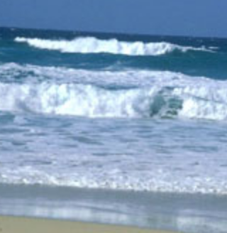
Our Agenda - Hydrosphere
Data Entry Log
GLOBE Observer
Freshwater Macroinvertebrates
Mosquito Habitat
Introductions/Ice breaker
Review GLOBE Protocols – Hydrosphere
Alkalinity - Conductivity
Dissolved Oxygen
Nitrates
Salinity
Water Temp & Transparency
pH

Slide 3
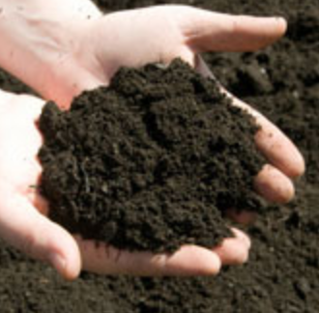
Our Agenda - Pedosphere
Soil Protocols
"Why do we study soil?"
"Digging around " - A Field View of Soil.
"From Mud Pies to Bricks"
"Just Passing Through"
"Just Passing through" (Beginners Version)

Slide 4
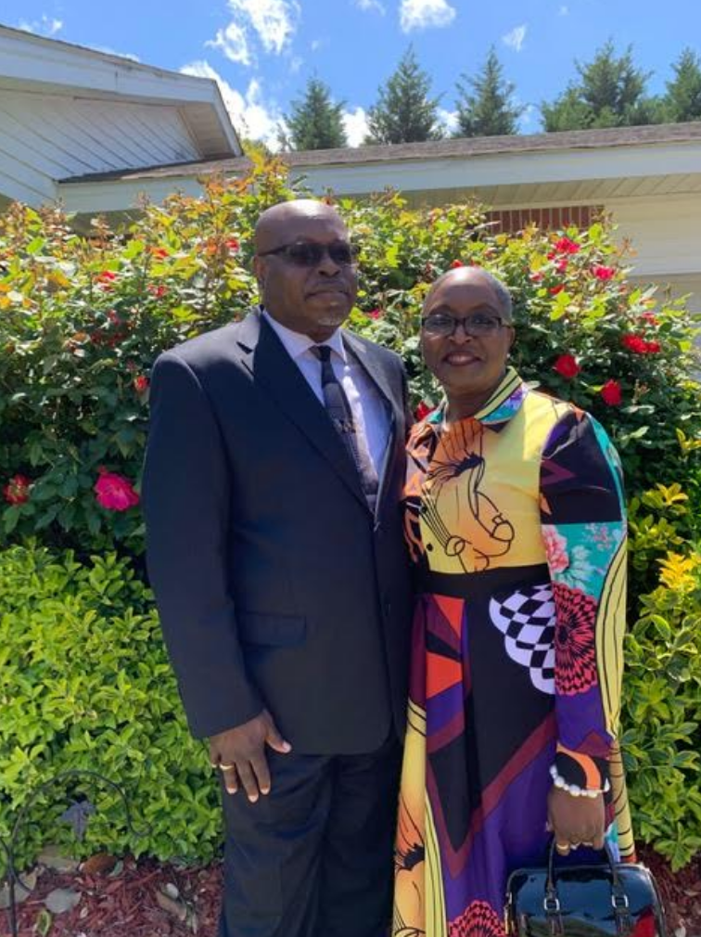
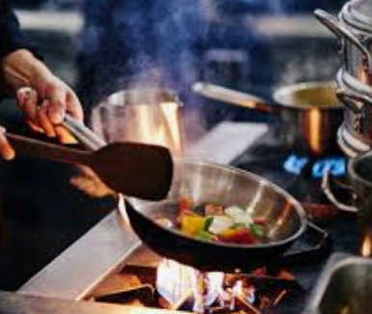
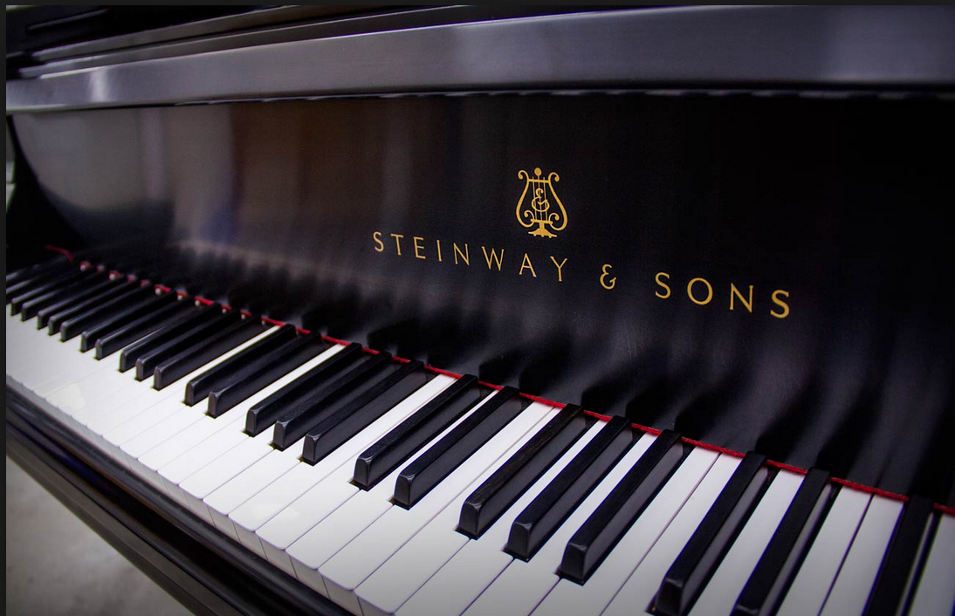
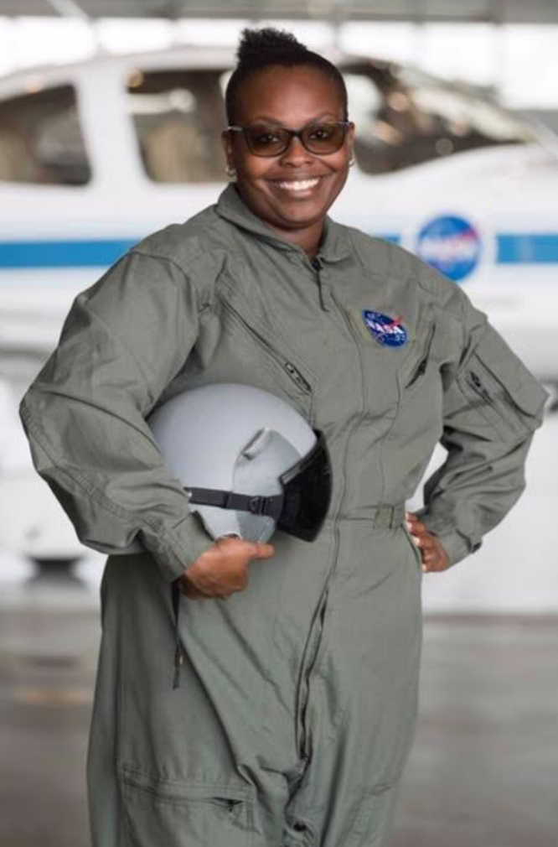
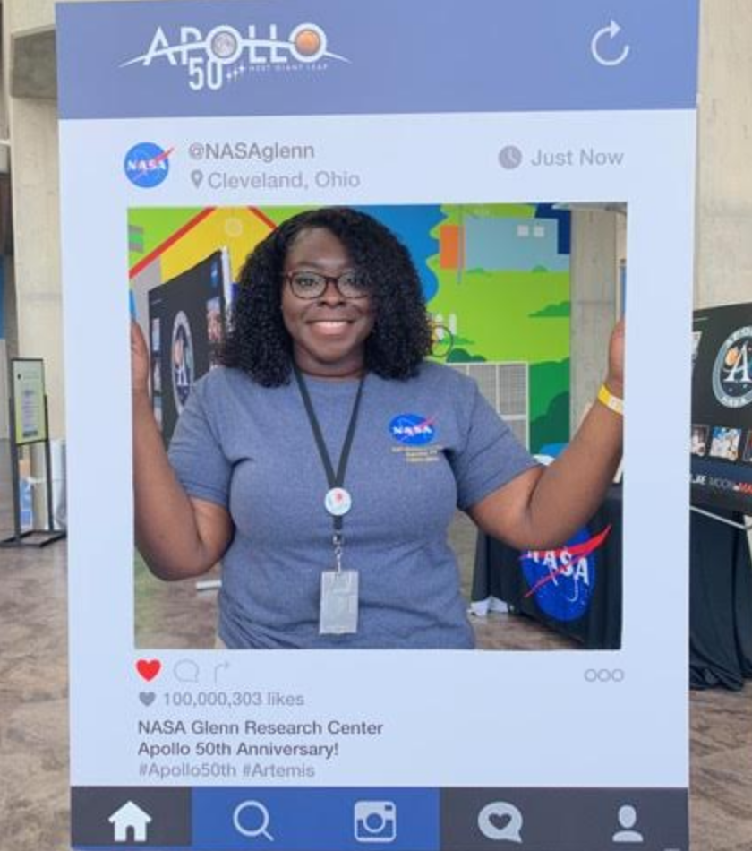
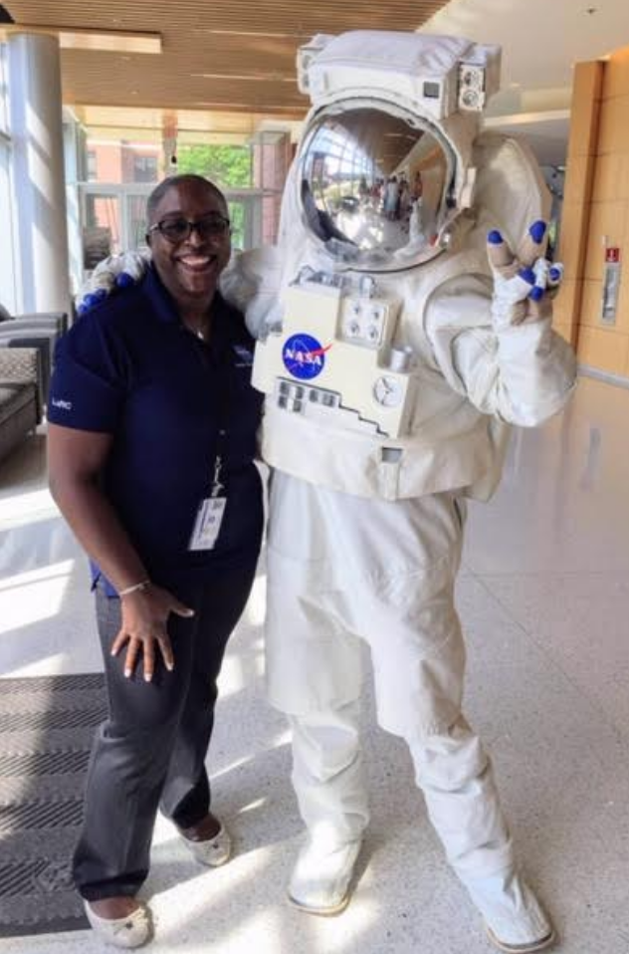
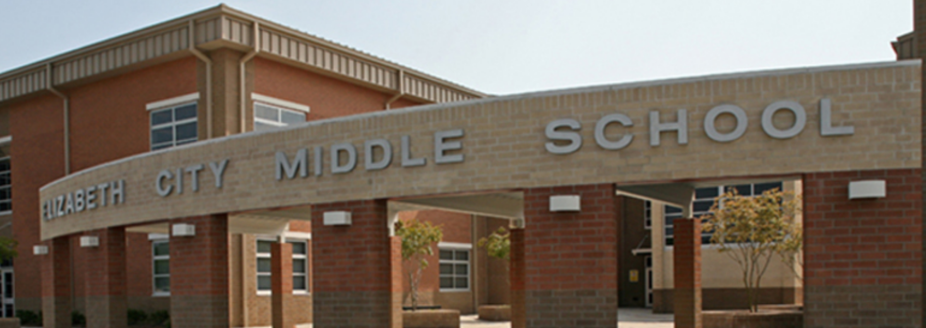
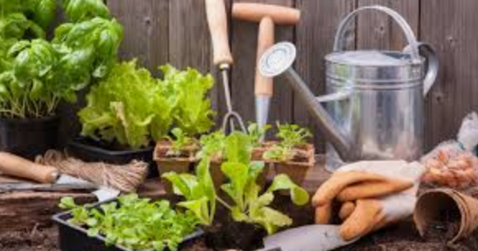
About Me

Slide 5
??????????????? GLOBE stands for: a. Global and Latitude Observations to Benefit Everyone b. Glad to Live On Beautiful Earth c. Good Living Observations to Benefit Education d. Global Learning and Observations to Benefit the Environment

Slide 6
??????????????? GLOBE stands for: a. Global and Latitude Observations to Benefit Everyone b. Glad to Live On Beautiful Earth c. Good Living Observations to Benefit Education d. Global Learning and Observations to Benefit the Environment

Slide 7
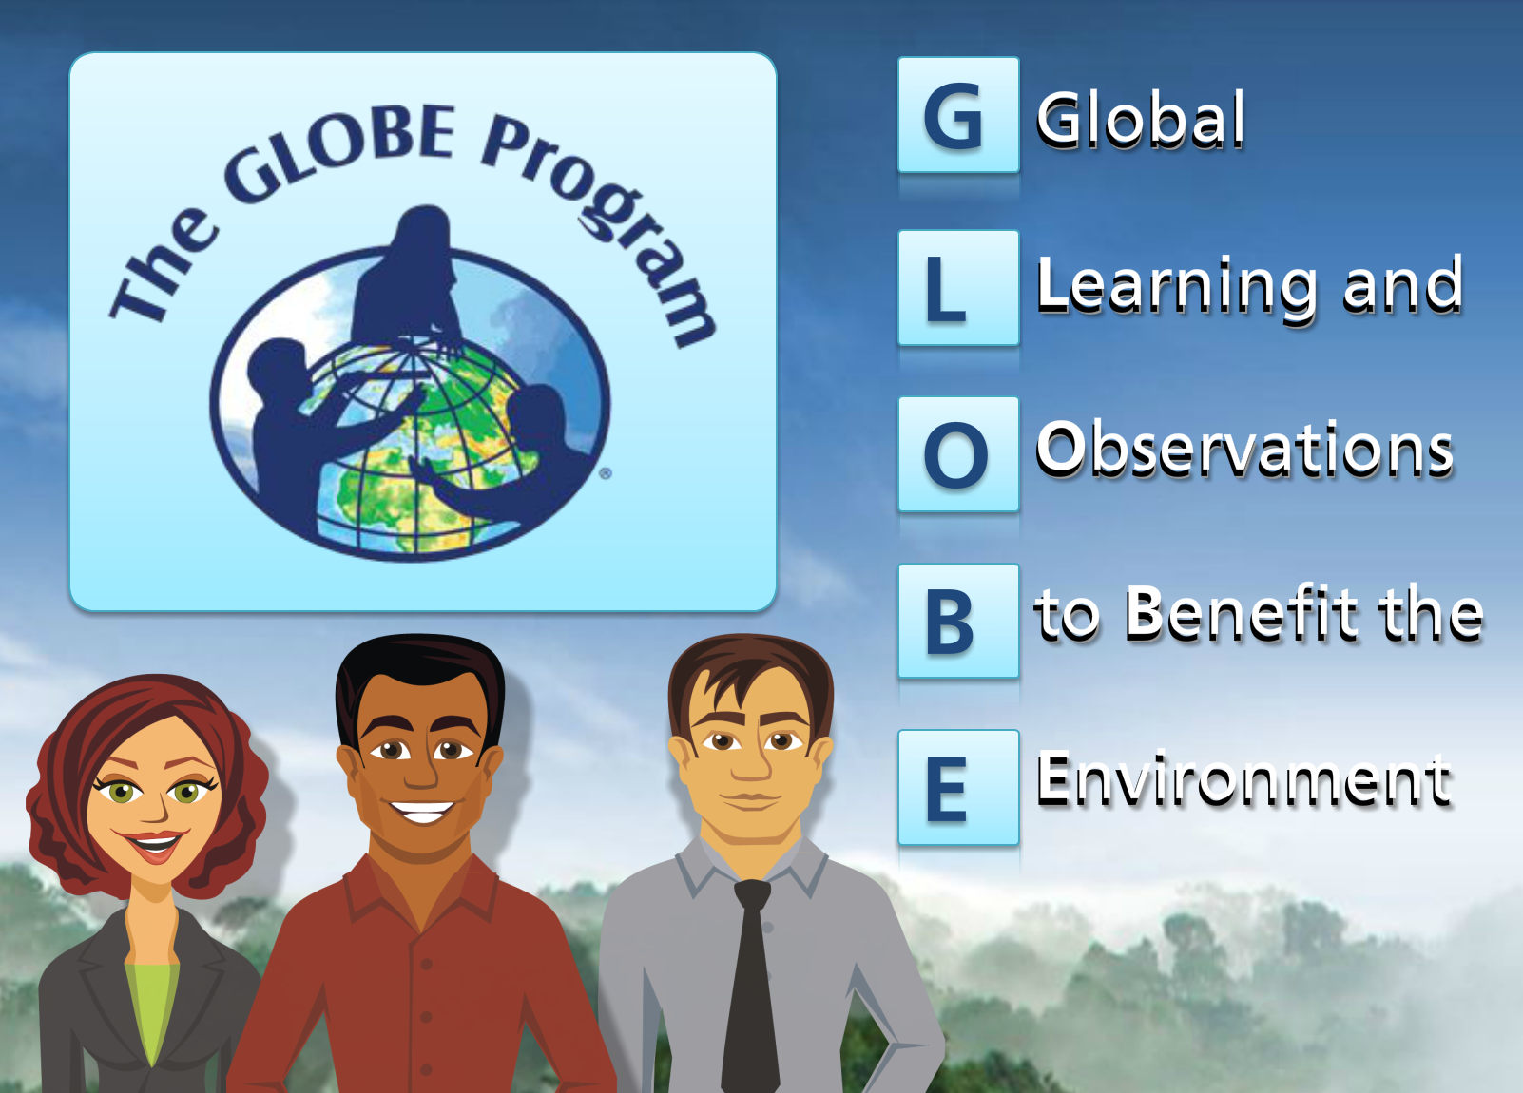
What is GLOBE?
globe.gov
Notes:
Talk about origin and how it works; funding, supporters

Slide 8
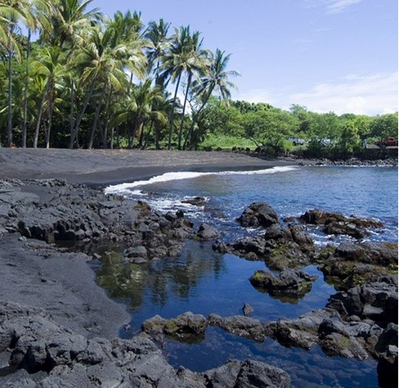
GLOBE Investigation Areas
Biosphere
The biosphere includes plant life and land cover.
Atmosphere
The atmosphere includes the air around the earth and weather.
Hydrosphere
The hydrosphere includes water on Earth, in rivers, lakes, and the ocean.
Geosphere
The geosphere (pedosphere) includes rocks and soil.
Notes:
Different spheres based on what you are interested in doing in your classroom.

Slide 9
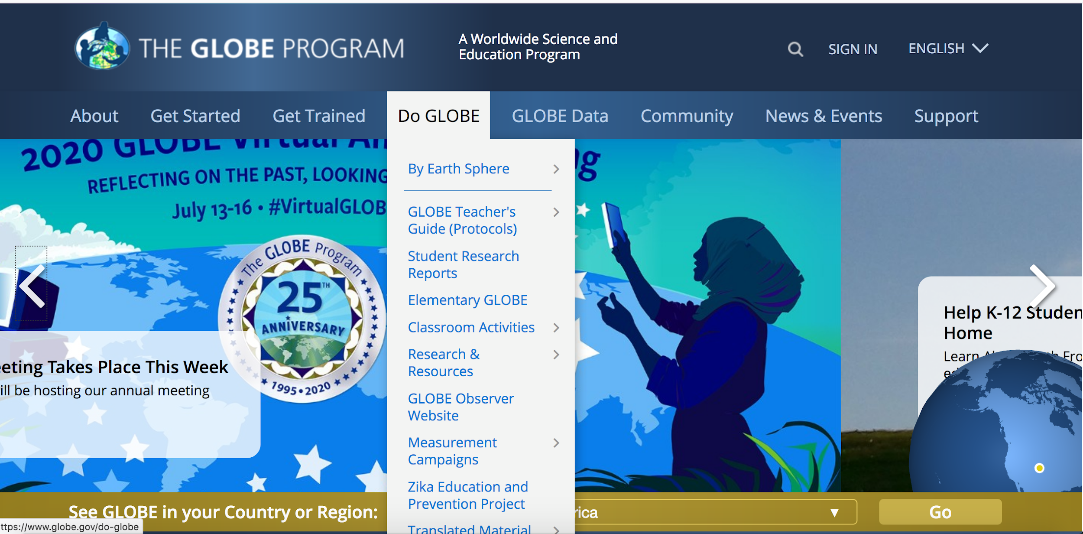

Slide 10
Navigating GLOBE - Hydrosphere
Hydrosphere
Establish a sample site
Know your students and train young scientist
Cross train students - delegate jobs
Equipment
Data log procedure and entry
Learning Activities
Learning Activities ! ?
Selecting and Documenting Your Hydrosphere Study Site

Slide 11
Lesson Planning in the classroom - “Where do we start?”
Selecting and Documenting your water site
Practice your Protocols
Water Walk
Water Detectives
Model a Catchment Basin
Freshwater Macroinvertebrates Protocol

Slide 12
Digging deeper into data - Hydrosphere
Modeling your water balance
Water Collection
Dissolved Oxygen
Freshwater Macroinvertebrates : Instrument Construction
Freshwater Macroinvertebrate technique

Slide 13
Hydrosphere Continued
Water Transparency instrument construction
Water Collection Protocol
pH Protocol

Slide 14
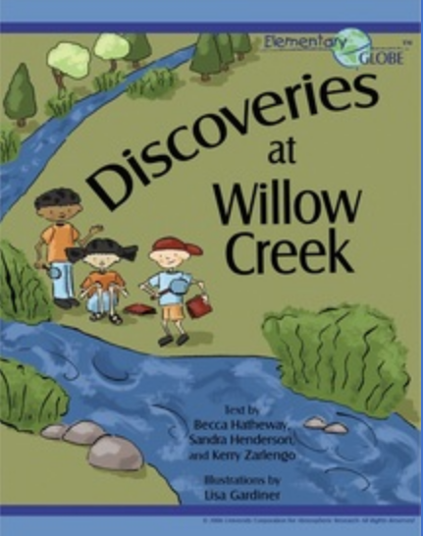
Hydrosphere Picture Books
Elementary GLOBE - "Discoveries at Willow Creek"
Students learn how to describe a creek by making observations, taking measurements, and looking for macroinvertebrates. They get to know tools for making science observations.

Slide 15
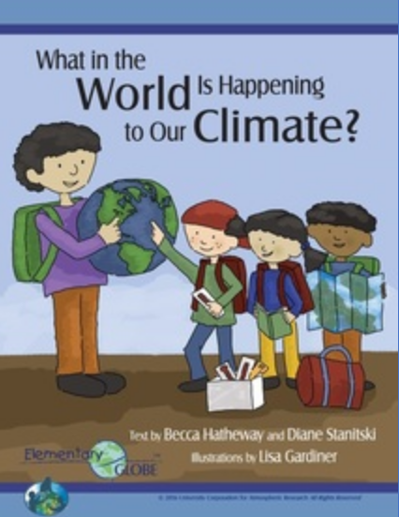
Hydrosphere Picture Books
Elementary GLOBE - "What in the world is happening to our climate?"
Through the storybook and activities, students learn about regional climate variations and how climate change is affecting our world. Then students consider what we can do to solve climate change.

Slide 16
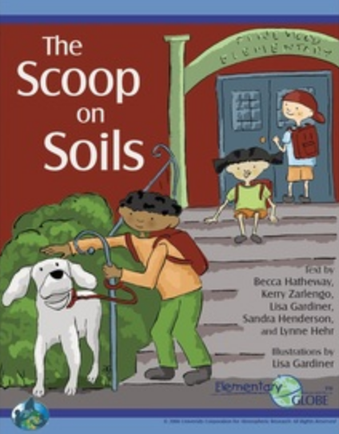
Pedosphere Picture Books
The Scoop on Soils
Students investigate how soils are different in different locations, learn to describe what they find in soil, and explain the importance of soil to plants and animals.

Slide 17
Atmosphere Picture Books
What's up in the atmosphere
Students consider how and why aerosols and other types of air pollution affect the color of the sky and learn how to describe sky color and conditions in the atmosphere.

Slide 18
Biosphere Picture Books
The Mystery of the missing Hummingbirds
Students learn how hummingbirds deal with seasonal changes and use science journals to describe the seasonal changes in their local environment.

Slide 19
Earth System Picture Books “Bring it all together”
All about Earth - "Our World on Stage"
Students explore how water, air, soil, and living things interact in the Earth system and how they are all important parts of our planet.

Slide 20
Let’s Talk
Describe the four sphere in GLOBE.
What would be the best approach to teach students about the spheres in GLOBE?
What is the difference between a Transparency Tube and Secchi Disk and how are they similar.

Slide 21
Let’s Talk Answers:
Atmosphere, Biosphere, Hydrosphere, Geosphere (Pedosphere)
Teach as a cycle not in isolation.
Transparency Tube is better for shallow water clarity, Secchi Disk used for deeper water clarity. They both measure water clarity.

Slide 22
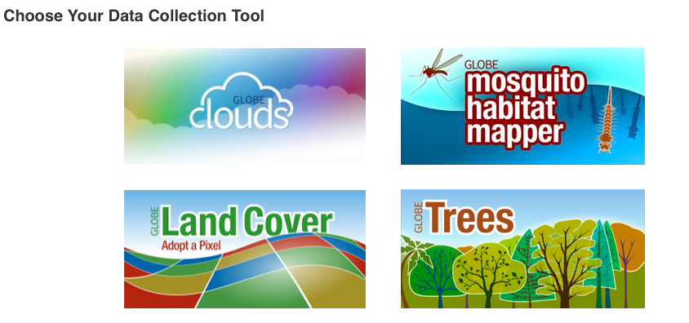
GLOBE Observer
Free Download
Sign up with an email
address
Start being a
citizen scientist
Notes:
15 minutes TOTAL
“We recommend you do not down load at this time (google ply for android and app store

Slide 23
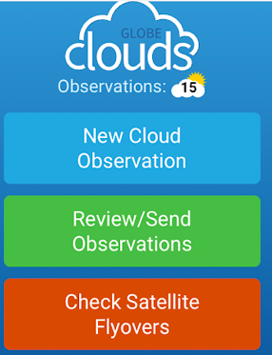
Make Cloud Observations Frequently
Take a peek out of your nearest window
Look up into the sky
What do you see?
Clouds?
Contrails?
Cloud height (high, medium, low)
Sky color (light blue, blue, dark blue)
Sky clarity (unusually clear, clear, hazy)
Notes:
Give participants description of what they will be doing for 30 seconds.
Then share screen

Slide 24
BREAK – 5 minutes and 35 seconds

Slide 25
Pedosphere - Our Soil
Soil Protocols
"Why do we study soil?"
"Digging around " - A Field View of Soil.
"From Mud Pies to Bricks"
"Just Passing Through"
"Just Passing through" (Beginners Version)

Slide 26
Pedosphere
Pedosphere Protocols
SMAP - Soil Moisture Active Passive
Soil Characterization Protocol
Soil Fertility Protocol

Slide 27
Pedosphere Protocols Continued
Soil Infiltration Protocol
Soil infiltration Data Sheet
Soil pH Protocol

Slide 28
Making Connections: Hydrosphere and Pedosphere Let’s Chat: What connections do you see with these two spheres?

Slide 29
Tips for Classroom implementation with GLOBE
Start small (Data sheets in One Notebook)
Cloud Observation twice a week
Train small group of students
Cross train ( Month later)
Invite fellow Science Teachers (Science Club)
Invite Community, Environmental Supporters
Collaborate with local High Schools and Universities

Slide 30
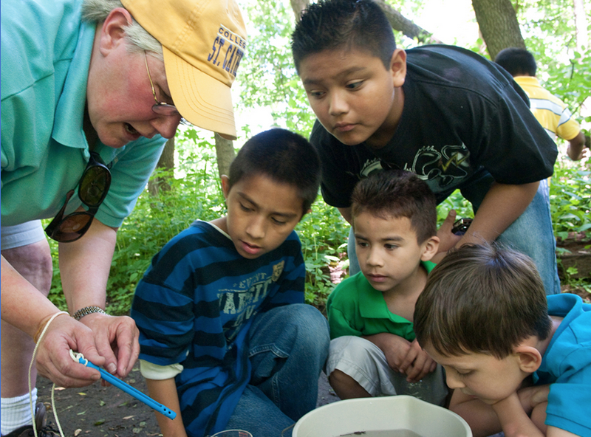
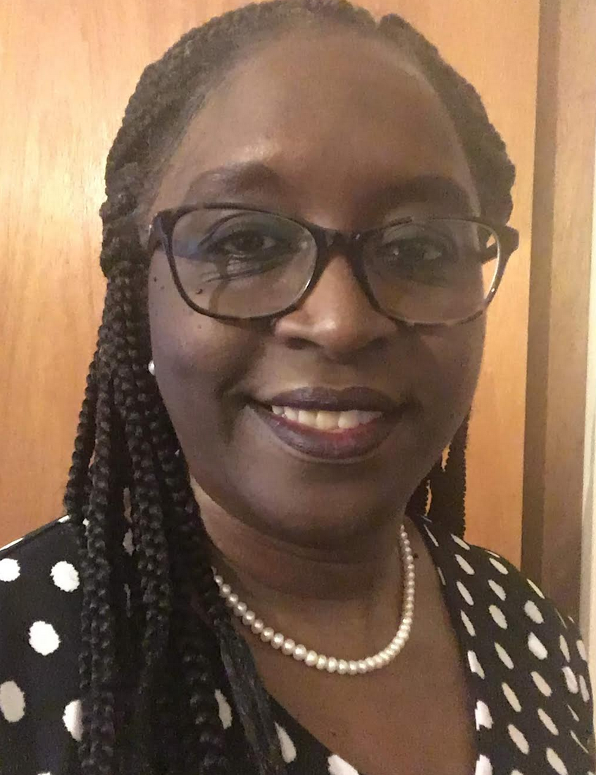
Many Thanks
Wanda Hathaway
wanda.hathaway@portsk12.com

