Slide 1



GLOBE Virtual Training
Atmosphere & Biosphere
Tracy Ostrom, Garry Harris, Linda Hayden
July 17, 2020
10 am – 12 pm

Slide 2
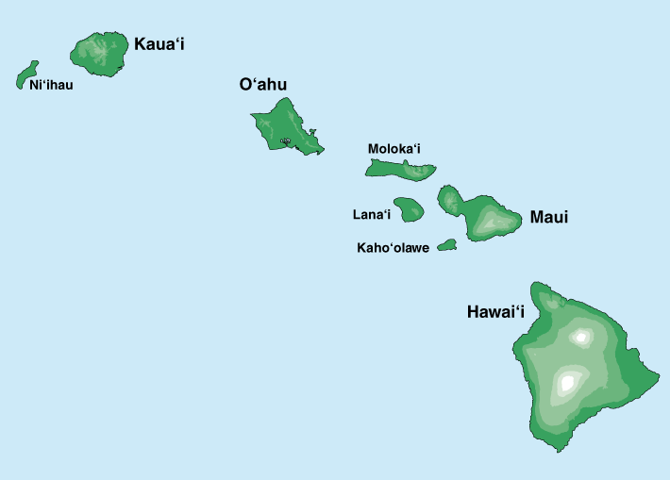
Annotate – Where are You?
From your zoom window:
1. Go to the top of zoom and
click on “view options”
2. Click on “annotate”
3. Click “stamp” and choose a stamp
4. Place your curser on the map
where you are located and click;
your stamp will appear
at that spot

Slide 4
Our Agenda - Atmosphere
GLOBE Observer
Connections
  UHIE
  Cloud Challenge
  Air Quality
Introductions/Ice breaker
Review GLOBE Protocols – Atmosphere
  Air Temperature
  Surface Temperature
  Clouds
Data Entry & Site Set Up

Slide 5
Take a Poll
GLOBE stands for: a. Global and Latitude Observations to Benefit Everyone b. Glad to Live On Beautiful Earth c. Good Living Observations to Benefit Education d. Global Learning and Observations to Benefit the Environment

Slide 6
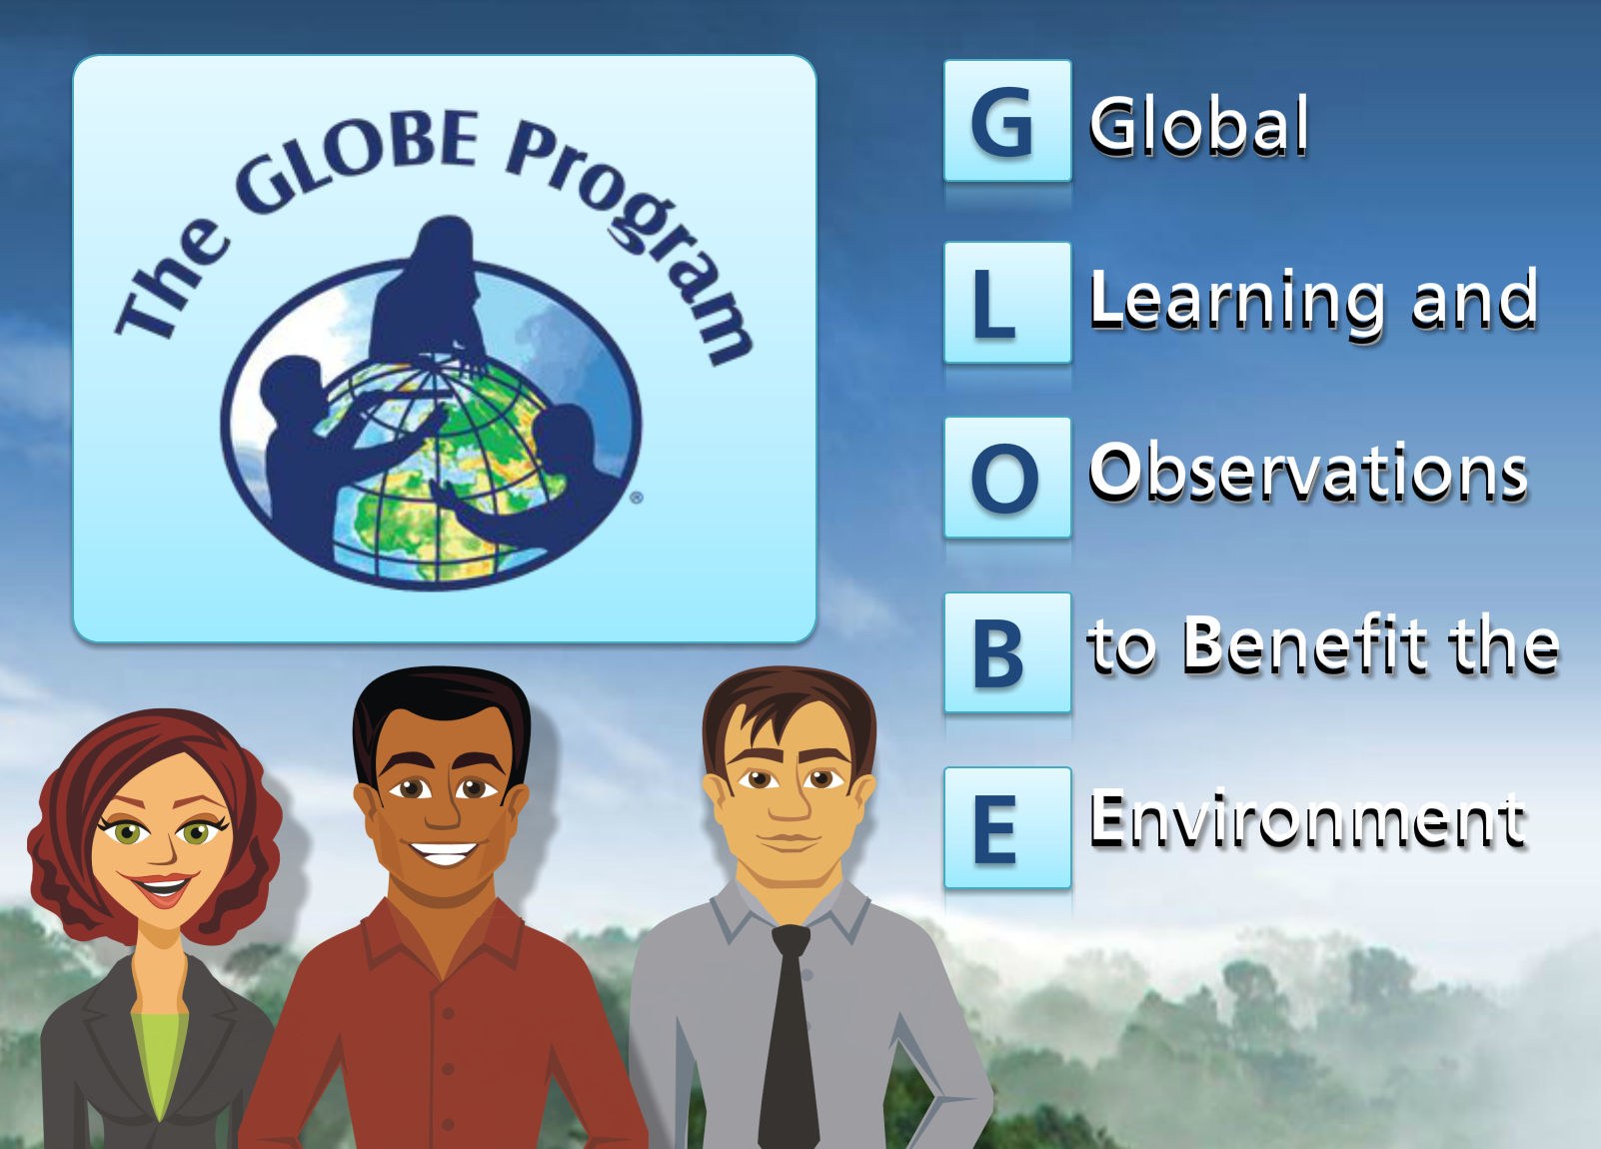
What is GLOBE?
globe.gov
Notes:
Talk about origin and how it works; funding, supporters

Slide 7
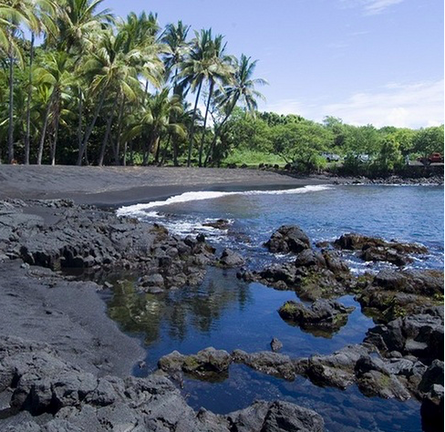
GLOBE Investigation Areas
Biosphere
The biosphere includes plant life and land cover.
Atmosphere
The atmosphere includes the air around the earth and weather.
Hydrosphere
The hydrosphere includes water on Earth, in rivers, lakes, and the ocean.
Geosphere
The geosphere (pedosphere) includes rocks and soil.
Notes:
Different spheres based on what you are interested in doing in your classroom.

Slide 8
Let’s Review the Atmosphere Protocols
Go to: https://www.menti.com
Enter Code 83 66 46
I will put you into 2 breakout rooms.
Work as a team to answer each question.

Slide 9
Atmosphere - Tips
Air temperature
  ok to use analog thermometers
  can compare data to digital readings
Clouds
  ok to use cloud chart
  use cloud triangle to teach clouds
  Practice, practice, practice
Surface temperature
  9 data points/same surface
  ground condition observations
  Students love using IRT – SAFETY FIRST

Slide 10
Data Entry
Setting up a site
(I’ll go first)

Slide 11
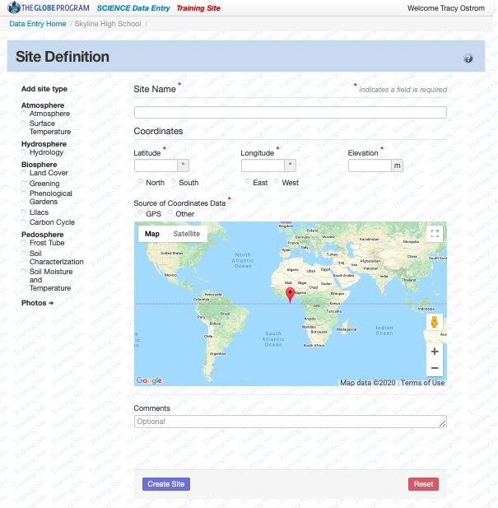


Data Entry – your turn
Login to GLOBE website
Click GLOBE Data
Click Data Entry
Click Training Data Entry
  Should see at top
  Click your school
  Click

Slide 12


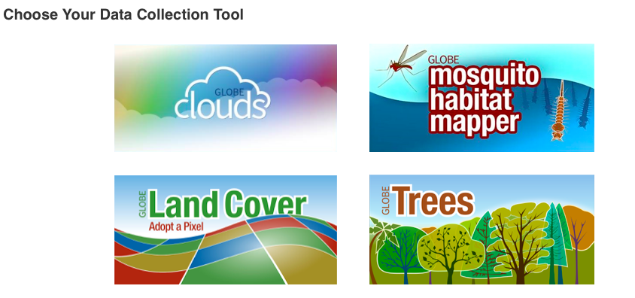
GLOBE Observer
Free Download
Sign up with an email
address
Start being a
citizen scientist
Notes:
15 minutes TOTAL
“We recommend you do not down load at this time (google ply for android and app store

Slide 13
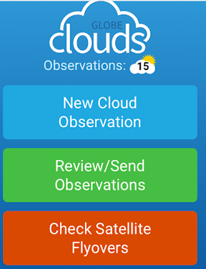
Let’s Make a Cloud Observation
Take a peek out of your nearest window
  Look up into the sky
  What do you see?
    Clouds?
    Contrails?
    Cloud height (high, medium, low)
    Sky color (light blue, blue, dark blue)
    Sky clarity (unusually clear, clear, hazy)
Notes:
Give participants description of what they will be doing for 30 seconds.
Then share screen

Slide 14
GLOBE Opportunities to Connect

Slide 15
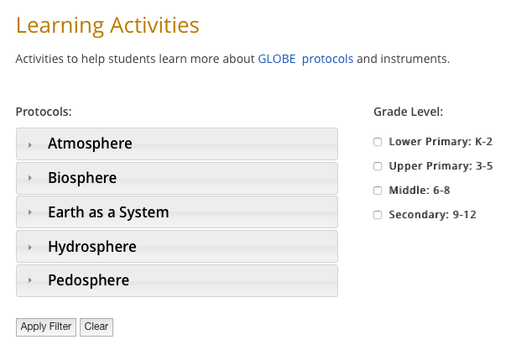
GLOBE Opportunities Get Started…
Urban Heat Island Effect
Air Quality
GPM – Global Precipitation Measurement
El Niño and La Niña
Tree Height (ICESAT 2)
GLOBE Mission EARTH
AREN Project
Arctic and Earth SIGNS
NESEC

Slide 16
BREAK – 5 minutes and 35 seconds

Slide 17
Our Agenda - Biosphere
Making Connections – Atmosphere & Biosphere
Review GLOBE Protocols – Biosphere
  Tree Height
  Green Up/Green Down
Data Entry & Site Set Up
GLOBE Observer
Putting It All Together
  Research Process
  SRS/IVSS
  Guide/Rubric/Poster

Slide 18
Making Connections: Atmosphere and Biosphere
Let’s Chat: What connections do you see with these two spheres?

Slide 19
Let’s Review the Biosphere Protocols
Go to: https://www.menti.com
Enter Code
I will put you into 2 breakout rooms.
Work as a team to answer each question.

Slide 20
Biosphere - Tips
Tree Height
  Make a clinometer activity
  Join the campaign and share data with NASA
  Compare different types of clinometer for the same object
Green Up/Green Down
  ok to use local plants/trees
  Easily combined with atmosphere protocols

Slide 21
Data Entry
Setting up a site
(I’ll go first)

Slide 22
Data Entry – your turn
Login to GLOBE website
Click GLOBE Data
Click Data Entry
Click Training Data Entry
  Should see at top
  Click your school
  Click

Slide 23
GLOBE Observer
Free Download
Sign up with an email
address
Start being a
citizen scientist
Notes:
15 minutes TOTAL
“We recommend you do not down load at this time (google ply for android and app store

Slide 24
Putting It All Together – Project Based Learning
International Virtual Student Symposium (IVSS)
Student Research Symposium (SRS)
  Funding to attend
  Open to all GLOBE students
  Held regionally in the spring every year (Colorado, New Mexico, Texas)
  SRS Guide for teachers
  Project Rubric
  Template for poster presentations

Slide 25
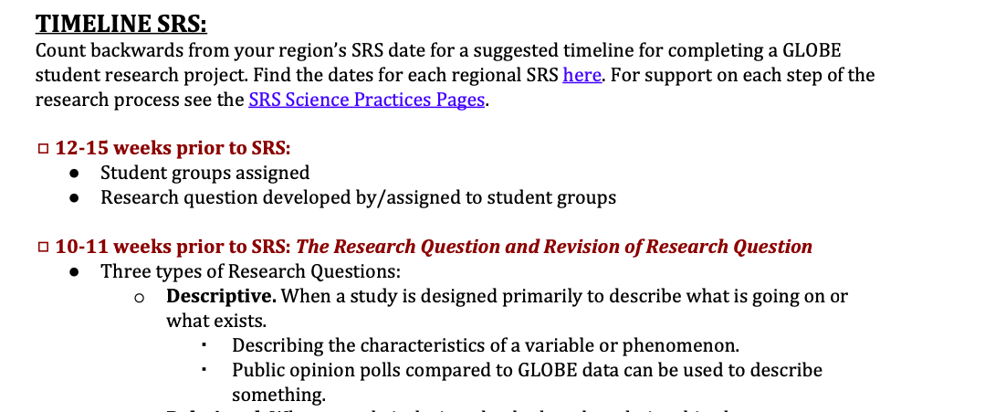
SRS Planning Guide

Slide 26
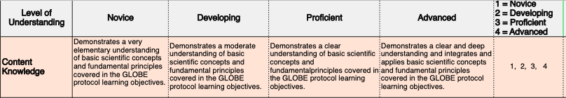
Project Rubric
Notes:
Note NGSS alignment

Slide 27
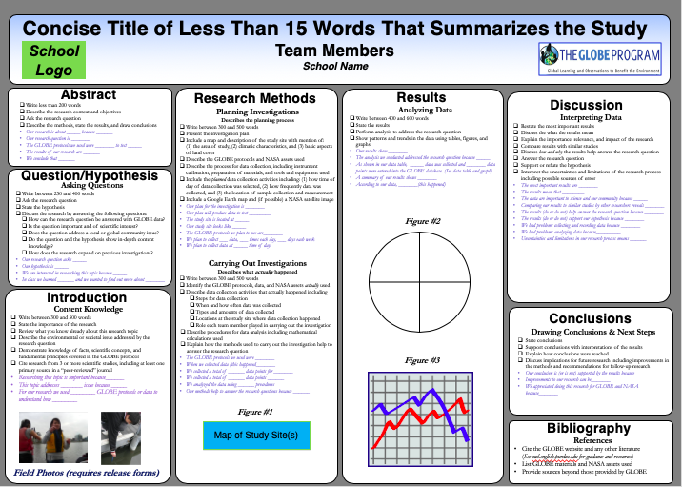
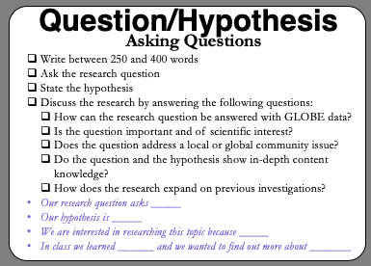
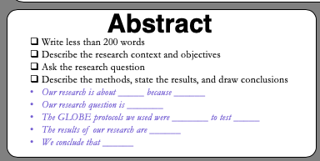
Poster
Presentation
Template
Notes:
Note sentence starters for each panel

Slide 28

Student
Research
Projects
Notes:
I

Slide 29
Let’s Chat:
How Do You See Using GLOBE
With Your Students?

Slide 30
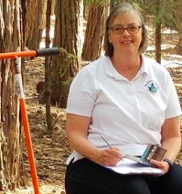
THANK YOU
Tracy Ostrom
tostrom@berkeley.edu

